Slide 1


Final Report to
Seeing Is Believing Innovation Fund
July 13, 2017

Slide 2
Agenda
Overview of SightLife’s The World Through New Eyes – China project
Updates on Objectives of the Project
Innovation Achieved
Impact on the Eye Care Sector
What Didn’t Work and Why
Key Lesson Learned from Project
Looking to the Future
Appendix - Photos

Slide 3
Overview – The World Through New Eyes - China
The innovation is the application of real time, real-world testing to address the shortage of transplantable corneas in China that would lead to accessible, low cost, effective sight-restoring corneal transplant surgery, affecting 4.6 million corneal blind Chinese children, women and men.
Objectives:
Continue our research into identifying target donor populations, identifying barriers and motivators to consent to donation, and measuring donation awareness in China. Research has been added to identify the factors contributing to China’s transplant success rate (TSR).
Build eye bank capacity by establishing a pilot partnership with an eye bank and placing an Eye Donation Counsellor in a local hospital to approach families for consent. This will enable SightLife to create a successful eye banking model that addresses the corneal tissue shortage and need in China.
Establish an in-country presence by placing a Country Director and Partner Account Manager in China.
Form a network of key opinion leaders (KOLs) as an advisory team to connect leading cornea surgeons and eye banks who can collectively advocate for updated eye donation legislation that meets international norms.

Slide 4
Objective 1: Research
Activities
Identify target eye donor population segments
Identify barriers, benefits and motivators to real-time family approach/consent process
Measure a base level of awareness and knowledge of corneal donation
Identify factors contributing to the cornea TSR in China
Update:
SightLife Eye Donation Counselor (EDC) training translation complete. Working with ZOC and Tongren to identify EDC pilot site and test hypothesis. Phase II is outlined below; estimated time to completion from Dr. Xiao at ZOC is 6-9 months.
  Interview the family members of previous donors, seeking their positive experiences/comments/suggestions on donation;
  Establish the donation culture in two study hospitals (no. 1 affiliate and Chinese traditional hospitals in Guangzhou) by supplying promotion materials, etc. before we start delivering counseling services. Eye bank staff is cautious about how this approach will be accepted by partner hospitals. Will also try the promotion at two communities;
  Test/Revise the conversation by using them for individuals and then establish a RCT study to test the effectiveness of the communication instruments.
Incorporating findings from China research study on donation awareness (top 3 research activities listed above).
Working with both ZOC and Tongren to create final integrated EDC China training.
Finalizing research plan with ZOC for transplant success rate research, targeted to begin in the second half of 2017.

Slide 5
Objective 2: Build Eye Bank Capacity
Activities
Identify desired locations for eye bank partnerships and resource allocation for related scaling programs such as awareness and education campaigns
Build Chinese eye bank partner's capacity to address the cornea transplantation needs in their community
Update:
Partnership with Tongren and Dr. Pan in process.
Training plan agreed upon for both Eye Bank Manager and Recovery Technicians from both Tongren and ZOC. In the process of mapping competencies needed to build curriculum. Training will occur at the National Eye Bank of Taiwan.
Meeting May 17 in China to finalize curriculum and set training dates.
Standard Operating Procedures for international quality eye bank translated and delivered to ZOC and Tongren.
EDC training workshop #1 planned for May in Tongren; a collaboration between Tongren, Dr. Nathan Congdon, Hong Kong Eye Bank, and SightLife. Goal is to create scalable China-wide curriculum for EDC training through this workshop and another with ZOC by Q4 2017.

Slide 6
Objective 3: Establish SightLife In-Country Presence
Activities
Build SightLife's in-country team and expertise so that Chinese eye bank partners benefit from one-on-one knowledge sharing and support
Update:
SightLife Wholly-Owned Foreign Enterprise (WOFE) was approved May 1st and business license received.
Migrating all employees currently from Proton Consulting to SightLife. Employee contracts, handbooks, and legal documents completed and repeatable. Accounting firm on boarded.
Hired Director of Strategic Development and Partner Account Manager (PAM). PAM has been managing ZOC and Tongren relationships. She had to take medical leave in February; targeted backfill in June.
Hired Director of Advocacy and Public Relations in May 2017, will lead relationships with existing partners as well as lead efforts in advocacy arena.

Slide 7
Objective 4: Identify Key Opinion Leaders
Activities
Formulate an association of key influencers to prioritize and influence regulatory policy
Update:
Hosted Key Opinion Leader (KOL) cornea ecosystem workshop in November 2016.
18 of the top KOLs of cornea surgeons, Eye Bank Directors and government officials attended. Priorities established were
  Request for SightLife to help KOLs establish the equivalent of an Eye Bank Association of China.
  Request for SightLife to be the technical advisor on SOPs for eye banking in China.
  Request for SightLife to help formulate training standards for eye bank staff in China.
  SightLife to provide technical expertise on policies needed to create a favorable ecosystem for cornea donation and transplantation.

Slide 8
Innovation Impact on the Eye Care Sector
Current Impact to Date
Projected Impact
24 month China impact strategy approved by KOLs (surgeons and Eye bank managers)
  KOL for Eye Bank Federation of China identified
  Standard Operating Procedures for eye banking under translation by ZOC
  Eye bank training curriculum in development (eye donation counselor, Recovery technician, eye bank manager
Attitudes toward behavior study completed and published
Partner MOU signed with ZOC, in process of creating with Tongren
Initial eye bank consultation underway with ZOC
Formulation of Eye Bank Federation of China H1 of 2018
Instantiation of Eye Bank SOPs at ZOC and Tongren H2 2017
Eye Bank Manager, Eye Donation Counselor & Recovery Technician training at ZOC and Tongren 2017 H2 resulting in increase it utilization (quality) and tissue collection
Surgeon training at one host institution H2 2017.
Major Milestones
Key Dependencies & Assumptions
May and Oct 2016 ZOC eye bank assessment and consultations
Fall 2016 Attitudes Toward Donation in China study completed and published in eye health journal
2016 China hires: October Director of Strategy and December Partner Account Manager
Eye bank Standard Operating Procedures translated by ZOC and distributed to ZOC and Tongren
May 1 SightLife China business license approved
May 24, 2017 ZOC training plan finalized
By Nov 2017 ZOC and Tongren eye bank staff trained to international standards
October 2017 China Eye Bank Federation KOL conference
Govt approval of Eye Bank Federation application
Continued cooperation with National Eye Bank of Taiwan for training
Patient cooperation on ZOC Transplant Success Rate research
Notes:
Shubhi – QA #s and cost
Claire & Brian – Training
Connect training and cert to better patient outcomes
Curriculum dev and elearning $9K per role (multiple courses) 9K x 10 roles = $90K
Annual conferences $65K x 4 = $260K

Slide 9
What Didn’t Work and Why
Having dedicated staff on the ground is key. Managing relationships remotely from the US was doable but definitely slowed down progress. We have seen an increase in momentum with local staff on board and managing directly.
Difficulties can arise working relationships through an intermediary, while partnerships both locally and globally are advantageous, we recommend taking primary ownership of key relationships
Having our China host institute work across multiple foreigner relationships/partnerships muddied the waters on true transparency and hindrances to the program (when our China partner was dealing with us and another foreign entity in a collaboration). Desire to save face across 2 foreigners reduced transparency to real issues that dissolved the minute we had a local employee on the ground.
The business license application process took 12 months; 4 months longer than expected.

Slide 10
Key Lesson Learned
Always maintain direct relationship with key leadership at partners vs through a liaison
When making decisions around government engagement and policy in the donation space, its important to evaluate successes and failures from the approach chosen by organ, muscle and tissue orgs. Each had very different approaches with government and policy, and very different outcomes, which will serve as key learning in the path we choose for cornea donation.
Infrastructure drivers and motivations of both public and private hospitals need to be taken into account when creating eye banking policy.
For national standards and association, regional approaches are the path of least resistance but we’ll need to broker a national level federation for cornea (a national approach is what’s really needed) donation/transplantation.
Opportunity to capitalize on government hospital training institutions as training partners based on a requirement to provide training to rural areas. We see a great opportunity to partner with Orbis, leveraging their existing hospital training relationships for cataract and diabetic retinopathy. They would like us to slipstream cornea into these established programs.
Hiring local staff experienced with international organizations is key to success.

Slide 11
Looking to the Future
The next step is to further our original proposal to build capability and capacity in Southern China. In a similar manner, we are also working in Northern China with Tongren Hospital, as well, working at a national level on policy and advocacy. The long term goal is to scale a successful pilot model to all regions of need in China, and to steward key players in eye banking and corneal transplantation in working together to influence policy around cornea donation and distribution.
Policy & Advocacy
  Creating a functional China Eye Bank federation, scope and charter could take 8-10 months (there are politics and regionally federated efforts in China).
Eye Bank Capacity Building
  Tongren Partnership – The research could start within 1-2 months of receiving funding, and eye banking training within 3-6 months
  Eye Bank Community Portal – The goal would be to launch this by the end of 2017, assuming funding came in by July 2017
Ophthalmologist and Allied Ophthalmic Personnel Training
  Identify host institution(s) within first 4 months of receiving funding
  Training completed within 12-14 months (targeting the training of 8-10 corneal surgeons and 30 ophthalmologists and allied ophthalmic providers).

Slide 12
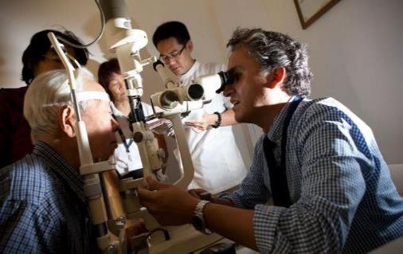
Thank You Slide
Thank You
As our project with Seeing is Believing comes to a close, we want to thank you for your partnership in restoring sight to the corneal blind in China. Without your support, we would not be where we are in China today. We are on the cusp of
Creating policies favorable to cornea donation
Building eye bank capacity with not 1, but 2 major eye bank partners so far
Training Surgeons in China in corneal transplantation techniques
Training general ophthalmologists and community health workers in diagnosis of corneal blindness and post-transplant care
We look forward to sharing our progress with you and hope to partner again in the near future.

Slide 13

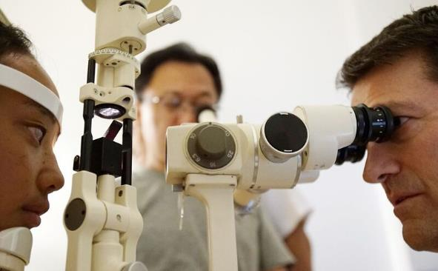
Claire Bonilla
Chief Global Officer
Claire.Bonilla@SightLife.org
+206-838-4624 desk
+425-449-0041 mobile
Suman Bhat-Kincaid
Manager of Corporate & Foundation Partnerships
Suman.Bhat-Kincaid@SightLife.org
+206-838-4639 desk
+206-604-9242 mobile
SightLife – Global HQ
1200 6th Avenue, Suite 300
Seattle, WA USA
www.sightlife.org

Slide 14
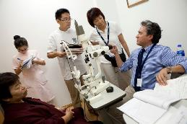
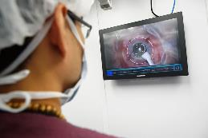
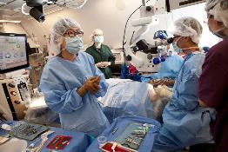
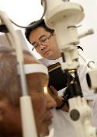

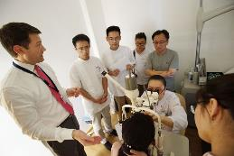
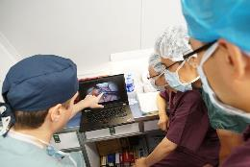
Appendix - Photos
Shenyang Surgeon Training Session (SightLife Partnership with Orbis)

Slide 15
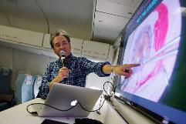
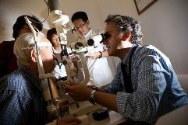
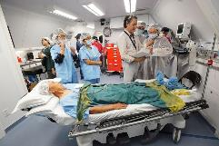
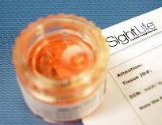
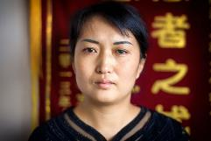
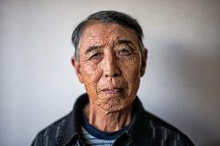
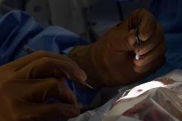
Appendix - Photos
Cornea stored in Optisol, a medium that maintains its viability for 14 days
Li Hui, Cornea Recipient
Sun Mide, Cornea Recipient

