Slide 1
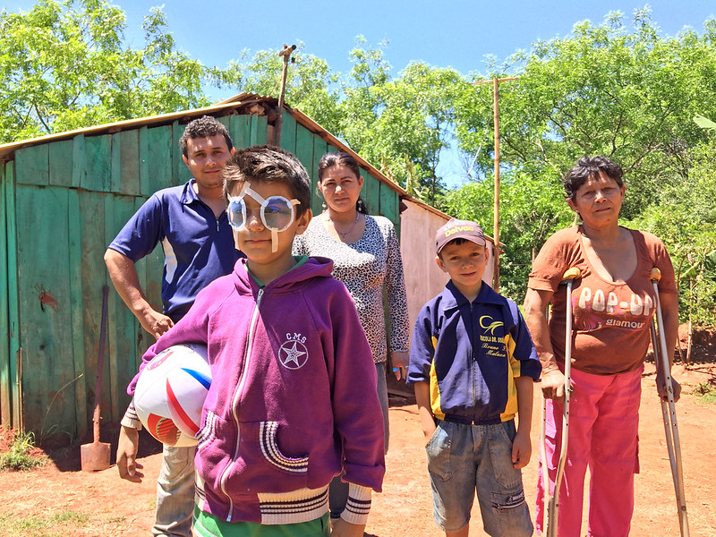

Achievements
“VISION2020:
THE RIGHT TO SIGHT”
1999-2020
Victoria M. Sheffield, Vice President
International Agency for the Prevention of Blindness
Professor Hugh R. Taylor, AC
Harold Mitchell Chair of Indigenous Eye Health
Melbourne School of Population and Global Health
Prof. Rupert Bourne, VLEG Coordinator
Consultant Ophthalmic Surgeon, Cambridge, UK
Jude Stern, Head
Knowledge Management, IAPB
Notes:
VISION2020: The Right to Sight celebrates its 20th anniversary which is the culmination of the initiative to eliminate avoidable blindness by the year 2020. This slide deck is a summary of the history, the challenges, what has been achieved, and the tremendous support that made VISION2020 a success. This slide deck was developed for IABP to give to its members as an anniversary gift. It is not clinically detailed, but rather a top line review to be used when speaking to lay persons, donors, Boards of Trustees and others. I am enormously grateful to Prof. Hugh Taylor who helped me take what was a simple summary of about 12 slides and turn it into something with gravitas with his contributions. And to Prof. Rupert Bourne for his critical data for 20202. Thanks go to Jude Stern for her creative eye and contributions around URE and data. Also, many thanks to Tejah Balantrapu and team, especially Ishwarya Teeparthi at IAPB in India for making this slide deck so attractive. The photos are from collections of my own, Prof. Taylor, VLEG, IAPB’s Vision Atlas 2.0, and from IAPB’s gallery.

Slide 2
1994: Global Causes of Blindness
45 million
Cataract
Refractive
Errors
Trachoma
Vit A Def
Onchocerciasis
Diabetic
Retinopathy
Glaucoma
AMD and other
diseases
60%
15%
15%
10%
Notes:
In 1994, IAPB and the World Health Organization’s (WHO) Programme for the Prevention of Blindness looked at the leading causes of blindness, all avoidable meaning that they could be treated or the blindness could be prevented and wondered whether we could eliminate them as a public health problem.

Slide 3
1996: WHO Projections with & without VISION 2020
Global Blindness (millions affected, all ages)
millions
100
90
75
60
50
50
38
30
40
25
25
0
1980
1990
2000
2010
2020
With VISION 2020
Without VISION 2020
Notes:
3
1
In the mid-1990’s, IAPB and WHO made projections for rates of blindness and visual impairment if the community did nothing to change them. The green bars show where the rates of blindness were projected to be without the interventions of VISION2020. The black bars show the anticipated number of blind people would be if the Vision 2020 interventions were fully implemented. In 2020 the actual number of people who were in blind was higher than hoped for, although the percent of people with blindness was reduced.

Slide 4

1999: Launch of VISION 2020:The Right to Sight
Promote “A world in which nobody is needlessly visually impaired, where those with unavoidable vision loss can achieve their full potential.”
“Intensify and accelerate prevention of blindness activities so as to achieve the goal of eliminating avoidable blindness by 2020.”
“Focusing initially on certain diseases which are the main causes of blindness and for which proven cost effective interventions are available.”
Notes:
In the mid-1990’s, IAPB’s Partnership Committee made up of IAPB member agencies and others joined over a period of five years at WHO in Geneva to plan VISION2020: The Right to Sight. The third point focused on the leading causes of blindness at the time for which we could mitigate the projected trajectory.

Slide 5
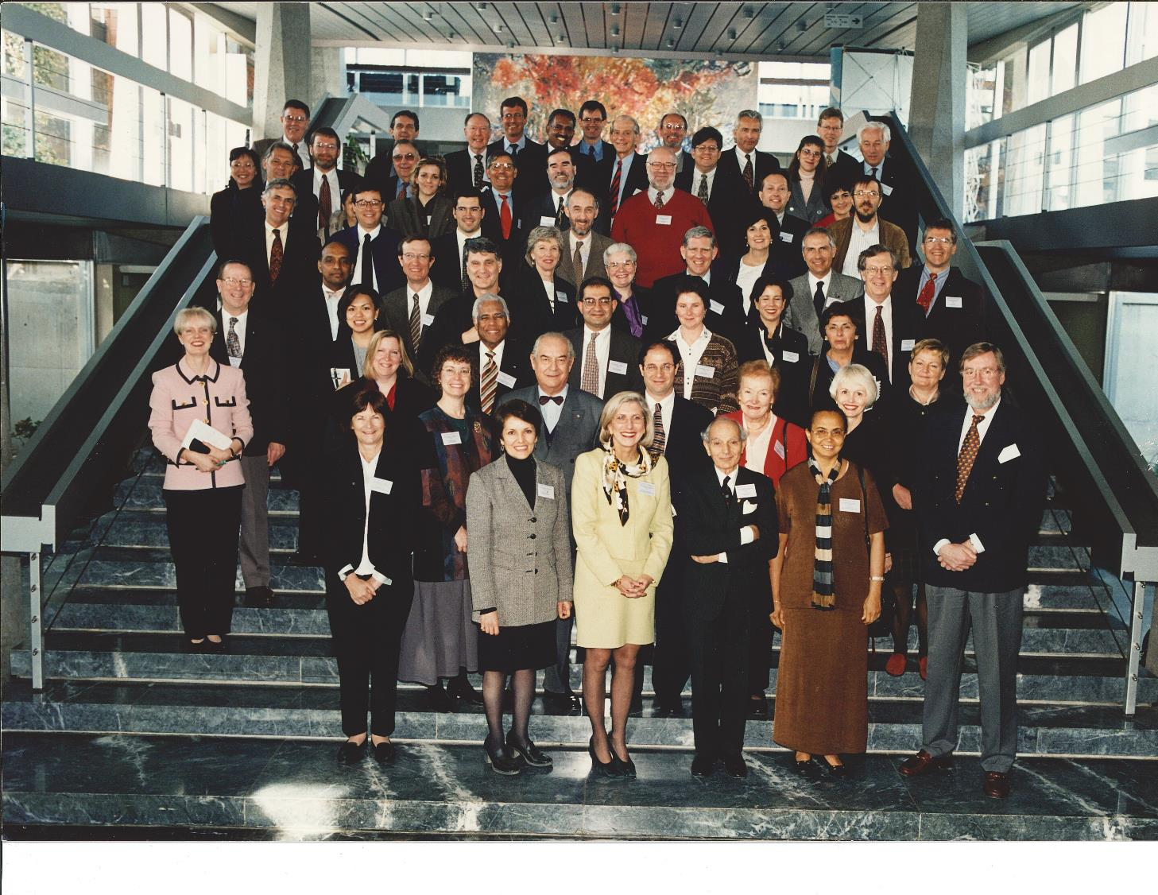
IAPB Partnership Committee, forerunner of the Council of Members, at WHO 1998
Notes:
This slide shows IAPB’s Partnership Committee, the predecessor of IAPB’s current Council of Members which was established when IAPB reconstituted in 2004. I was Chair of the Partnership Committee from 1993-1999 and had the great privilege of working with Dr. Bjorn Thylefors standing front row, far right, head of WHO’s Programme for Prevention of Blindness who was instrumental in getting WHO’s commitment to VISION2020 and to getting WHO’s Director General Dr. Gro Harlem Brundtland to launch VISION2020: The Right to Sight in 1999. The driving forces were Rev. Christian Garms, CEO of CBM and head of IAPB’s Consultative Group pictured top row, third from the right; Dr. Allen Foster, also with CBM pictured top row, second from left; and Mr. Richard Porter, CEO of SightSavers pictured 5th row back on the left next to Dr. Juan Carlos Siva and just behind Dr. Nag Rao’s right shoulder.

Slide 6
1999 – VISION 2020: The Right to Sight
Goal: The elimination of avoidable blindness by 2020, in order to give all people in the world, the right to sight.
1. Effective disease control
  Cataract
  Trachoma
  Onchocerciasis
  Childhood Blindness
  Refractive Error and Low Vision
2. Human resource development
3. Infrastructure development
Notes:
VISION2020 had three main objectives shown on this slide.

Slide 7


VISION 2020: The Right to Sight
Technical Assistance
Capacity
Building
National Partners - National Vision 2020 Plans
Sustainable program delivery
Government, NGOs, civil society working together
Notes:
VISION2020 was successful because of the many partnerships, particularly between IAPB and WHO which works with governments.

Slide 8

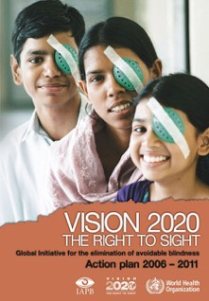
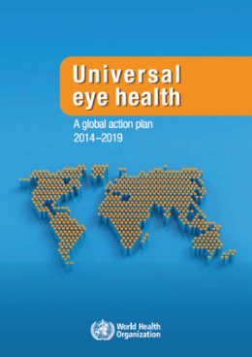
Four World Health Assembly & Executive Board resolutions
28 May 2003
WHA56.26 Elimination of avoidable blindness
27 May 2006
WHA59.25 Prevention of avoidable blindness and visual impairment
21 May 2009
WHA62.1 Prevention of avoidable blindness and visual impairment
May 2013
WHA66.4 Towards universal eye health: a global action plan 2014-2019
Notes:
WHO was committed to VISION2020 by passing four resolutions between 2003 and 2013 including the Global Action Plan 2014-2019.

Slide 9

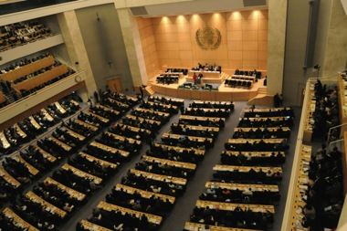
2013: WHO Global Action Plan, 65th WHA
Global Target
  25% reduction in avoidable visual impairment from 2010 to 2019
Indicators
  Prevalence and cause of visual impairment
  Cataract surgery rate and coverage
  Eye care personnel by cadre
Reporting
  To WHA in 2017 and 2020
Notes:
WHO set targets, indicators, and described how governments were to report to WHO on the progress of their eye health strategies.

Slide 10
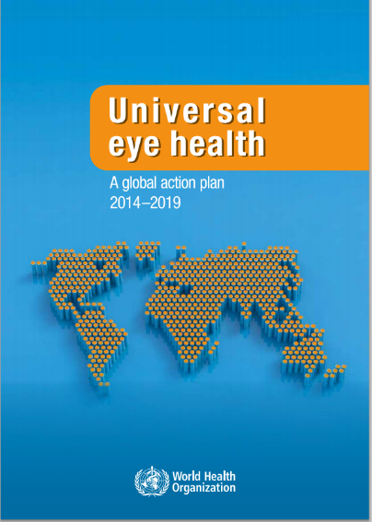

2014 – 2019: Universal Eye Health, Global Action Plan
Strategic objectives:
Multi-sectoral engagement and effective partnerships for improved eye health strengthened
National eye health policies, plans and programmes for enhancing universal eye health developed and/or strengthened and implemented in line with WHO’s framework for action for strengthening health systems in order to improve health outcomes
Evidence generated and used to advocate increased political and financial commitment of Member States for eye health
Collaboration
Health Systems
Evidence
Notes:
The WHO’s Global Action Plan highlighted collaboration, health systems, and evidence.

Slide 11

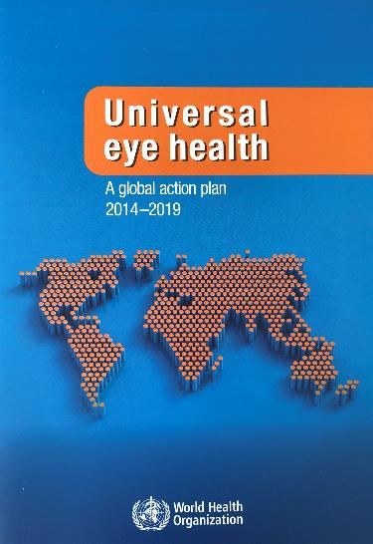
2013: WHO Global Action Plan, 65th WHA
WHA66.4 Towards universal eye health: a global action plan 2014-2019
“The adoption of the global eye health action plan by the Sixty-sixth World Health Assembly opens a new opportunity for Member States to progress with their efforts to prevent visual impairment and strengthen rehabilitation of the blind in their communities.”
Dr. Oleg Chestnov
Assistant Director-General
Noncommunicable Diseases and Mental Health
World Health Organization
http://www.who.int/blindness/actionplan/en/
Notes:
The Global Action Plan was WHO’s commitment to assisting governments to prioritize resources for eye health.

Slide 12
Global Blindness Prevalence 2004-2020
 | Definition | Eye Disease & RE* 2004 | Eye Disease & RE* 2011 | Eye Disease & RE* 2015 | Eye Disease & RE* 2020
Blind | Presenting V/A <6/120 (20/400) or corresponding VF loss to <10° in the better eye with available correction | 45 million | 39 million | 36 million | 43 million
Low Vision | Severe visual impairment: presenting V/A <6/60 (20/200) but >6/120 (20/400) Moderate visual impairment: presenting V/A <6/18 (20/70) but >6/60 (20/200) | 269 million | 246 million | 217 million | 295 million
Total | Combined Blind & Low Vision | 314 million | 285 million | 253 million | 338 million
 |  | WHO data 2004 and 2011 |  | VLEG data 2015 and 2020
Based on a world population of 7.33 Billion
* includes blindness and low vision caused by eye diseases and Refractive Error (RE)
Notes:
How did we do? This slide shows WHO data from 2004 which included uncorrected refractive error (URE) through to 2011. Then VLEG data for 2015 and 2020. Data shows the number of blind, those with low vision (MSVI), and the total. Whilst the trajectory was was on a downward trend through 2015, the increases in 2020 reflect greater numbers for refractive error than in the past and from the increased number of studies conducted in the past five years.

Slide 13

Cataract 17 million
Other 16 million
(includes trachoma & onchocerciasis)
Glaucoma 4 million
URE 4 million
AMD 2 million
DR 1 million
* Rounded to the nearest million
Global
Notes:
This chart shows the number and percent of BLIND in the world. At the side, the actual VLEG numbers are shown for each cause in the pie chart. [open access] GBD 2019 Blindness and Vision Impairment Collaborators; Vision Loss Expert Group of the Global Burden of Disease Study. Causes of blindness and vision impairment in 2020 and trends over 30 years, and prevalence of avoidable blindness in relation to VISION 2020: the Right to Sight: an analysis for the Global Burden of Disease Study. Lancet Glob Health. 2020 Dec 1:S2214-109X(20)30489-7. doi: 10.1016/S2214-109X(20)30489-7

Slide 14
URE 161 million
Cataract 98 million
Other 61 million
(includes trachoma & onchocerciasis)
AMD 8 million
Glaucoma 7 million
DR 4 million
* Rounded to the nearest million
Global
Notes:
This chart shows the number and percent of BLIND + MSVI in the world. At the side, the actual VLEG numbers are shown for each cause in the pie chart. [open access] GBD 2019 Blindness and Vision Impairment Collaborators; Vision Loss Expert Group of the Global Burden of Disease Study. Causes of blindness and vision impairment in 2020 and trends over 30 years, and prevalence of avoidable blindness in relation to VISION 2020: the Right to Sight: an analysis for the Global Burden of Disease Study. Lancet Glob Health. 2020 Dec 1:S2214-109X(20)30489-7. doi: 10.1016/S2214-109X(20)30489-7

Slide 15
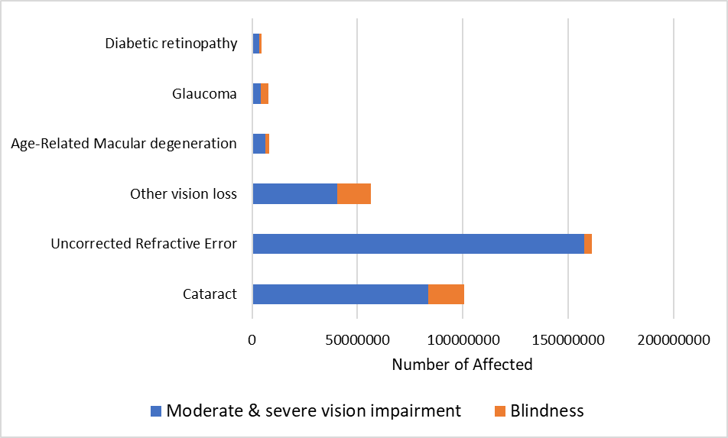
Global number of blind and visually impaired by cause
3M; (75%)
1M; (25%)
3M; (43%)
4M; (57%)
6M; (77%)
2M; (23%)
Global
45M; (74%)
16M; (26%)
157M; (98%)
4M; (2%)
Blind <3/60
MSVI <6/18 to 3/60
Presenting vision…
in the better eye
81M; (83%)
17M; (17%)
0
50M
100M
150M
200M
Notes:
[open access] GBD 2019 Blindness and Vision Impairment Collaborators; Vision Loss Expert Group of the Global Burden of Disease Study. Causes of blindness and vision impairment in 2020 and trends over 30 years, and prevalence of avoidable blindness in relation to VISION 2020: the Right to Sight: an analysis for the Global Burden of Disease Study. Lancet Glob Health. 2020 Dec 1:S2214-109X(20)30489-7. doi: 10.1016/S2214-109X(20)30489-7

Slide 16
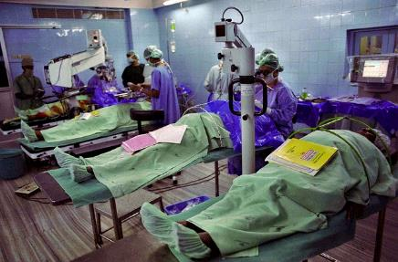
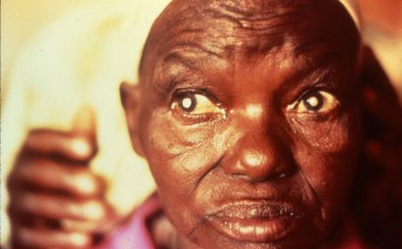
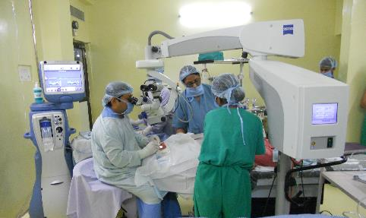
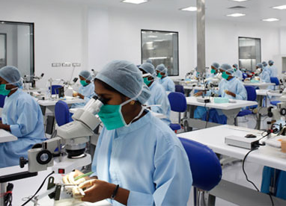
VISION 2020: Focusing initially on certain diseases which are the main causes of blindness and for which proven cost effective interventions are available.
CATARACT
The world’s leading cause of blindness
VISION 2020 Partners:
  WHO
  IAPB member agencies
  World Bank loan to India 1982 demonstrating investment in cataract surgery has enormous ROI
Move to ECCE and phaco procedures
Manufacture of equipment and consumables (IOLs) at affordable prices
Notes:
This slide shows the key stakeholders, the importance to technology and new surgical procedures, and the paradigm shifts on cost reductions of consumables to address unoperated cataract on a large scale.

Slide 17
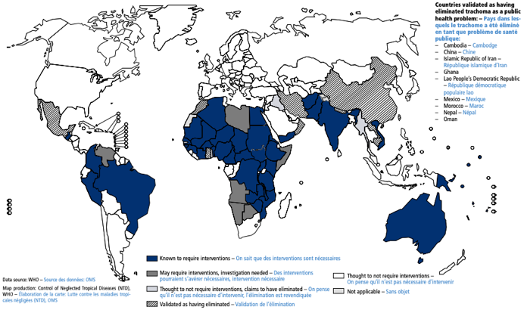
2019: WHO Trachoma
91%
2002: 1.3 billion
2019: 142 million
Trachoma has been eliminated in:
Cambodia*
China*
Gambia
Ghana*
Iran*
Iraq
Laos*
Mexico*
Morocco*
Myanmar
Nepal*
Oman*
Togo
* Validated by WHO
Trachoma remains a public health problem in 44 countries
However it is estimated that it will be eliminated in: 2020: 8 countries, 2023: 20 countries, 2025: all 44 countries
Notes:
This slide shows the reduction in trachoma, a highly communicable disease especially affecting women and children who have less access to clean water and sanitation. Trachoma is now shown as just 1% in the blindness pie chart.

Slide 18
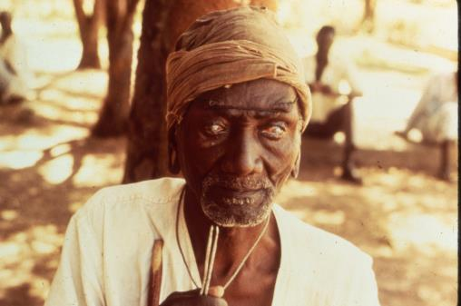
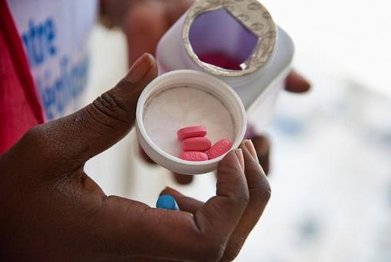
VISION 2020: Focusing initially on certain diseases which are the main causes of blindness and for which proven cost effective interventions are available.
TRACHOMA
Highly communicable, the world’s leading cause of blindness for millennia
VISION 2020 Partners:
  WHO
  IAPB member agencies
  International Trachoma Initiative
Medication donation: Pfizer, azithromycin for mass distribution
2020: less than 1% of the world’s blindness
Notes:
This slide shows the major partners and the significant donation of azithromycin by Pfizer for mass distribution as part of the WHO’s SAFE strategy to achieve a reduction in trachoma blindness worldwide.

Slide 19
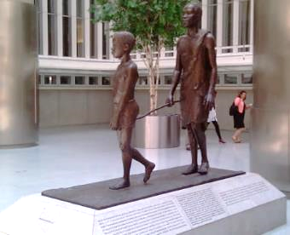
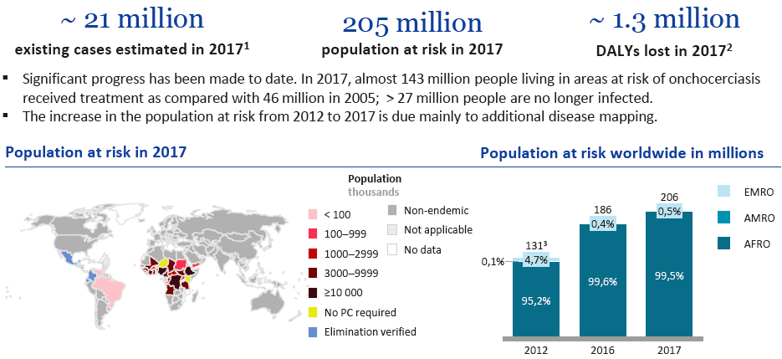
WHO Onchocerciasis: 2020
SDG NTD Road map – Feb 2020
Notes:
This slide shows the reduction in blindness from onchocerciasis commonly known as “river blindness” because the black flies that transmit the microscopic worms from one human to another breed in fast flowing, fresh water rivers. When the micro-filariae invade the interior of the eye, they destroy the eye’s fine, delicate structures causing blindness, usually when the person is in their 30’s, their most productive years.

Slide 20
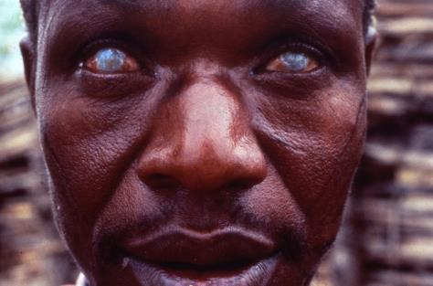
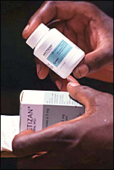
VISION 2020: Focusing initially on certain diseases which are the main causes of blindness and for which proven cost effective interventions are available.
ONCHOCERCIASIS
Commonly known as river blindness
Parasitic disease; mainly Africa & parts of Latin America
VISION 2020 Partners:
  WHO’s African Programme for Onchocerciasis Control (APOC) in Ouagadougou, Burkina Faso
  World Bank funding to APOC (21 major donors-mainly governments)
  IAPB Member Agencies
Medication donation: Merck and Company, Mectizan® Donation Program
6 countries declared “oncho free” by WHO: Colombia 2013, Ecuador 2014, Mexico 2015, Guatemala 2016
Notes:
This slide shows the VISION2020 partners, funders, and the significant donation of Mectizan® (formulation for human use of ivermectin) by Merck and Company for as long as it is needed, that have reduced rates of onchocerciasis generally and blindness from the disease specifically. The donors were governments and major foundations that contributed to a fund at the World Bank which then funded the WHO’s Onchocerciasis Control Program which devolved into the African Programme for Onchocerciasis Control with the advent of Mectizan® in 1989, both based in Ouagadougou, Burkina Faso.

Slide 21
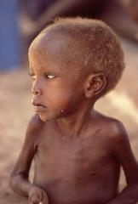
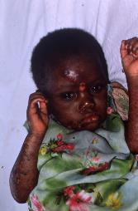
ICEH Vitamin A Deficiency: 2020
Twenty years of childhood blindness: what have we learnt?
Vitamin A deficiency and measles
“During the 1980s, it was realised that vitamin A deficiency was an important cause of child mortality and that high-dose vitamin A supplementation significantly reduced child deaths, even in communities with low levels of clinical xerophthalmia. Intermittent high-dose vitamin A supplementation is an important public health intervention and approximately 500 million doses are given annually throughout the world at a cost of approximately US $1 per dose. As a result, the prevalence of vitamin A deficiency has declined in many regions of the world.”
“Measles immunisation is another large-scale public health intervention to reduce child
morbidity and mortality. Since the launch of EPI in 1974, coverage with measles
immunisation has increased to target levels in most regions. The numbers of measles
cases and measles-related deaths have declined as a consequence. Measles epidemics
are now relatively rare and measles-related corneal blindness has also declined.”
Clare Gilbert Professor, International Centre for Eye Health, Medical Advisor, SightSavers, UK.
Mohammed Muhit Clinical Research Fellow, International Centre for Eye Health, UK.
http://www.cehjournal.org/article/twenty-years-of-childhood-blindness-what-have-we-learnt/ 1/29/2016
Notes:
Whilst a long slide to read, it summarizes the significance of the reduction in vitamin A deficiency and measles in reducing child blindness and death.

Slide 22
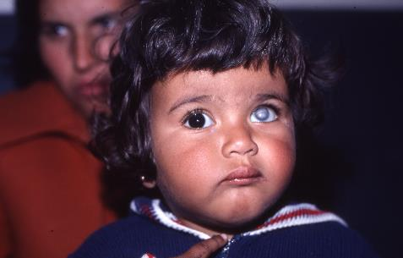
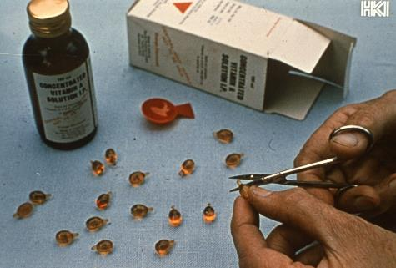
VISION 2020: Focusing initially on certain diseases which are the main causes of blindness and for which proven cost effective interventions are available.
Blinding Malnutrition
Once the world’s leading cause of blindness in children
VISION2020 Partners:
  WHO/UNICEF/FAO
  Nutrition & gardening partners
  IAPB member agencies
International Vitamin A Consultative Group (IVACG)
Medication donation: DSM and its predecessor F. Hoffmann-LaRoche, high dose vitamin A capsules (200,000 IU) for mass distribution
Notes:
This slide shows the VISION2020 partners and the significant donation of high dose vitamin A capsules (200,000 IU) for treatment and prevention programs to reduce blinding malnutrition which prevented blindness and even death in children.

Slide 23
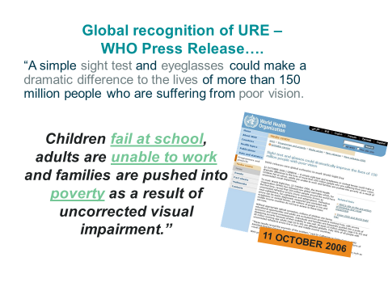
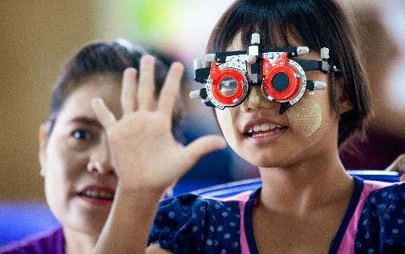
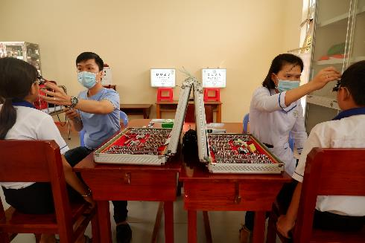
VISION 2020: Focusing initially on certain diseases which are the main causes of blindness and for which proven cost effective interventions are available
UNCORRECTED REFRACTIVE ERROR
Included as cause for blindness and vision impairment in 2006
Leading cause of vision impairment
Sector wide strategy is a key focus of post Vision 2020 strategy
Notes:
This slide discusses the strategy to address URE: hyperopia, myopia, and presbyopia in order the improve vision which leads to improved learning, work opportunities, and poverty reduction.

Slide 24
2015
Notes:
IAPB is a strong advocate for the UN Development Goals working closely with Amb. Aubrey Webson, UN Representative of Antigua and Barbuda who founded the UN Friends of Vision with the leadership of Ireland and Bangladesh and including over 50 UN member states.

Slide 25

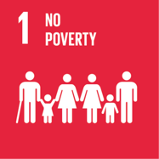
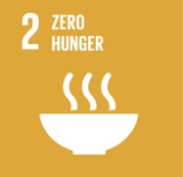

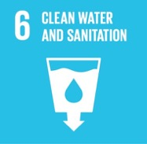
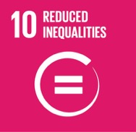
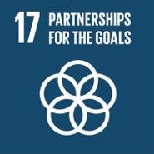
3.3 By 2030, end AIDS, Tb, malaria, NTDs and other communicable diseases.
3.c Increase health financing and health workforce
3.8 Achieve universal health coverage, including financial risk protection, access to quality essential health-care services and access to safe, effective, quality and affordable essential medicines and vaccines for all.
http://www.iapb.org/advocacy/sustainable-development-goals
Notes:
SDGs approved by the UN in September 2015. These SDGs in particular can be impacted positively by reductions in the rates of visual impairment.

Slide 26
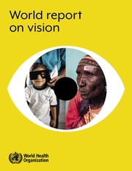
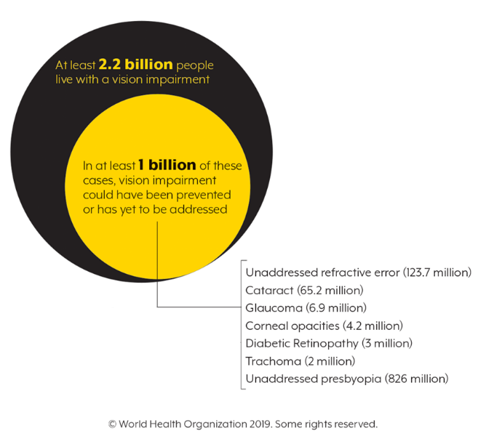
2019: WHO launched World Report on Vision
World Sight Day, October 10, 2019, WHO Geneva
Directed at ministries of health, development agencies, civil society organizations and researchers, practitioners and policy-makers from the field of eye care.
Shape the global agenda on vision.
Assist Member States and their partners in their efforts to reduce the burden of eye conditions and vision loss and
Achieve the UN Sustainable Development Goals (SDGs), 1,2,3,4,5,8,10,11,17, particularly SDG target 3.8 on universal health coverage.
https://www.who.int/publications/i/item/world-report-on-vision
Notes:
IAPB continues to support WHO’s commitment to improving eye health as part of general health and indeed integrating eye health into general health strategies. The WHO’s World Report on Vision was launched on World Sight Day 2019 at WHO in Geneva.

Slide 27
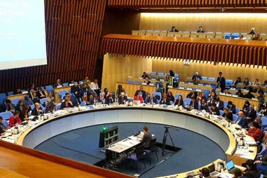
2019
Notes:
The WHO’s World Report on Vision’s simple take away is that 2.2 million people in the world have a vision impairment. 1.2 billion have been helped by treatment, surgery or glasses. There remains of gap of 1 million whose visual impairment is either avoidable or is yet to be treated. These data will be updated as new data are published.

Slide 28
2019: World Report on Vision
Notes:
The World Report on Vision guides us with five advocacy objectives to ensure that eye health is part of general health strategies, that resources are directed toward improving eye health, and that people and their communities are aware of their needs and create a demand for services.

Slide 29

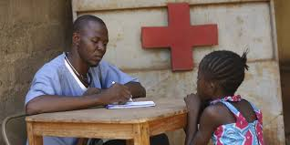
2019: Integrated People – Centered Eye Care
Train more ophthalmologists is obvious, but not the whole solution
Train eye care teams to meet community needs
Integrate comprehensive eye care into health care system
Integrate community-level primary eye care into primary health care
Provide eye care teams with:
  infrastructure
  support
  continuing professional development
Notes:
The importance of human resources for eye Health (HReH) cannot be understated. And for ophthalmologists to be most effective, teams of allied ophthalmic personnel create efficient and effective services that people will trust and seek for their care. This is the case from the community to the secondary to the tertiary levels. Also, the importance of effective and efficient referral and management structures are critical to a quality team approach.

Slide 30
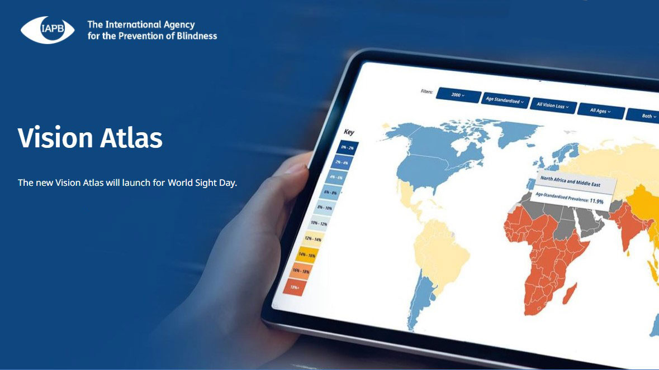
2020: Vision Atlas 2.0 launched
IAPB Vision Atlas Version 2.0 - Launched World Sight Day 2020
https://www.iapb.org/vision-atlas
Notes:
IAPB’s Vision Atlas 2.0 was launched on World Sight Day 2020, an on-line tool for researching data on diseases, maps, resources, and critical information globally and by regions. It will be updated regularly when new data are published.

Slide 31

IAPB’s network includes over 150
Eye health NGOs
Universities and research centres
Professional bodies
Private sector
To see the full list of IAPB members, visit www.iapb.org
Photos: https://www.flickr.com/people/iapb/
IAPB believes in a world in which no one is needlessly visually impaired, where everyone has access to the best possible standard of eye health; and where those with irreparable vision loss achieve their full potential.
Key priorities:
Global advocacy: Raise the profile of eye care with key international institutions to receive the attention and resources needed to achieve universal access to eye health.
Connecting knowledge: Underpinning activities is IAPB’s role in providing authoritative data and information and enabling access to up-to-date knowledge, information and practice.
Strengthening the network: IAPB supports active partnership building both between members and with other key sectors to tackle the barriers to delivering eye care for all.
Providing services: IAPB aims to provide high quality, economically viable services which add value to members.
Notes:
IAPB’s strength is its network and partnerships. Visit www.iapb.org for a full list of members.

Slide 32
Thank You

