Slide 1
The Roadmap To Universal Health Coverage for Eye Health through Integrated People-centred Eye Care

Slide 2
THE CHALLENGE
Over 1 billion people worldwide do not have access to the eye care that they need
Inequities in access
Changing population demographics and a growth in demand
Inadequate government prioritisation
Fragmented services that are poorly integrated into health systems and coordinated with other health areas
Insufficient and uncoordinated workforce
Lack of resources and financial protection
Gaps in data

Slide 3
WORLD REPORT ON VISION - Strategic Framework
Make eye care an integral part of Universal Health Coverage
Implement integrated people-centred eye care in health systems
So all people have access to the eye care they need, where and when they need it without suffering financial hardship

Slide 4
A NEW PARADIGM FOR EYE CARE
The World Report on Vision defines Integrated People Centred Eye Care -
‘services that are managed and delivered so that people receive a continuum of health interventions covering promotion, prevention, treatment and rehabilitation, to address the full spectrum of eye conditions according to their needs, coordinated across the different levels and sites of care within and beyond the health sector, and that recognizes people as participants and beneficiaries of these services, throughout their life course’.

Slide 5
ACHIEVING IPEC 1.
EMPOWERING AND ENGAGING PEOPLE AND COMMUNITIES
Increase demand on eye care services including rehabilitation, through improving felt need and rights-based approaches
Improve timely and appropriate health seeking
Increase access via community - based approaches, telehealth and other means to reach underserved and remote communities

Slide 6
ACHIEVING IPEC 2.
REORIENTING THE MODEL OF CARE
Increase emphasis on primary care and accounting for the life course
Facilitate access across the levels of care from promotion to rehabilitation, with appropriate referral systems
Improve timeliness of diagnosis and interventions to catch diseases and conditions early
Establish quality assurance and monitoring mechanisms at all levels of eye care
Promote affordability and access

Slide 7
ACHIEVING IPEC 3.
COORDINATING SERVICES WITHIN AND ACROSS SECTORS
Ensure individual continuity of care/ patient-centred care
Coordinate eye health within healthcare including neonatal, NCDs, occupational health
Reframe eye health as also a development issue contributing to the Sustainable Development Goals
Work across sectors and ministries including work, education and with private sector

Slide 8
ACHIEVING IPEC 4.
CREATING AN ENABLING ENVIRONMENT
Enhance eye health planning integrated in health strategies
Establish effective governance and strong regulatory systems
Prioritise investment in and development of the eye health workforce, with needs-based planning and distribution
Establish quality control and accreditation systems for training institutions
Integration of eye care data within health information systems

Slide 9
ADVOCACY TO IPEC
World Report on Vision 2019
WHA Resolution political commitment 2020
WHO Global targets for IPEC 2021
WHO suite of instruments 2020-2021
Advocacy and policy at national level 2021
Strategic Guidance
Guide For Action
Package of Eye Care Interventions
Monitoring framework menu of indicators
Eye Care Competency Framework

Slide 10
WHO's tools for IPEC
Strategic Guidance on IPEC
Guide for Action
Package of Eye Care Interventions (PECI)
Global Targets and Menu of indicators
mMyopia Toolkit
Eye Care Competency framework
Sets out core components of IPEC, steps for implementation, roles and responsibilities
Comprehensive guide and instruments for government for situation assessment, planning and implementation of IPEC
Resource for intervention selection, prioritization, budgeting to integrate in health insurance essential packages
Tool to collect data on global targets on cataract and refractive error, and menu for comprehensive measurement of progress at national level
Handbook and library to guide governments to scale health programmes on myopia
A golden standard of competencies to assist planning and set practice standards for eye health workforce

Slide 11
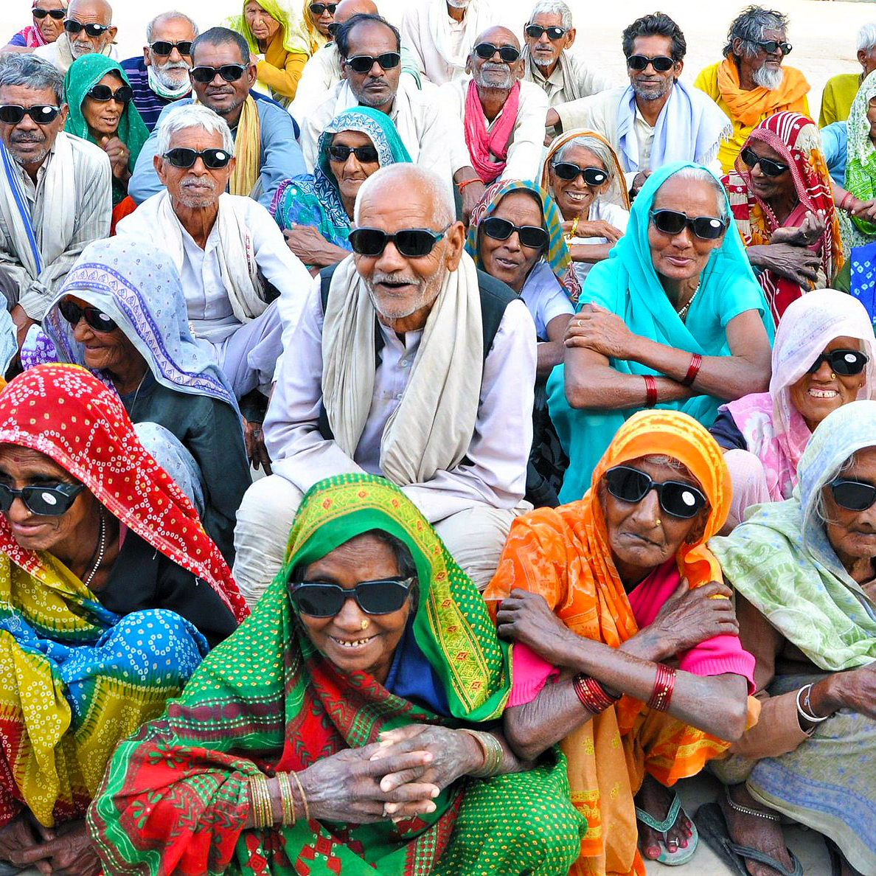
ADVOCACY TO IPEC
World Report on Vision 2019
WHA Resolution political commitment 2020
WHO Global targets for IPEC 2021
WHO suite of instruments 2020-2021
Advocacy and policy at national level 2021+
Participate in WHO and IAPB’s webinar series
Lead on in-country Policy dialogues/ support a national implementation process
Discuss this agenda at Eye Care Working Group, National Prevention of Blindness Committees
Promote IPEC and integration of eye health within UHC schemes such as national health insurance to national and district stakeholders, including governments

Slide 12
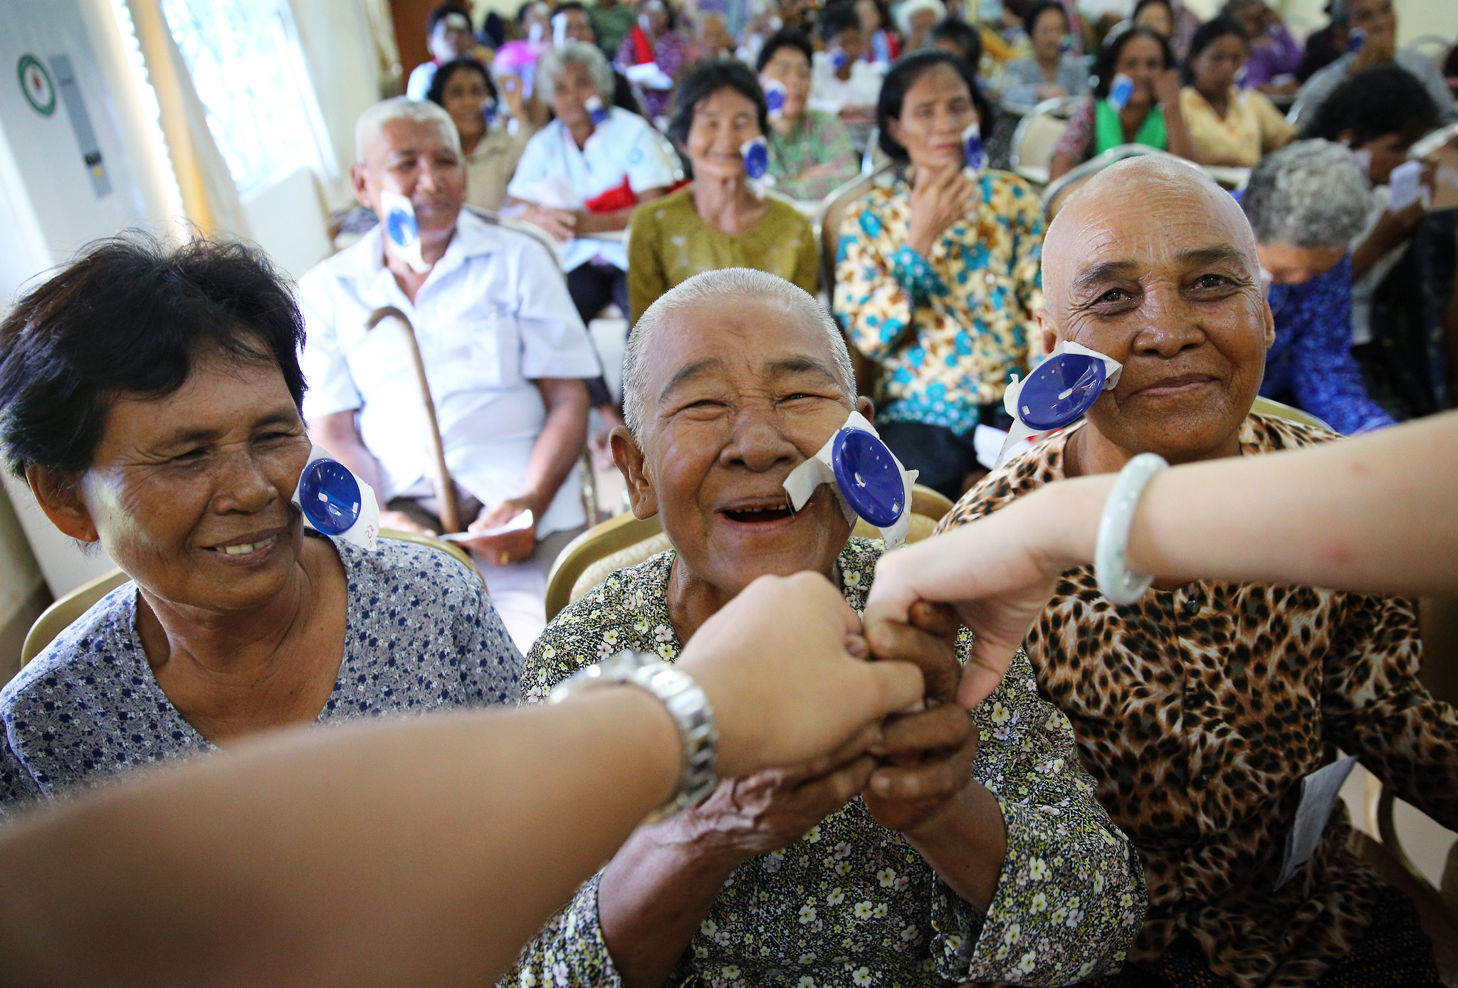
THANK YOU
WWW.IAPB.ORG/ADVOCACY

