Slide 1


Call to Action
Climate Action Working Group (CAWG)
Photo: The Hans India

Slide 2


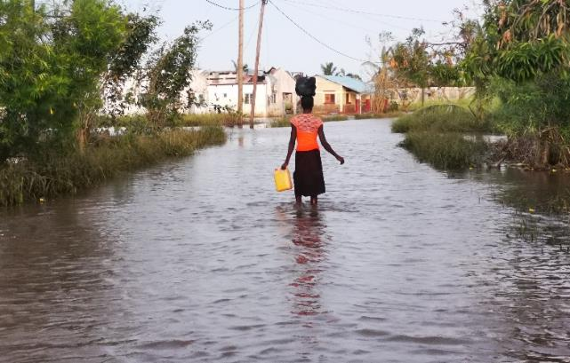
Why act on climate change?
Photo: Sydney Morning Herald
Photo: Light for the World
It is a global human health issue and it’s happening now
Need for mitigation and adaptation strategies from health care sector
Disproportionately impacts marginalized and vulnerable populations
  Women and girls
  People with disabilities including vision impairment
  People living in remote and rural areas
Notes:
Immense damage to the environment globally: more intense extreme weather events, rising temperatures and sea levels, spread of disease, devastation on habitats and increase in air pollution.

Slide 3
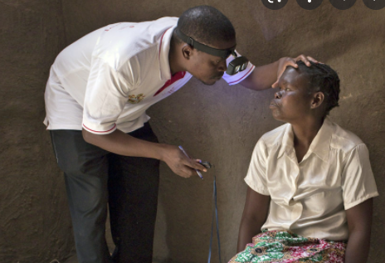

How will it impact eye health?
Predicted increase in
trachoma infections
onchocerciasis infections
cataracts
skin cancers, corneal and conjunctival lesions
eye injuries
age-related macular degeneration
glaucoma
allergic eye diseases
Photo: Sightsavers
Notes:
Trachoma infections – increase incidences due to poor supply to clean water
Temperature and rainfall appear to play a role in the transmission of acute trachoma, possibly mediated through reduced activity of flies at lower temperatures. (Ref: Ramesh A et al. The impact of climatic risk factors on the prevalence, distribution, and severity of acute and chronic trachoma. PLoS Negl Trop Dis. 2013 Nov 7;7(11):e2513. doi: 0.1371/journal.pntd.0002513)
Water shortages could increase trachoma occurring: In times of shortage, water is used for cooking rather than personal hygiene and sanitation (Ref: Jaggernath Jyoti et al. Climate change: Impact of increased ultraviolet radiation and water changes on eye health. Health 2013. 05. 921-930. 10.4236/health.2013.55122)
Onchocerciases – increased risk due to increase in rainfall patterns spreading vector borne diseases
High rainfall intensity is projected to facilitate the transport of vector-borne diseases and parasites from one locality to another, as rivers overflow and river velocity increases.
Vectors travel hundreds of kilometres on wind currents and this could eventually lead to the colonisation of blackflies in new habitats, thereby introducing and facilitating the spread of onchocerciasis (Ref: Jaggernath Jyoti et al. Climate change: Impact of increased ultraviolet radiation and water changes on eye health. Health 2013. 05. 921-930. 10.4236/health.2013.55122)
Cataracts – earlier onset and accelerated progression due to increase UVR exposure
- Global warming may become a factor in the early onset and rapid progression of cataract. (Ref: Johnson GI. The environment and the eye. Eye 2004;18:1235-1250)
- Ultraviolet radiation (UVR) and increased exposure to sunlight has been shown in many studies to be one of the major risk factors for cortical cataract. Number of cortical cataract cases would increase between 1.3% and 6.9% by the year 2050. (Ref: Jaggernath Jyoti et al. Climate change: Impact of increased ultraviolet radiation and water changes on eye health. Health 2013. 05. 921-930. 10.4236/health.2013.55122)
- due to increased poower of storms there is more moisture in the stratosphere which depletes the ozone https://science.sciencemag.org/content/337/6096/835
Ocular lesions - increased due to increase UVR exposure
Acute and chronic exposure of the eyelid to UVA and UV-B solar radiation causes UVR related damage to the skin of the eyelids potentially resulting in basal cell carcinoma, squamous cell carcinoma, sebaceous cell carcinoma, and malignant melanoma.
Conjunctiva and corneal lesions (Pterygium, Photokeratitis, Climatic Droplet Keratopathy) is due to chronic exposure to solar UVR .
Retinal lesions, retinal damage, age-related macular degeneration, uveal melanoma have been related to their exposure to high levels of UVR.
Eye injuries - increased risk due to extreme weather events
Extreme weather events will lead to an increase in physical injuries, including eye injuries, and will likely affect those with visual impairment and disabilities dispro­portionately.
Age-related macular degeneration – increase risk due to increase in air pollution
A small increase in exposure to tiny pollution particles raised the risk of AMD by 8%, while small changes in larger pollution particles and nitrogen dioxide were linked to a 12% higher risk of adverse retinal changes. (Ref: Chua S et al Association of ambient air pollution with age-related macular degeneration and retinal thickness in UK Biobank. British Journal of Ophthalmology Published Online First: 25 January 2021. doi: 10.1136/bjophthalmol-2020-316218)
Glaucoma – increase risk due to increase in air pollution
- Areas with higher amounts of fine particulate matter pollution are at least 6% more likely to report having glaucoma than those in the least-polluted areas. (Ref: Chua S et al. The Relationship Between Ambient Atmospheric Fine Particulate Matter (PM2.5) and Glaucoma in a Large Community Cohort. Investigative Ophthalmology & Visual Science, 2019; 60 (14): 4915 DOI: 10.1167/iovs.19-28346)
Allergic– increased incidences due to increase in air pollution and/or temperature
Ambient air pollution and weather changes may contribute to the worsening of allergic conjunctivitis. (Ref: Hong J et al. Ambient air pollution, weather changes, and outpatient visits for allergic conjunctivitis: A retrospective registry study. Sci Rep. 2016; 6: 23858. Published online 2016 Apr 1. doi: 10.1038/srep23858 )
An increase of temperature and ground-level ozone was associated with a higher prevalence of allergic eye disease cases during the year among children and adolescents (Ref: Das A et al. Environmental and Air Pollution Factors Affecting Allergic Eye Disease in Children and Adolescents in India. Int J Environ Res Public Health. 2021 Jun; 18(11): 5611. Published online 2021 May 24. doi: 10.3390/ijerph18115611)
Vitamin A deficiency – increased risk due to food insecurity and/or nutrient depletion due to rising carbon dioxide levels
- Need to find a resource that links it better
??? Talks more about zinc deficiency (Ref: Smith M et al. Impact of anthropogenic CO2 emissions on global human nutrition. Nature Climate Change. 2018 Sep 8;834-839 doi:10.1038/s41558-018-0253-3)

Slide 4
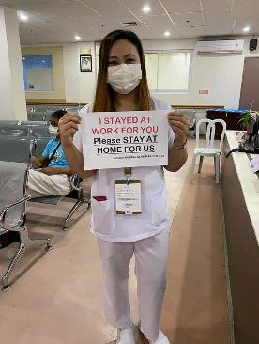
How will it impact eye care services?
Disruption of eye care services
Severe impact on supply chains
Raw material extraction
Manufacture capabilities
Increased competition/product availability
Impeded logistic supply lines
Cost increases
Photo: Fred Hollows Foundation
Notes:
Disruption of eye care services and supply chains - photos of Pandemic used to illustrate that climate change events (e.g. floods/ fires/ hurricanes) will disrupt eye care services and supply chains. In time of crisis, only core health services may be prioritised – which often leaves out eye care. During the COVID -19 Pandemic we saw an almost universal suspension of crucial eye health services such as cataract surgeries and distribution of glasses. From raw materials, production capabilities, logistics to ship medical products and pharmaceuticals through to increased competition for the same products and cost increases health supply chains are vulnerable and will be severely impacted.
Disruption to the critical eye care services, in addition to the predicted increased in eye disease will further exacerbate the situation.

Slide 5
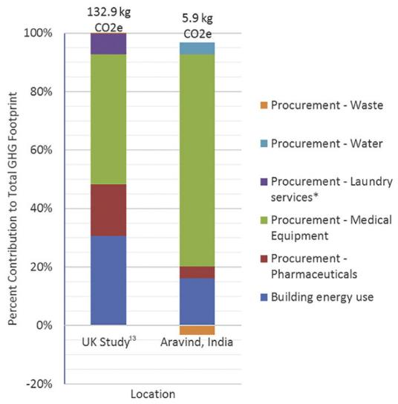
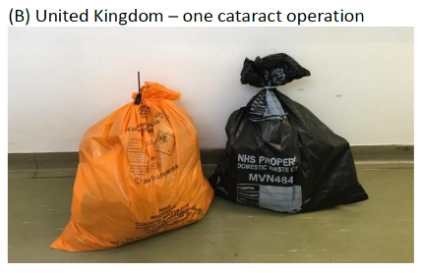
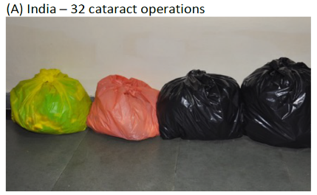
How does eye care contribute to climate change?
Healthcare is responsible for 4.4% of global emissions including unsustainable procurement and poor waste management
Thiel et al. showed that the same cataract surgery yields 30x more emissions in UK than compared to when it was performed in India
Notes:
Globally, healthcare is a massive consumer of resources and major emitter of greenhouse gas emissions, responsible for 2 billion tons of carbon dioxide equivalent (CO2e), which is 4.4% of all global net greenhouse gas emissions (GHGs)
71% of emissions are from the supply chain. This include unsustainable procurement on medical equipment, pharmaceuticals, cleaning, and water use
Poor waste management contributes to our carbon footprint. Although 85% healthcare waste is non-hazardous, its disposal still has an impact on the environment. For example, non-contaminated healthcare plastic will add to the plastic pollution if not recycled. And the GHG emissions produced by biodegradable waste in landfill are especially high as they include methane which is 21 times more potent that carbon dioxide.
Within eye health, there have been studies which have looked at the carbon footprint of cataract surgery. Morris et al estimated that the carbon footprint of cataract surgery by phacoemulsification in the UK is 133 kgCO2eq, whereas Thiel et al found that the same surgery in India releases 6 kgCO2e.
This case study shows how we carry out our eye care activities, can have a significant impact on the carbon emissions we’re producing.
Ref
Morris, D. S., Wright, T., Somner, J. E., & Connor, A. (2013). The carbon footprint of cataract surgery. Eye (London, England), 27(4), 495–501. https://doi.org/10.1038/eye.2013.9
Thiel, C. L., Schehlein, E., Ravilla, T., Ravindran, R. D., Robin, A. L., Saeedi, O. J., Schuman, J. S., & Venkatesh, R. (2017). Cataract surgery and environmental sustainability: Waste and lifecycle assessment of phacoemulsification at a private healthcare facility. Journal of cataract and refractive surgery, 43(11), 1391–1398. https://doi.org/10.1016/j.jcrs.2017.08.017
Extra notes
The disposal of untreated healthcare waste in landfills can lead to the contamination of water with pathogens, pharmaceutical products and toxic pollutants, if those landfills are not properly constructed and managed.

Slide 6



Political drive to address climate change
The UN has declared climate change as a global emergency
The Lancet Commission on Global Eye Health added Planetary Health as a key component to improving quality of eye care
WHO has stated that climate change affects the social and environmental determinants of health
Notes:
In the last decade, we have seen a tremendous shift in energy globally to tackle climate change.
There is strong momentum from leading international agencies.
The United Nations established the 17 interdependent Sustainable Development Goals (SDGs), several of which are directed towards addressing climate change. These goals provide master plan for the global community to work towards an equitable and sustainable future.
The World Health Organization has acknowledged that climate change affects the social and environmental determinants of health​, and that responses to climate change can have significant co-benefits in improving health outcomes
More recently, The Lancet Commission on Global Eye Health stated that planetary health is a key component to improving quality of eye care and emphasized that the eye care community strongly consider environmentally sustainable eye health services to make progress towards the SDGs.
Given the significant role we play in generating carbon emissions, and the substantial impact climate change will have on eye care – we do not want to be left behind.
Ref: Burton MJ et al. (2021). The Lancet Global Health Commission on Global Eye Health: vision beyond 2020. The Lancet Global Health, 9(4), e489-e551. doi:10.1016/S2214-109X(20)30488-5
Ref: WHO (2018) Climate change and health, Fact Sheetshttps://www.who.int/news-room/fact-sheets/detail/climate-change-and-health

Slide 7
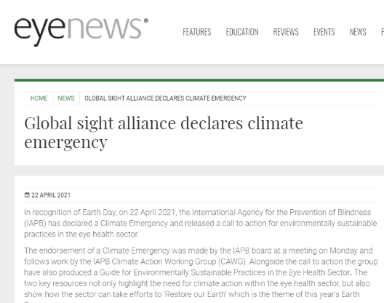
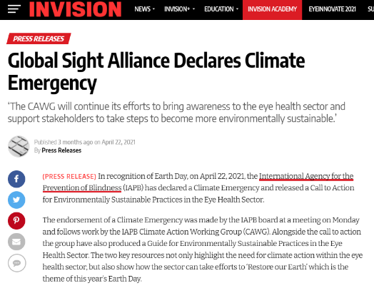
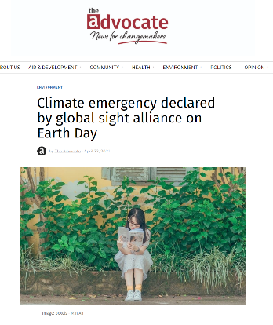
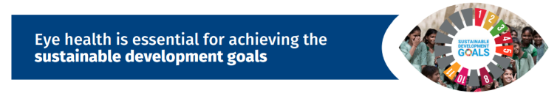

What action is IAPB taking?
Established Climate Action Working Group in 2017
2-day workshop during 2019 IAPB Council of Members to define the priority issues for eye health
Declared a climate emergency in 2021
Encouraging the sector to take climate action
UN Resolution linking eye health to the SDGs across economic, social, environmental pillars in 2021
Notes:
Established Climate Action Working Group in 2017 – as there was great interest in the sector. The goal of the CAWG is to provide leadership and advocacy for increased adoption and action on priority matters relating to climate action in eye health for IAPB members and other stakeholders. The Group now has 17 active members that meet regularly through the year.
Held a 2 day workshop during the 2019 IAPB Council of Members (CoM) in Tanzania to define the priority issues for eye health – hosted by CBM Tanzania the CAWG presented to the CoM at the start of the CoM to receive feedback on sustainability issues. These issues were defined, prioritised, and an action plan to address were developed over the 2 day workshop. Findings and action plan were presented back to the CoM for endorsement to progress.
Declared a climate emergency in 2021 – In recognition of Earth Day, on April 22, 2021, the International Agency for the Prevention of Blindness (IAPB) has declared a Climate Emergency. This declaration shows the sight sector is committed and united to act on the climate emergency that is impacting access to critical, sight-saving eye health services.
Encouraging the sector to take climate action - The CAWG have produced and released a Call to Action for Environmentally Sustainable Practices in the Eye Health Sector and an accompanying guide. Both these resources sets out practical steps that organizations and individuals can prioritize to adapt to adverse climate events and decrease the negative effect that health services delivery has on the environment.
Advocated and secured endorsement of UN resolution which explicitly links eye health to achievements of the 17SDGs, across economic, social and ENVIRONMENT domains, first agreement designed to tackle preventable sight loss to be adopted at the United Nations and enshrines eye health as part of the United Nations’ Sustainable Development Goals.

Slide 8
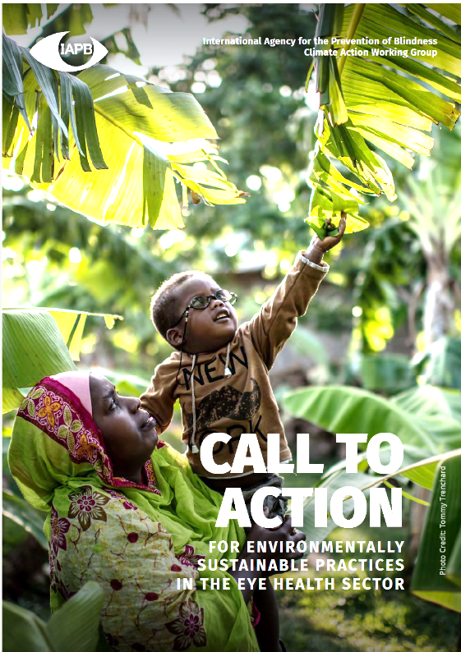

Call to Action
Call out to the sector to take action
Leads the sector to mitigate our own carbon footprint
Helps to mobilize and support other IAPB members in responding to environmental sustainability and climate change​

Slide 9
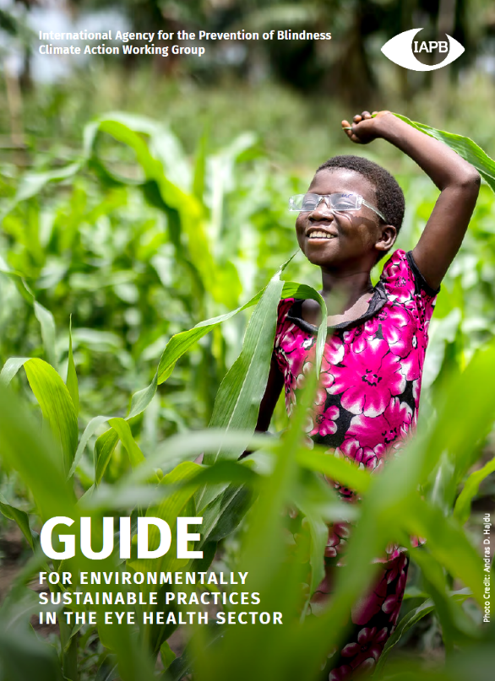
The Guide
Aligned to the Call to Action
A comprehensive practical guide developed by the Climate Action Working Group
Provides detailed guidance to eye care sector on ways they can reduce their environmental impact and support climate resilience

Slide 10









10 Key Areas of Action
Lead
Advocate
Procure sustainably
Reduce the use of fossil fuels
Conserve water
Reduce and safely dispose of waste
Reduce and green the travel
Follow the 4 Principles of sustainable clinical practice
Embed environmental sustainability in education
Focus your research
Notes:
Both resources highlight 10 Key areas of action that individuals and organizations can take
Extra note: 4 principles^{xiii} of sustainable clinical practice includes: prevention, patient empowerment, lean eye health service delivery and the use of medical procedures and technologies which have a lower environmental impact.

Slide 11

1. Lead
Why? | How?
Recognises the urgency Shows commitment To achieve leadership in environmental sustainability there are four key pillars: accountability, transparency, compliance and equity | Acknowledge a climate emergency and commit to climate action publicly Prioritise and resource climate change initiatives, Identify a sponsor/ champion Develop a policy and strategy Engage all departments in the development of an environmental sustainability strategy Establish a framework for regular monitoring Develop or join cross-sector coalitions Consider how vulnerable populations can actively participate
Notes:
For short presentations, consider removing this slide.
Presenter can reduce slide text based on presenting context
How? Through the following actions:
- Acknowledge a climate emergency and commit to climate action publicly, such as developing an environmental policy or position statement on your website to show your commitment to environmental sustainability and climate action.
• Prioritise and resource climate change initiatives, including behaviour change through policies, within your organisation
• Identify a sponsor/ champion of environmental sustainability at board/ executive level
• Develop a policy to set guidelines for your organisation and employees to follow to implement environmental sustainability strategies and address climate action.
• Engage all departments in the development of an environmental sustainability strategy and supporting actions
• Establish a framework for regular assessment and internal and external reporting on progress towards environmental sustainability targets, such as emissions reductions and sustainable development goals. Ensure the framework promotes equity and fairness for vulnerable populations, particularly girls and women, to avoid exacerbating inequalities from climate action strategies.
• Clearly communicate climate action commitment, policy and actions internally to all staff, such as induction training and on noticeboards
• Develop or join cross-sector coalitions working towards climate action and environmental sustainability
• Consider how vulnerable populations, particularly girls and women, can actively participate and benefit from environmental sustainability strategies.

Slide 12

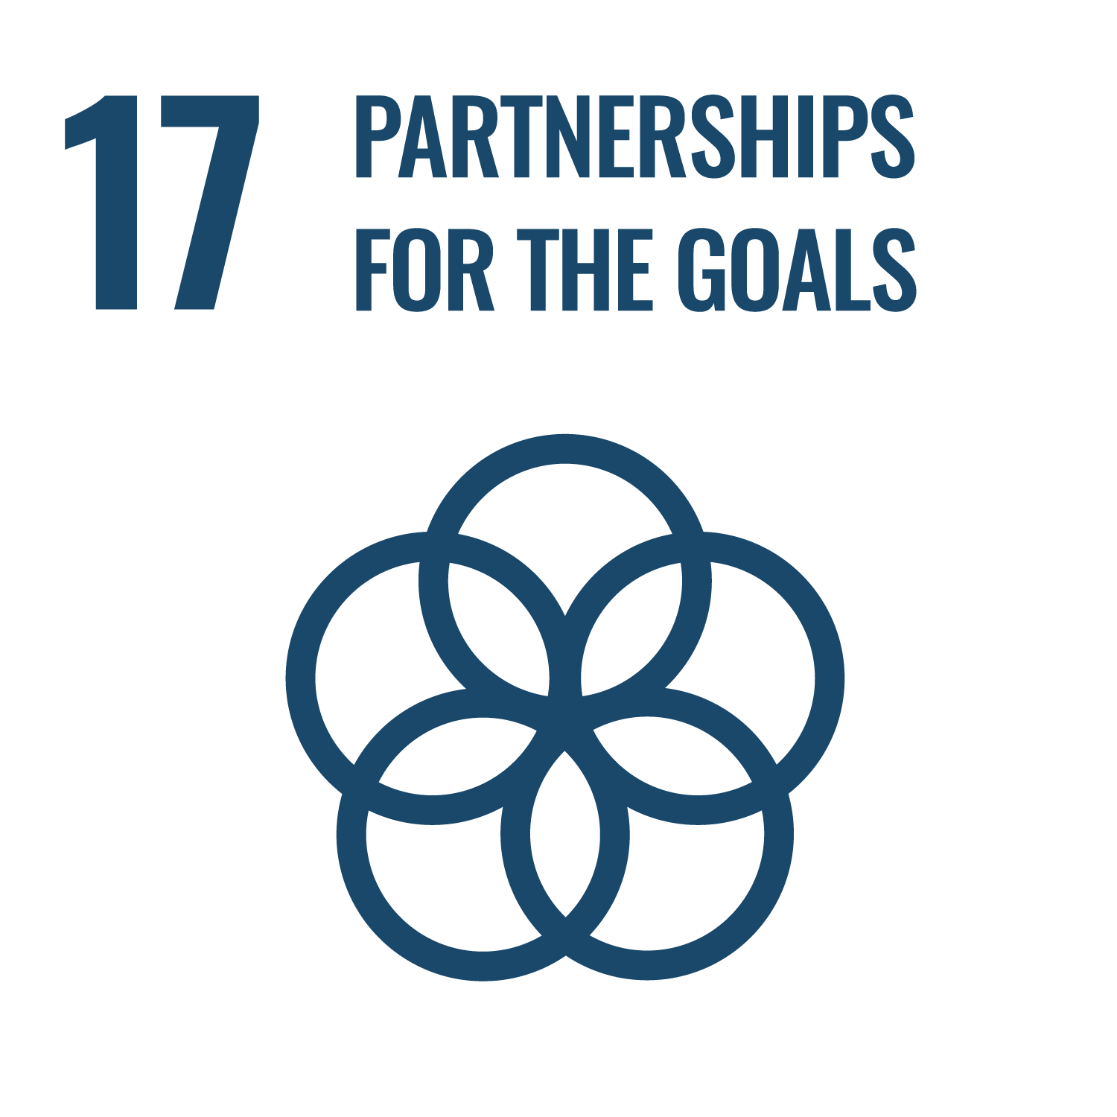
2. Advocate
Why? | How?
Creates awareness Collaboration among NGOs and eye care providers will offer peer support and accelerate implementation | Embed environmental sustainability into your advocacy Declare a climate emergency to raise awareness Make every contact count (advocate at events/meetings/clients/other practitioners) ‘Use’ your voice - eye health practitioners are well respected. Collaborate and include representatives from vulnerable populations in your discussions and plans Show young people and vulnerable populations that the health sector increasingly cares deeply about the future of the planet
Linked with SDG 17: Diverse partners can also mobilise resources and combine their voice to advocate for increased attention and investment in sustainability efforts.
Notes:
For short presentations, consider removing this slide.
Presenter can reduce slide text based on presenting context
How? Through the following actions:
- Embed environmental sustainability into your advocacy, so it becomes part of core business.
• Declare a climate emergency to raise awareness and emphasise the urgency of climate change.
• Make every contact count:
- Advocate for environmental sustainability in partnership working: The more organisations recognize the urgency of climate change, the easier it will be to take action. Use the opportunity to ‘create’ new advocates.
- Raise environmental sustainability at events for eye health by making the event environmentally sustainable and also lobbying for environmentally sustainable eye health practice.
• ‘Use’ your voice. Eye health professionals are well respected. Use your voice to advocate for environmentally sustainable eye health practices.
• Collaborate and include representatives from vulnerable populations in your discussions and plans. Vulnerable populations are disproportionately affected by the adverse effects of the climate crisis and their voice needs to be heard, e.g. invite Disability People Organisations, Women and Elderly Groups, representatives from ethnic minorities.
• Create awareness of the links between environmental sustainability and the health/ eye health of poor communities
SDG 17 highlights the role of inclusive, interdisciplinary and multi-sectoral partnerships to realize the potential of the sustainable development agenda and ensure no-one is left behind. Strong partnerships at the local, national, regional and global level are critical to build shared values, knowledge exchange and collaboration. Coalitions of diverse partners can also mobilise resources and combine their voice to advocate for increased attention and investment in sustainability efforts.

Slide 13

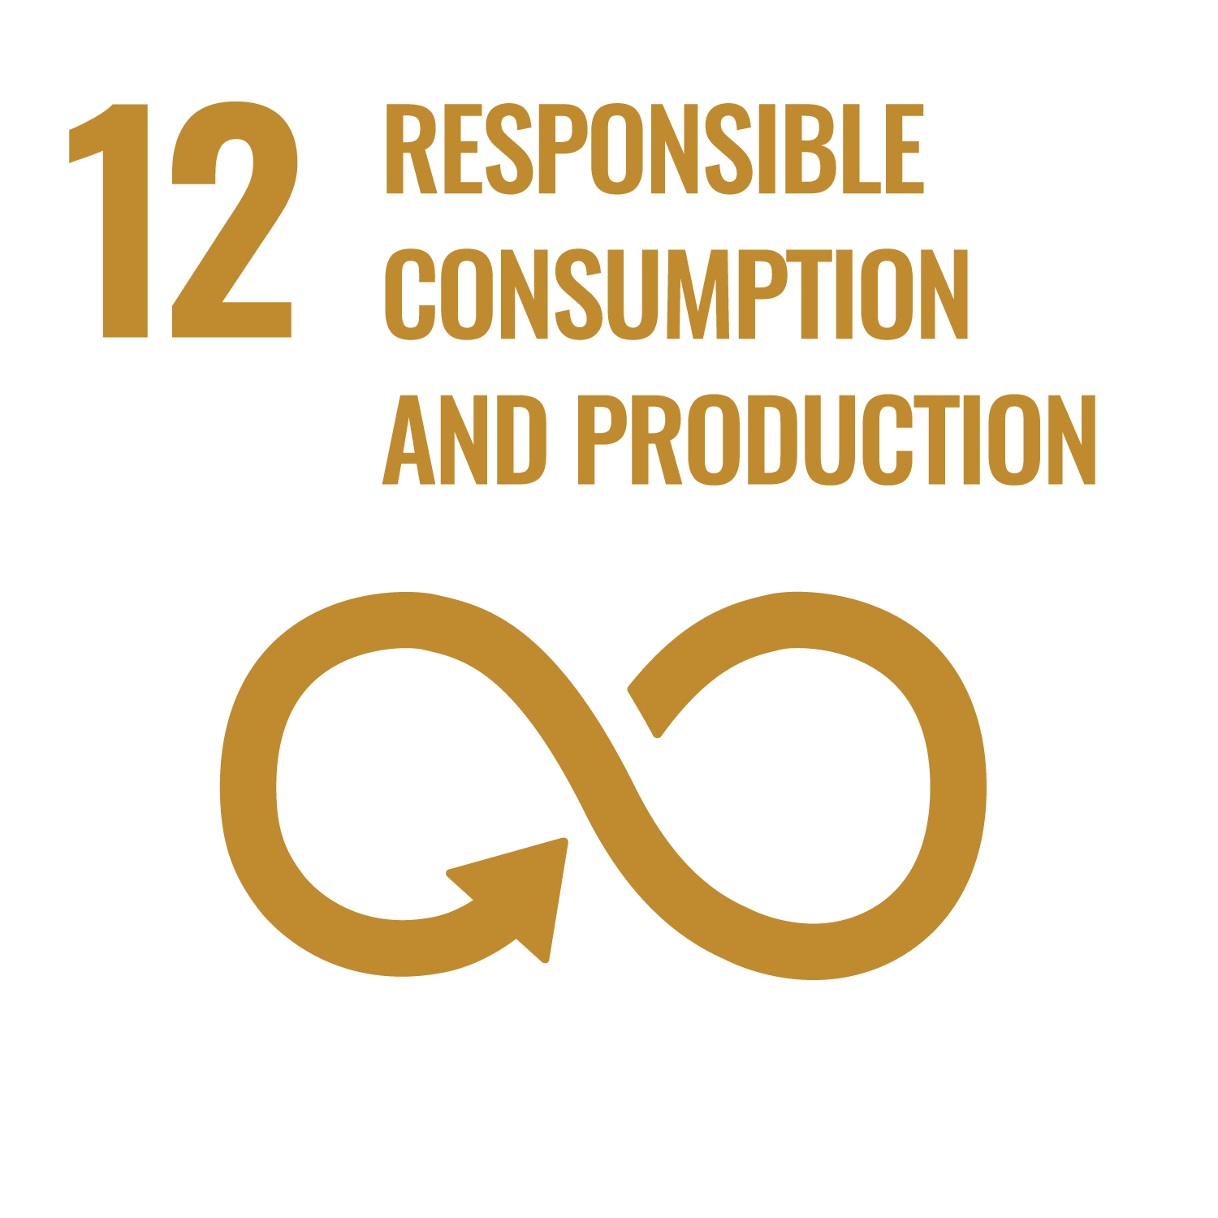
3. Procure sustainably
Why? | How?
71% GHG emissions of the global health sector are associated with the supply chain Consider entire lifecycle including raw material extraction, use of resources in production, transportation and logistics, to end-of-life and disposal | Engage with suppliers and manufacturers Develop a sustainable procurement policy Assess the impact of products and services Explore the potential for collective bargaining. Consider reusables vs single use Buy locally Encourage a plant-based diet in hospitals and meetings Manage waste and hazardous chemicals Develop training in sustainable procurement Training of local staff for basic maintenance of equipment
Linked with SDG 12: the 2019 update has warned that worldwide total and individual material consumption has expanded rapidly, seriously jeopardizing the achievement of the goal.
Notes:
For short presentations, consider removing this slide.
Presenter can reduce slide text based on presenting context
How? Through the following actions:
Engage with suppliers and manufacturers to understand environmentally sustainable product options, global trends, emerging innovations and circular economy standards. Focussing on packaging might be a good first step. Procure items that have been made from recycled content – while the end of life of products is hard to control, we can influence the materials used in the products we buy. Therefore, emphasis should be placed on purchasing items that are made from recycled materials.
• Develop a sustainable procurement policy and embed environmental criteria in the purchasing process including tender specifications, supplier selection and contract management. Buy products, equipment or services that consume less and have a lower environmental impact during their in-use life and at disposal.
• Assessing the environmental impact of products and services. Sustainable health product rankings are available, substitute an existing product or material with an alternative that has less impact on the environment.
• Identify supply chain priority areas. IAPB members collectively spend over US$200 million on procurement per year. Collect and analyse expenditure data, identify and target the highest volume items to maximise buying power as a powerful lever for change.
• Consider reusables vs single use. In recent years the utilisation of single use instruments has increased massively contributing to the global plastic pollution, with medical plastic currently 2% of total plastics production by value23. Increase the focus and value of sanitisation in operations, use reusable items where possible. Where reusables are not practical include effective waste management practices to minimise the impact on healthcare workers, the environment and the community.
• Buy locally. Using high quality local suppliers/distributors presents an opportunity to boost the country’s economy, offering local employment opportunities. This is particularly important for low- and middle-income countries (LMICs). Using local suppliers might result in a decrease in supply chain emissions by reducing GHG emissions associated with transport and increase economic opportunity in the local community.
• Encourage a plant-based diet. Animal agriculture puts a lot of stress on the environment, using many natural resources and producing large amounts of methane, an extremely potent greenhouse gas. The United Nations is one of the most significant ways for individuals and organizations to reduce greenhouse gases. As an organisation, you can take the opportunity to encourage plant-based diets, by ensuring meals that are provided during work events such as conferences, meetings, and training sessions, to be centred around plants.
• Manage assets. As the manufacturing of any new item has a carbon cost, reducing the demand for new items reduces the impact on the environment. Regular preventative maintenance and repair of medical equipment extends its lifetime but is also important to ensure optimal and uninterrupted delivery of services, especially in remote areas, where the delivery of new equipment is more difficult. When equipment has reached its end of life and cannot any longer be maintained and repaired, consider if it could be repurposed or, if that is not possible, recycled.
• Assist procurement teams in working with health staff on the ground. There is a need to close the feed-back loop between procurement, utilisation, maintenance and disposal. Often there is very little or no communication between the procurement team and the health staff on the ground. This makes it difficult for procurers to tailor and review their procurement decisions to the needs of the health staff as procurement staff have limited clinical knowledge. Efficiency opportunities in utilisation are likely to be missed, for example, disposing of eye drops after one use when they could have been used for other patients. Lack of communication encourages unnecessary purchase or renewal of products, increased waste and hampers discussion of alternative solutions.
• Manage waste and hazardous chemicals. Review policies, protocols and practice to minimize the production of healthcare waste. Substitute or minimize products using hazardous chemicals with less hazardous alternatives to reduce costs, consumption and the carbon footprint.
Actions for the Eye Health Community
• Explore the potential for collective bargaining. The combined purchasing power of all IAPB members is considerable. Leveraging purchasing power to understand and engage with manufacturers and suppliers, reduces costs, creates supply chain efficiencies and improves shared environmental sustainability goals and targets to support the circular economy.
• Develop training in sustainable procurement. Informed and capable procurers who are able to embed environmental sustainability into the procurement process are essential. Organisations who have embedded sustainability in their procurement processes could support and train other organisations in doing so.
• Develop case studies in sustainable procurement. Case studies offer very practical illustrations of how projects can be implemented and are an opportunity to celebrate successful achievements. The CAWG page on the IAPB website includes resources and case studies. Organisations who have got case studies to share are encouraged to get in touch with CAWG (https://www.iapb.org/learn/work-groups/climate-action/).
• Develop a toolkit for organisations, which are looking for more information on environmentally sustainable procurement practices. A toolkit in the area could offer a step by step guide in how to implement it.
SDG 12 is actively promoting sustainability consciousness throughout the manufacturing (production) and use (consumption) of goods and/or services across the supply chain. However, the 2019 SDG update has warned that worldwide total and individual material consumption has expanded rapidly, seriously jeopardizing the achievement of the goal. It is asking for urgent action to prevent over extraction of resources or the degradation of environmental resources, and to include policies that improve resource efficiency, reduce waste and mainstream sustainability practices across all sectors of the economy.

Slide 14

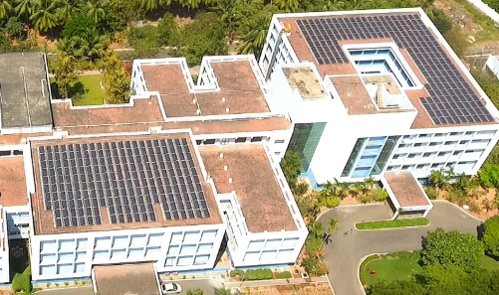
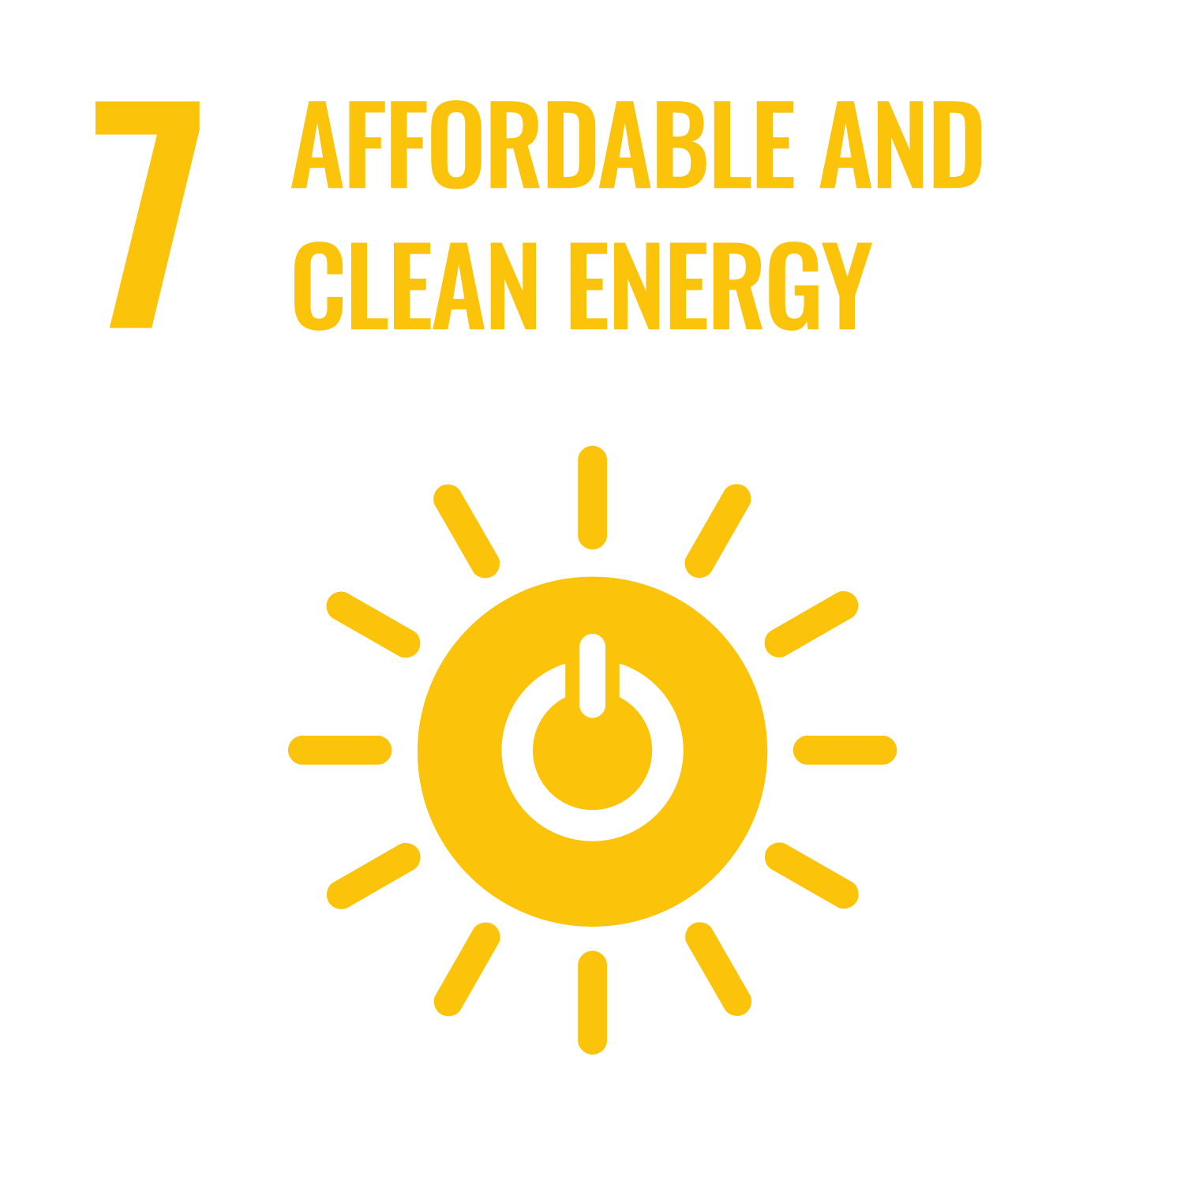
4. Reduce the use of fossil fuels
Why? | How?
Energy used in healthcare facilities contributes to around 25% of healthcare’s global carbon footprint | Minimise electricity consumption through building design energy efficient heating/cooling, lighting, equipment and appliances behaviour change campaigns Procure electricity from a renewable energy provider Where appropriate generate your own electricity through solar
Linked with SDG 7: the renewable energy share of total final energy consumption gradually increased from 16.6% in 2010 to 17.5% in 2016. However, much faster change is required to meet climate goals.
Solar panels on Aravind Eye Hospital, Pondicherry, India
Notes:
For short presentations, consider removing this slide.
Presenter can reduce slide text based on presenting context
How? Through the following actions:
Engage with suppliers and manufacturers to understand environmentally sustainable product options, global trends, emerging innovations and circular economy standards. Focussing on packaging might be a good first step. Procure items that have been made from recycled content – while the end of life of products is hard to control, we can influence the materials used in the products we buy. Therefore, emphasis should be placed on purchasing items that are made from recycled materials.
• Develop a sustainable procurement policy and embed environmental criteria in the purchasing process including tender specifications, supplier selection and contract management. Buy products, equipment or services that consume less and have a lower environmental impact during their in-use life and at disposal.
• Assessing the environmental impact of products and services. Sustainable health product rankings are available, substitute an existing product or material with an alternative that has less impact on the environment.
• Identify supply chain priority areas. IAPB members collectively spend over US$200 million on procurement per year. Collect and analyse expenditure data, identify and target the highest volume items to maximise buying power as a powerful lever for change.
• Consider reusables vs single use. In recent years the utilisation of single use instruments has increased massively contributing to the global plastic pollution, with medical plastic currently 2% of total plastics production by value23. Increase the focus and value of sanitisation in operations, use reusable items where possible. Where reusables are not practical include effective waste management practices to minimise the impact on healthcare workers, the environment and the community.
• Buy locally. Using high quality local suppliers/distributors presents an opportunity to boost the country’s economy, offering local employment opportunities. This is particularly important for low- and middle-income countries (LMICs). Using local suppliers might result in a decrease in supply chain emissions by reducing GHG emissions associated with transport and increase economic opportunity in the local community.
• Encourage a plant-based diet. Animal agriculture puts a lot of stress on the environment, using many natural resources and producing large amounts of methane, an extremely potent greenhouse gas. The United Nations is one of the most significant ways for individuals and organizations to reduce greenhouse gases. As an organisation, you can take the opportunity to encourage plant-based diets, by ensuring meals that are provided during work events such as conferences, meetings, and training sessions, to be centred around plants.
• Manage assets. As the manufacturing of any new item has a carbon cost, reducing the demand for new items reduces the impact on the environment. Regular preventative maintenance and repair of medical equipment extends its lifetime but is also important to ensure optimal and uninterrupted delivery of services, especially in remote areas, where the delivery of new equipment is more difficult. When equipment has reached its end of life and cannot any longer be maintained and repaired, consider if it could be repurposed or, if that is not possible, recycled.
• Assist procurement teams in working with health staff on the ground. There is a need to close the feed-back loop between procurement, utilisation, maintenance and disposal. Often there is very little or no communication between the procurement team and the health staff on the ground. This makes it difficult for procurers to tailor and review their procurement decisions to the needs of the health staff as procurement staff have limited clinical knowledge. Efficiency opportunities in utilisation are likely to be missed, for example, disposing of eye drops after one use when they could have been used for other patients. Lack of communication encourages unnecessary purchase or renewal of products, increased waste and hampers discussion of alternative solutions.
• Manage waste and hazardous chemicals. Review policies, protocols and practice to minimize the production of healthcare waste. Substitute or minimize products using hazardous chemicals with less hazardous alternatives to reduce costs, consumption and the carbon footprint.
Actions for the Eye Health Community
• Explore the potential for collective bargaining. The combined purchasing power of all IAPB members is considerable. Leveraging purchasing power to understand and engage with manufacturers and suppliers, reduces costs, creates supply chain efficiencies and improves shared environmental sustainability goals and targets to support the circular economy.
• Develop training in sustainable procurement. Informed and capable procurers who are able to embed environmental sustainability into the procurement process are essential. Organisations who have embedded sustainability in their procurement processes could support and train other organisations in doing so.
• Develop case studies in sustainable procurement. Case studies offer very practical illustrations of how projects can be implemented and are an opportunity to celebrate successful achievements. The CAWG page on the IAPB website includes resources and case studies. Organisations who have got case studies to share are encouraged to get in touch with CAWG (https://www.iapb.org/learn/work-groups/climate-action/).
• Develop a toolkit for organisations, which are looking for more information on environmentally sustainable procurement practices. A toolkit in the area could offer a step by step guide in how to implement it.
SDG 12 is actively promoting sustainability consciousness throughout the manufacturing (production) and use (consumption) of goods and/or services across the supply chain. However, the 2019 SDG update has warned that worldwide total and individual material consumption has expanded rapidly, seriously jeopardizing the achievement of the goal. It is asking for urgent action to prevent over extraction of resources or the degradation of environmental resources, and to include policies that improve resource efficiency, reduce waste and mainstream sustainability practices across all sectors of the economy.

Slide 15

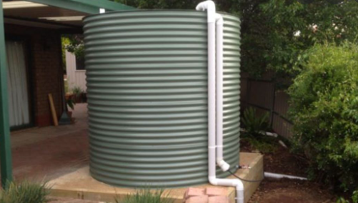
5. Conserve water
Why? | How?
50% of health-care facilities lack access to piped water Insufficient water management has a deleterious impact on health | Minimise water use Reuse water - explore the collection and use of rainwater and grey water cycling Monitor pipes and taps to minimise leakages Invest in effective wastewater treatment
Notes:
For short presentations, consider removing this slide.
Presenter can reduce slide text based on presenting context
How? Through the following actions:
- Minimise water use. In new builds or when refurbishing, install water saving devises such as low flow taps, toilets and fixtures. Consider taps which reduce water use through the way they are operated. For example, a study in the UK has shown that leg operated taps used at scrub sinks use less water than elbow operated taps26. The use of automated taps can also save water.
• Reuse water. Explore the collection and use of rainwater and grey water cycling at your healthcare facility.
• Monitor pipes and taps. Monitor pipes, taps, toilets and other fixtures for leakages. When leakages occur, repair them quickly.
• Invest in effective wastewater treatment. Specially constructed wetlands like at Aravind Eye Hospital in Pondicherry, India, might be a solution for effective wastewater treatment for LMICs.27Such actions may also be critical for protecting local communities from hospital effluent flows.

Slide 16
6. Reduce and safely dispose of waste
Why? | How?
Healthcare waste treatment and disposal can pose direct risks to health Although 85% healthcare waste is non-hazardous, its disposal still has an impact on the environment e.g GHG emissions produced by biodegradable waste in landfill are especially high | Where possible adopt a circular approach. Follow the waste hierarchy ‘reduce, reuse, repair, recycle’ Make waste disposal at your healthcare facility easy Consider for your local context the most appropriate option for safe disposal of hazardous medical waste
Linked with SDG 12: is advocating for environmentally sound management of chemicals and all wastes throughout their life cycle, to significantly reduce air, water and soil pollution, minimizing their adverse impacts on human health and the environment..
Notes:
For short presentations, consider removing this slide.
Presenter can reduce slide text based on presenting context
How? Through the following actions:
Where possible adopt a circular approach. For example, see if it is possible for suppliers not only to provide your items but to also collect them for recycling, providing a closed loop solution
• Follow the waste hierarchy ‘reduce, reuse, repair, recycle’:
- Explore if there are opportunities to reduce the use of healthcare products and/ or the disposal of unused products.
- Consider if items, e.g. medical instruments, can be reused; multi-dosed, e.g. in the case of eye drops, could they be used on other patients; or sent home with patients, e.g. in the case of medication can patients take medication prescribed during their stay at a healthcare facility home if they need to continue taking it once discharged.
- Explore if items can be repaired when damaged - the number of skilled medical equipment technicians is increasing in many LMICs.
- If items need to be disposed of, find out if there are reprocessing or recycling options.
• Make waste disposal at your healthcare facility easy. Introduce classification, waste reduction, reuse and recycling procedures for non-hazardous waste. Ensure there are enough bins for each waste stream, that the bins are labelled well, colour coordinated and are easily accessible for everyone, including people with visual and physical impairment. At every bin station there should be a separate bin for each waste stream giving the user the option to recycle
• Consider for your local context the most appropriate option for safe disposal of hazardous medical waste applicable to your local amenities. Can access to a modern incinerator operating at 850-1100 °C and fitted with special gas-cleaning equipment be secured? Would there be other options, e.g. autoclaving, microwaving, steam treatment integrated with internal mixing to treat medical waste? Are there sufficient resources to operate and maintain any of these solutions?
• Use and adapt existing guidelines to improve the management of medical and solid waste (for example “Green Hospital checklist” of the “Smart Hospital Initiative” of the Pan-American Health Organization).29
SDG 12 Responsible Consumption and Production
SDG 12 is advocating for environmentally sound management of chemicals and all wastes throughout their life cycle, to significantly reduce air, water and soil pollution, minimising their adverse impacts on human health and the environment.
It is also actively promoting prevention and reduction in waste generation, encouraging waste recycling and reuse.

Slide 17

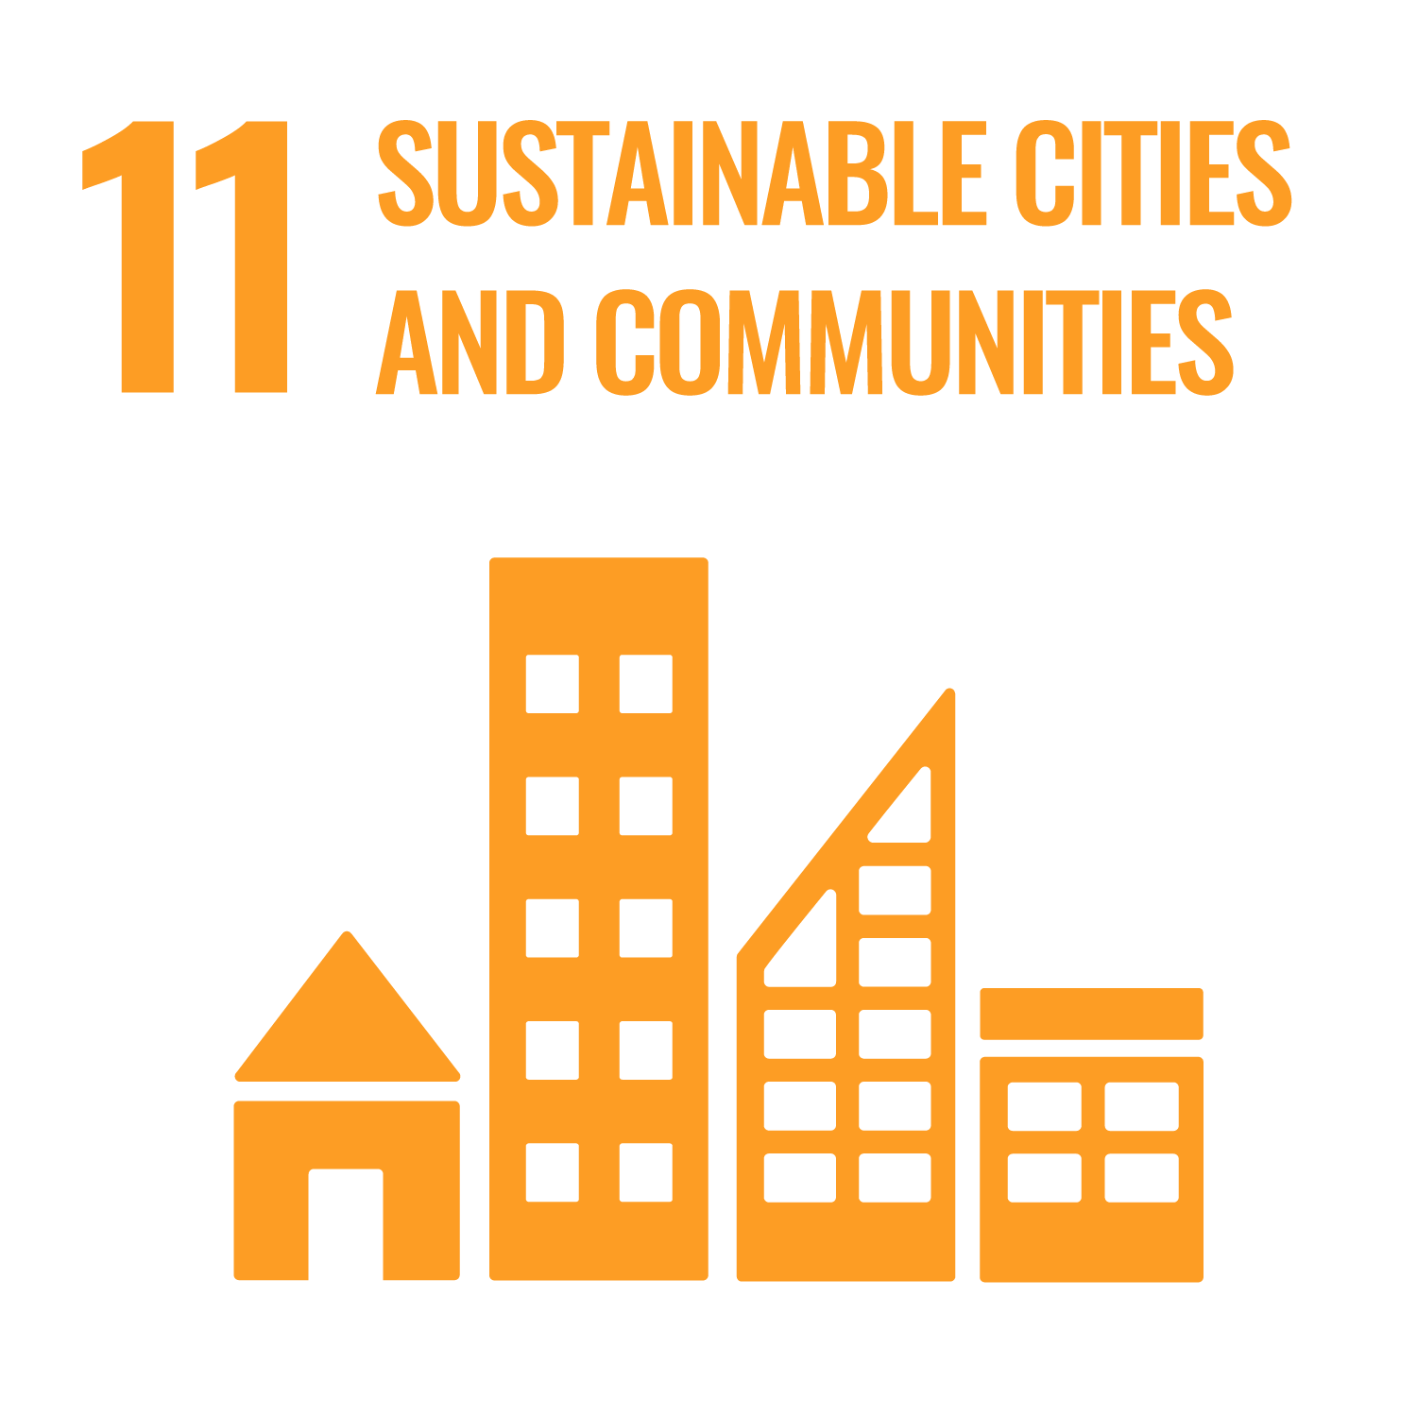
7. Reduce and green the travel
Why? | How?
Transport – business travel, operational transport and supply chain logistics – contributes globally 7% to healthcare’s carbon footprint Generally, healthcare facilities, especially bigger, high-volume hospitals, generate a huge amount of traffic | Question the necessity of journeys e.g. COVID-19 has prompted us to connect with others with reduced travel Consider video conferencing as an alternative Consider tele-medicine where possible Consider opportunities for active travel and public transport Consider options for reducing the number of journeys Advocate for better public transit in urban areas Conduct a commuter survey to ascertain how staff travel to the office
Linked with SDG 11: In 2016, 9 in 10 people living in urban areas still breathed air that did not meet the World Health Organization’s air quality guidelines for particulate matter
Notes:
For short presentations, consider removing this slide.
Presenter can reduce slide text based on presenting context
Generally, healthcare facilities, especially bigger, high-volume hospitals, generate a huge amount of traffic.30 This needs to be considered during the planning phase when constructing a new hospital, for example, how will the hospital be connected to existing public transportation systems, are there sufficient and secure parking lots for bicycles to encourage cycling, etc.
For NGOs flying for work often feels unavoidable. Visiting projects and partners across the world and networking at conferences are important. Covid-19, closure of international borders and disruption of air travel has forced organisations worldwide to suspend routine travel, and instead utilise digital technologies for meetings and programme management. Organisations should use this time to reset their expectations and attitudes around travel. Starting to question the necessity of travel can be a first step. Some face to face visits, meetings and conferences are already being held virtually. Digital technologies like video conferencing have greatly improved over recent years.
How? Through the following actions:
Question the necessity of journeys. This should become part of the organisation’s culture. While some travel may be necessary, reductions can generate significant savings and reduce emissions.
• Consider video conferencing as an alternative to face to face meetings. Ensure that your internet connection and video conferencing facilities are of reasonable quality.
• Consider opportunities for active travel and public transport. If you are operating in an urban area, consider if bicycles or public transport offer a more effective way of delivering services. Encourage your employees to take active or public transit modes to commute to work.
• Consider if the emissions of your fleet can be reduced. Explore if there are opportunities for vehicles which use less carbon intensive fuels. Also, consider the use of motorcycles where appropriate.
• Consider options for reducing the number of journeys by:
- Maximising the number of seats installed in patient transport vehicles
- Maximising the number of patients safely transported each journey
- Designing services to reduce the number of visits to complete the care cycle where appropriate; for example, offer one stop clinics
- Train primary health staff to treat primary eye disease in the community, offering appointments at centres closer to patients’ homes
- Using technology like tele-medicine, apps to reduce the number of face to face appointments (multiple options – individual’s phones, a clinic linked to a tertiary center, etc).
The latter three options not only reduce the environmental impact, but also lessen the pressure on staff. This is an important consideration as shortages in human resource is often a problem in health service delivery in LMICs.
• Advocate for better public transit (active transit) in urban areas.
• Conduct a commuter survey to ascertain how staff travel to the office. This will highlight means of travel, distances covered, and any barriers staff may have regarding travel.
• For unavoidable travel, consider a carbon offsetting scheme or create a travel levy green fund. If air travel cannot be avoided, pay into a quality assured carbon offsetting scheme or create a travel levy green fund
SDG 11 Sustainable Cities and Communities
Though none of the SDGs mentions active travel, SDG 11 has set targets for the expansion of public transport and the improvement of air quality. However, SDG 11’s update of 2019 states that the proportion of urban residents who have convenient access to public transport remains low, particularly in developing countries. In some regions with low access to public transport, informal transport modes in many cases provide reliable transport for the majority of urban populations.
It also reports that in 2016, 9 in 10 people living in urban areas still breathed air that did not meet the World Health Organization’s air quality guidelines for particulate matter and that more than half of the world population experienced an increase in particulate matter from 2010 to 2016.

Slide 18

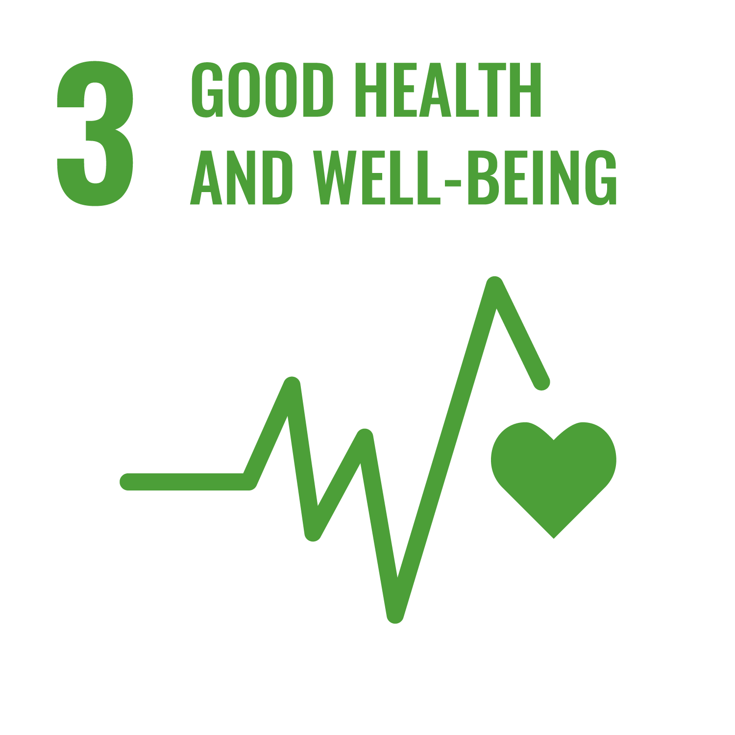
8. Follow the 4 principles of sustainable clinical practice
What? | How?
Sustainable clinical practice is underpinned by four principles Disease prevention and health promotion Patient education and patient empowerment Lean service delivery Preferential use of medical technologies with lower environmental impact | Support, promote and/or implement prevention programmes Review opportunities for engaging patients in their own treatment Review your service delivery models Review medical technologies Support, promote and/or implement plant-based diets which are important for general health
Linked with SDG 3: is advocating to end epidemics of communicable diseases by 2030, halve the number of deaths and injuries from road traffic accidents by 2020, and achieve universal health coverage.
Notes:
For short presentations, consider removing this slide.
Presenter can reduce slide text based on presenting context
What?
1. Disease prevention and health promotion. There are clear links between people’s living environments and their health, including eye health. If eye health professionals can help prevent eye disease early on, demand for secondary and tertiary eye care, which tend to have a higher impact on the environment than primary care, will be reduced.
2. Patient education and patient empowerment. To reduce disease progression and pre-empt complications, many patients should feel empowered to take on a greater role in the management of their own health and healthcare. Patient education and empowerment are effective ways to increase compliance with treatment and pathways management and thus preserve sight.
3. Lean service delivery. Reviewing clinical pathways in eye health will help to identify and reduce low value activities, for example, unnecessary blood or diagnostic tests, and their associated environmental impacts. Eye health professionals can support this by describing the relevant patient pathways and providing clear, evidence-based guidance.
4. Preferential use of medical technologies with lower environmental impact. Inclusion of environmental sustainability criteria in the evaluation of medical technologies will allow service planners, clinicians and patients to choose clinically effective products and technologies with the best environmental profile
How? Through the following actions:
- Support, promote and/or implement prevention programmes which are vital for eye health, for example, nutrition, clean water, environmental improvement, immunisation, vitamin A supplements, diabetes support.
• Review opportunities for engaging patients in their own treatment. Develop guidelines how best to involve patients in their own treatment and share with your team.
• Review your service delivery models. Describe your clinical pathways and review its evidence base. Reduce activities which do not add any value to patient outcomes or ease of delivery. If necessary, and based on evidence, re-design the clinical pathway.
• Review medical technologies. Discuss with your procurement team to help identifying technologies which maximise health outcomes but minimise the environmental impact.
• Support, promote and/or implement plant-based diets which are important for general health. In addition, diets are the main determinant of greenhouse gas emissions, with the highest emissions found in diets high in meat and dairy, and lowest emissions for diets that are plant-based.
SDG 3 Good Health and Wellbeing
Amongst others and linked to eye health, it is the target of goal 3 to end epidemics of communicable diseases by 2030, halve the number of deaths and injuries from road traffic accidents by 2020, and achieve universal coverage including access to quality essential healthcare services and access to safe, effective, quality and affordable medicines and vaccines.
However, progress is slow. Half the global population still does not have access to essential health services.

Slide 19

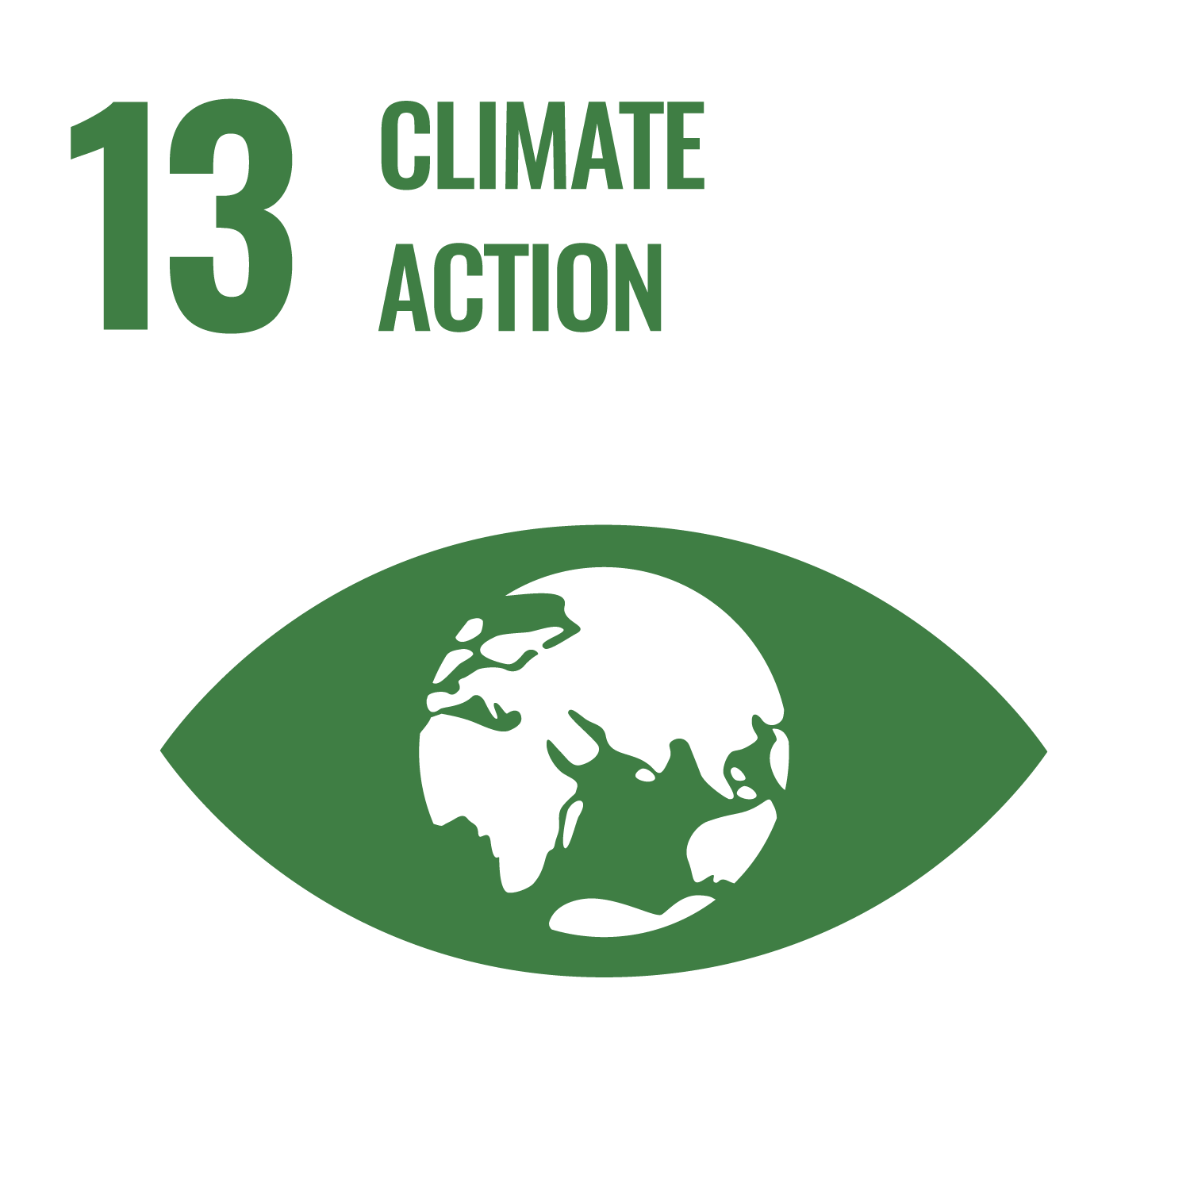
9. Embed environmental sustainability in education
Why? | How?
Climate action/ environmental sustainability in healthcare is an emerging concept Is a holistic approach to medical care | Embed environmental sustainability in education training programmes Promote resources of environmental sustainability in eye health Make every event count. Develop training programmes and e-learning Continuing professional development in eye health Set up environmental or sustainability working groups within your organisation
Linked with SDG 13: Training and education in all key areas of sustainability in healthcare will be vital to support eye health organisations and providers to meet the public health challenge climate change poses.
Notes:
For short presentations, consider removing this slide.
Presenter can reduce slide text based on presenting context
How? Through the following actions:
- Embed environmental sustainability in education training programmes. It is the mission of international and regional bodies like the International Council of Ophthalmology (ICO), World Council of Optometry (WCO), the College of Ophthalmology of Eastern Central and Southern Africa (COECSA) and the West African College of Surgeons to enhance ophthalmic education and education in optometry to improve eye care and contribute to the preservation and restoration of vision around the world. As part of their commitment, they develop curricula and offer initiatives to strengthen education in eye care, especially in low income countries. Their mission and global reach offer a unique opportunity to embed environmental sustainability and climate action in their educational programmes.
• Promote resources of environmental sustainability in eye health. Websites of many eye health organisations, like the IAPB or its members, include resources to help their communities improve their services. Information, toolkits and guidance on environmental sustainability in eye health can be made available on the websites to reach their global community. Be sure to build understanding of the links between good eye health and the environments in which adults and children live, work and go to school.
• Make every event count. Conferences, summits and workshops offer opportunities and have huge global reach. These events can be used to raise awareness about climate change and eye health and share ideas how to address the issue. The events should demonstrate environmental practices. Integrate climate change education into the curricula at health professional schools, residencies . Teach all OR personel about the "triple bottom line" and waste management.
• Develop training programmes and e-learning. There is a need to develop training programmes in all areas of sustainable eye health and care. This can be in the form of face to face trainings, but also online platforms. E-learning has the benefit of being more accessible for busy clinicians and hospital management as it can fit around their timetable and can be done from any location. It also has the potential to reach a wider audience.
• Continuing professional development in eye health: There is a need to offer a training programme to eye health professionals on how to embed environmental sustainability when working on quality improvement programmes in eye care.
• Set up environmental or sustainability working groups within your organisation to serve as a platform for initiating education campaigns, behaviour change and harnessing staff passion in combating climate change.
SDG 13 Climate Action
It is one of the targets of SDG 13 to improve education, awareness-raising and human and institutional capacity on climate change mitigation, adaptation, impact reduction and early warning. Training and education in all key areas of sustainability in healthcare will be vital to support eye health organisations and providers to meet the public health challenge climate change poses

Slide 20

10. Focus your research
Why? | How?
Research into environmental sustainability in healthcare is still in its infancy, particularly in eye care. E.g. research indicates Manual Small Incision Cataract Surgery has a lower carbon footprint than Phacoemulsification More data is required for evidence based interventions | Conduct more research in environmentally sustainable eye care practices Hot topics for further research include Surgical techniques Reusables versus single use New service delivery modules and climate resilient infrastructure Existing research evidence on the extent and nature of environmental impacts of health services
Notes:
For short presentations, consider removing this slide.
Presenter can reduce slide text based on presenting context
Why?
Morris et al estimated that the carbon footprint of cataract surgery by phacoemulsification in the UK is 182 kgCO2eq33, whereas Thiel et al found that the same surgery in India releases 6 kgCO2e.34 To get a better understanding of the global variation of the carbon footprint of cataract surgery and to reduce the GHG emissions associated with it, the Eyefficiency tool was developed. It not only facilitates the benchmarking and improvement of the carbon footprint of cataract surgery, but also its productivity and cost. Improving productivity will help in meeting demand in global cataract surgery
How? Through the following actions:
1. Manual Small Incision Cataract Surgery (MSICS) versus Phacoemulsification (Phaco). The results of the Eyefficiency beta testing phase at ten sites across the world and of other studies35 indicate that MSICS is less expensive, less technology dependent and might be faster than phacoemulsification while clinical outcomes are similar. The Eyefficiency tool also suggests that MSICS has a lower carbon footprint than Phacoemulsification. However, the sample size of the beta-testing phase was very small. Considering the potential of MSICS higher productivity in low resource setting, research into the greenhouse gas emissions variation between MSICS and Phaco will help in evaluating their different environmental impacts.
2. Reusables versus single use. In recent years the use of single use medical items has increased hugely contributing to the global plastic pollution of water, soil and air, with medical plastic currently 2% of total plastics production by value.36 The manufacturing and disposal of medical plastic products, which are made of fossil fuels and often incinerated as medical waste, release greenhouse gas emissions. However, single use items are very convenient, as they are disposed of after use, whereas reusables will need to be cleaned, sterilised and stored until next use. These processes also cause GHG emissions. Different regional contexts will require different choices. Research into the environmental impact of the manufacturing, use and disposal of single use versus reusable instruments in high and low resource settings would be hugely beneficial to advance the discussion if the use of single use or reusable medical items leads to less GHG emissions.
3. New service delivery modules and climate resilient infrastructure. Research into the environmental, social and financial impact of new service delivery modules, like one-stop clinics, teleclinics, or simultaneous bilateral surgeries, in low and high resource settings will help to understand the full cost and trade-offs of service provision and to choose the most appropriate, maximising clinical outcomes while minimising costs. Evaluation and analysis of climate resilient eye health infrastructure can generate useful case studies and learnings to promote sustainable practices.
4. Existing research evidence on the extent and nature of environmental impacts of health services. While direct research into climate change and eye health may be limited, there is a growing body of evidence on the broader impacts of climate on health and health care providers, and associated mitigation strategies. Reviewing existing resources from health and environmental bodies can address critical knowledge gaps and strengthen recommendations for environmental sustainability.
Photo

Slide 21
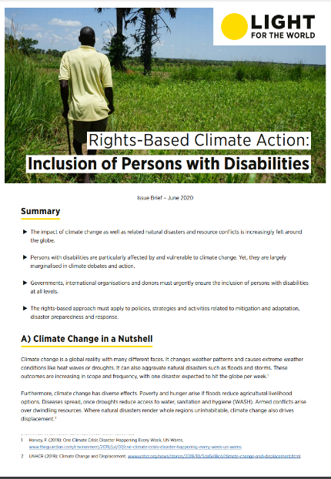




Case Study 1: KAA 1 - Lead
Issue: Organisational recognition of climate emergency
Action: Organisation wide steps:
    Environmental impact assessment at project sites
    Action plan developed (short and long term)
    Implementation of Environment Policy
    Internal working group
    Publication of brief on ‘Climate Change and Disability’
Key learnings
Input from experts
Implement step by step
Setting targets
Committed CEO
Get buy-in from colleagues
‘Burn for it’
Notes:
KAA = Key action area
Issue: Organisational recognition of climate emergency
Action: Several steps were taken organisation wide:
Conducted environmental impact assessment with partners on project sites
Developed and implemented an Environment Policy (included recommendations to improve current sites)
Established an internal working group
Published an issue brief on ‘Climate Change and Disability’

Slide 22
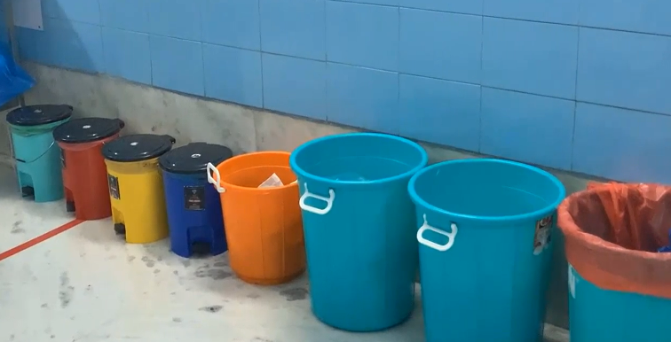
Case Study 2: KAA 6 - Reduce and safely dispose of waste
Issue: Operation theatre waste
Action:
  Colour coded biohazard waste bins placed
  Separate colour coded bins for recyclable waste installed
  Waste sent to waste storage room
  Waste processed appropriately (eg weekly recycling is collected)
Colour coded waste bins at Aravind Eye Hospital, Pondicherry, India

Slide 23

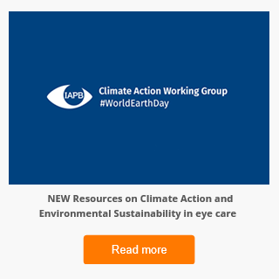
Case Study 3: KAA 9 Embed environmental sustainability in education
Issue: Building staff awareness on environmental sustainability and actions
Action:
  Established Sustainability Working Group
  Developed 'green office guides’
  Developed policy and procedures for sustainability, e.g. in procurement
  Internal blogs and knowledge sharing events

Slide 24

Lessons from case studies
It is not an all or nothing initiative​: individuals and organizations
can make efforts according to their capacity
Small changes can catalyse larger changes
Small changes can make a big impact
Be hopeful, that with action we can do our bit to address climate change
Eye health programmes can become environmentally sustainable – we are all accountable

Slide 25



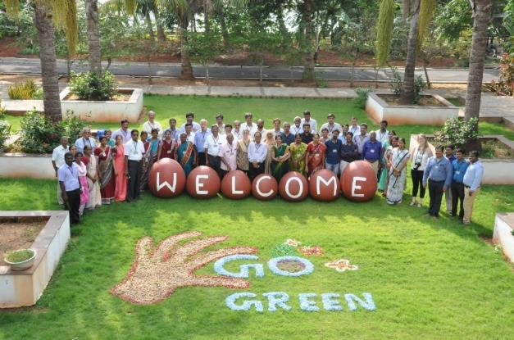
Going forward
Get informed
Get involved
Download the Guide for more information (iapb.org)
Join the IAPB mailing list – alerts for key events and resources
Join the Communities of Practice
Join IAPB’s Climate Action Working Group
Photo: Aravind Eye Hospital

