Slide 1
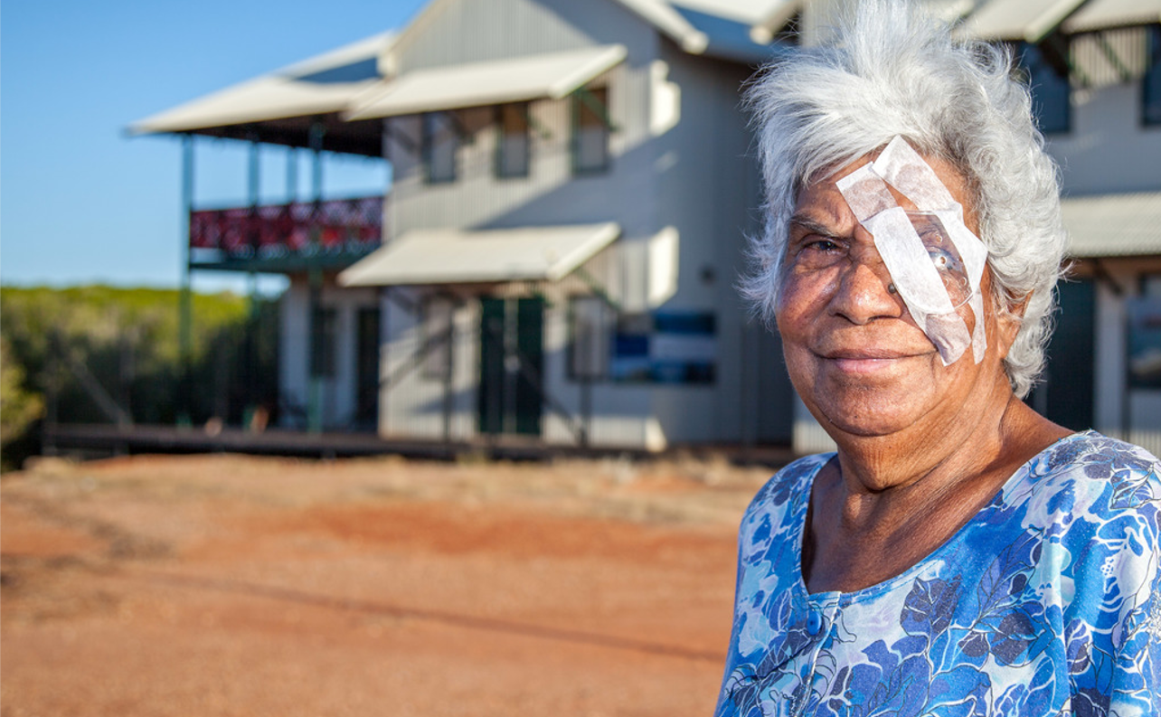
IMPACT OF COVID-19 on DIABETIC RETINOPATHY INITIATIVES
Photographer: Daniel Jesus Vignoli
A snapshot from the IAPB DR Work Group networks
May 2021
Presented by Fabrizio D’Esposito

Slide 2
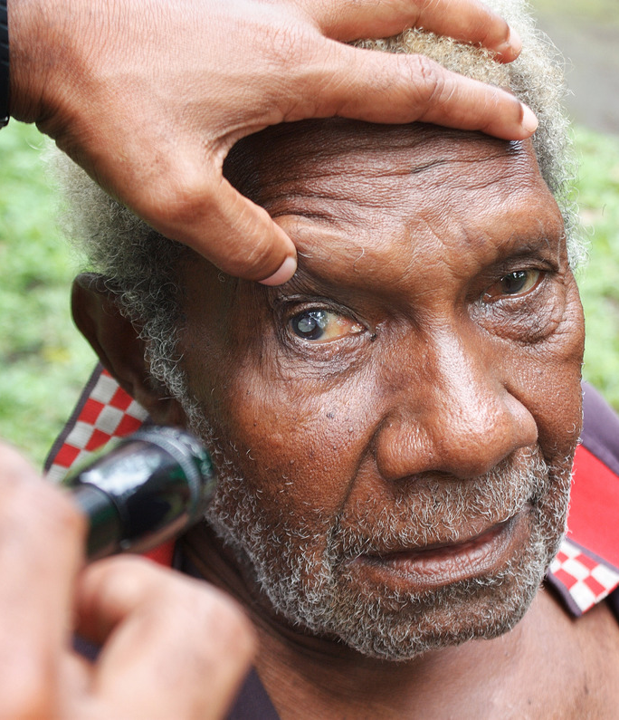
WHY DID WE DO THIS SURVEY?
To provide a quick snapshot of the changing situation for the implementation of diabetic retinopathy (DR) initiatives
Obtain insights of the impact of the pandemic on these initiatives and help the sector’s advocacy efforts
Photographer: Fabrizio D’Esposito

Slide 3
RESPONDENTS
Twenty responses
Excellent geographical spread
Half of respondents from organizations involved in direct delivery of DR services

Slide 4
IMPACT OF COVID-19 ON DR INITIATIVES
Virtually everyone, across geographies and types of organizations, was affected
Sixty percent or more of DR initiatives were either reduced or stopped completely

Slide 5
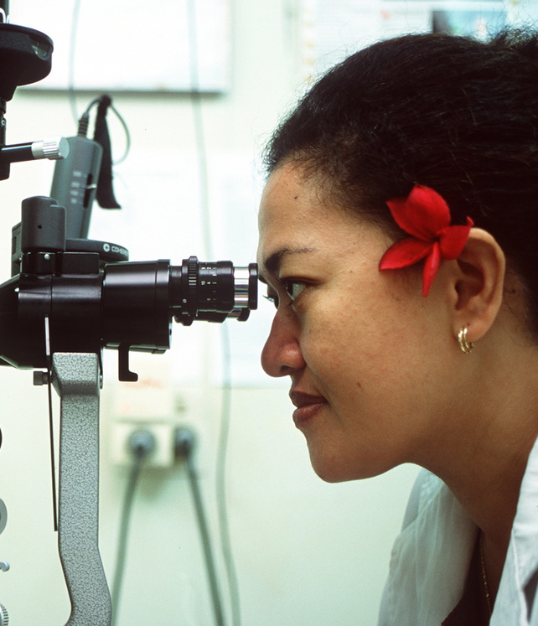
COVID-19 Perpetuating inequalities
Elderly patients with multi-morbidities the most impacted by changes in DR services
Remoteness and low socio-economic status also an important factor in reduced access to services
Healthcare workers at all levels of the health systems also most affected
Photographer: Sandy Scheltema

Slide 6

An intricate web of challenges
Linking communities with care faced with two-way transport challenges
New challenges associated with procurement of equipment and drugs
Increased administrative burden associated with shifting targets and related reporting
Increasingly challenging to secure funding for eye health initiatives
Photographer: Paul Zhang

Slide 7
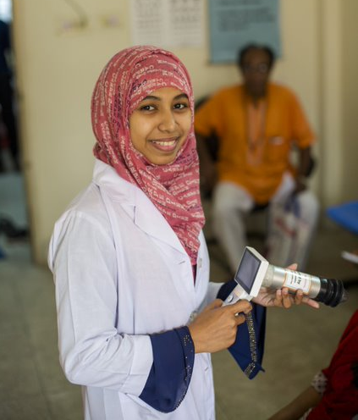
An intricate web of challenges (continued)
Pivoting services towards COVID-19 response important, but difficult
Contagion anxiety in patients and providers
A vicious cycle that precipitates the (eye) health of the most needy
… but also, some great opportunities arising from all these challenges.
Photographer: Michael Amendolia

Slide 8
It’s far from over
Seventy percent or more of DR initiatives either still most affected or still below pre-pandemic levels
A small proportion of initiatives have returned to pre-pandemic levels
Some initiatives have seen an increase compared to pre-pandemic levels

Slide 9
BUILDING RESILIENCE FOR A BETTER FUTURE
The introduction of teleophthalmology and management of patient flow were common strategies to retain services
Task shifting complex, but potentially important to provide resilient services
Increased reliance on non-face-to-face channels for communication
Strategies needed to meet increased demand post-pandemic

Slide 10
THANK YOU

