Slide 1

INTEGRATED
PEOPLE-CENTRED
EYE CARE

Slide 2
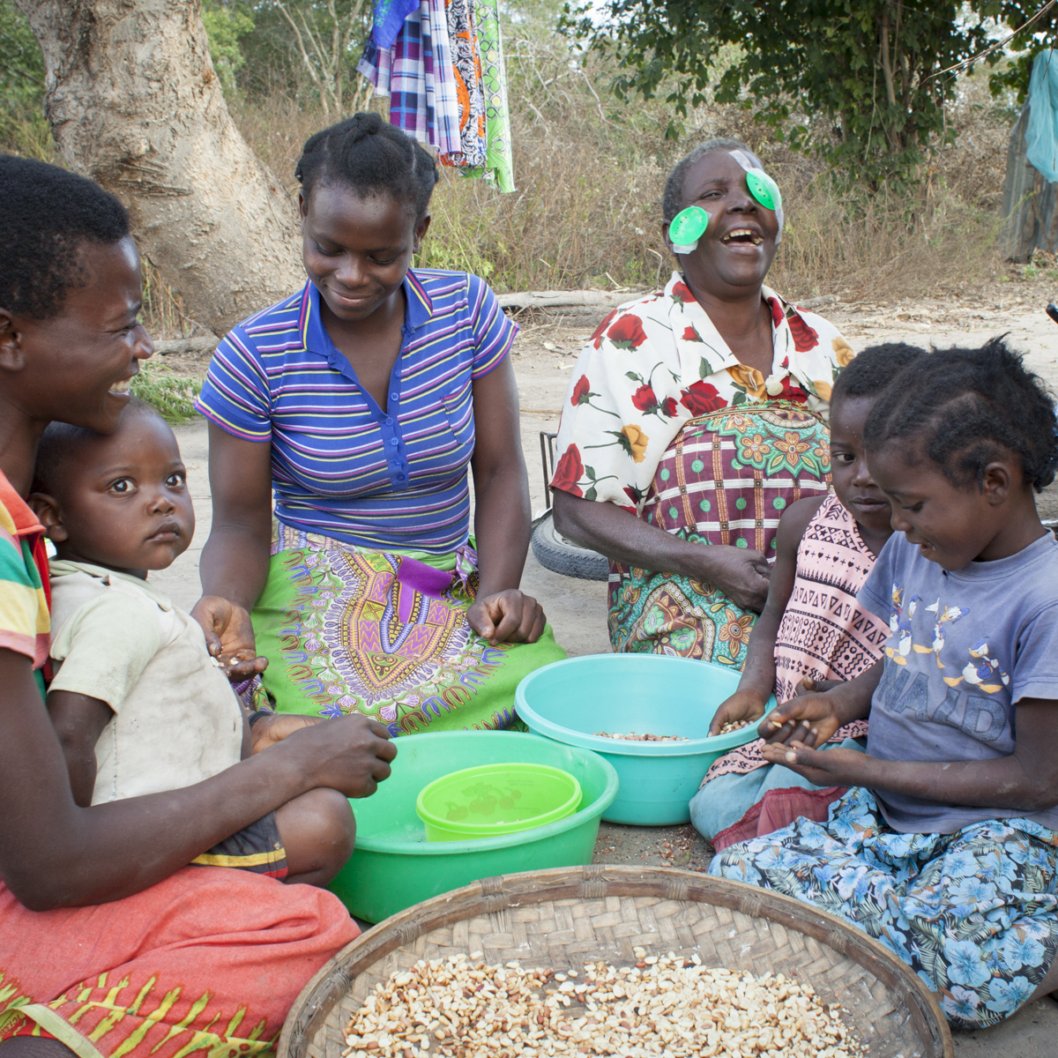
Challenges
Over 1 billion people
worldwide do not have access
to the eye care that they need
Without change, this will rise to
1.8 billion people by 2050
Photo Credit: Ulrich Eigner for IAPB WSD Photo Competition

Slide 3
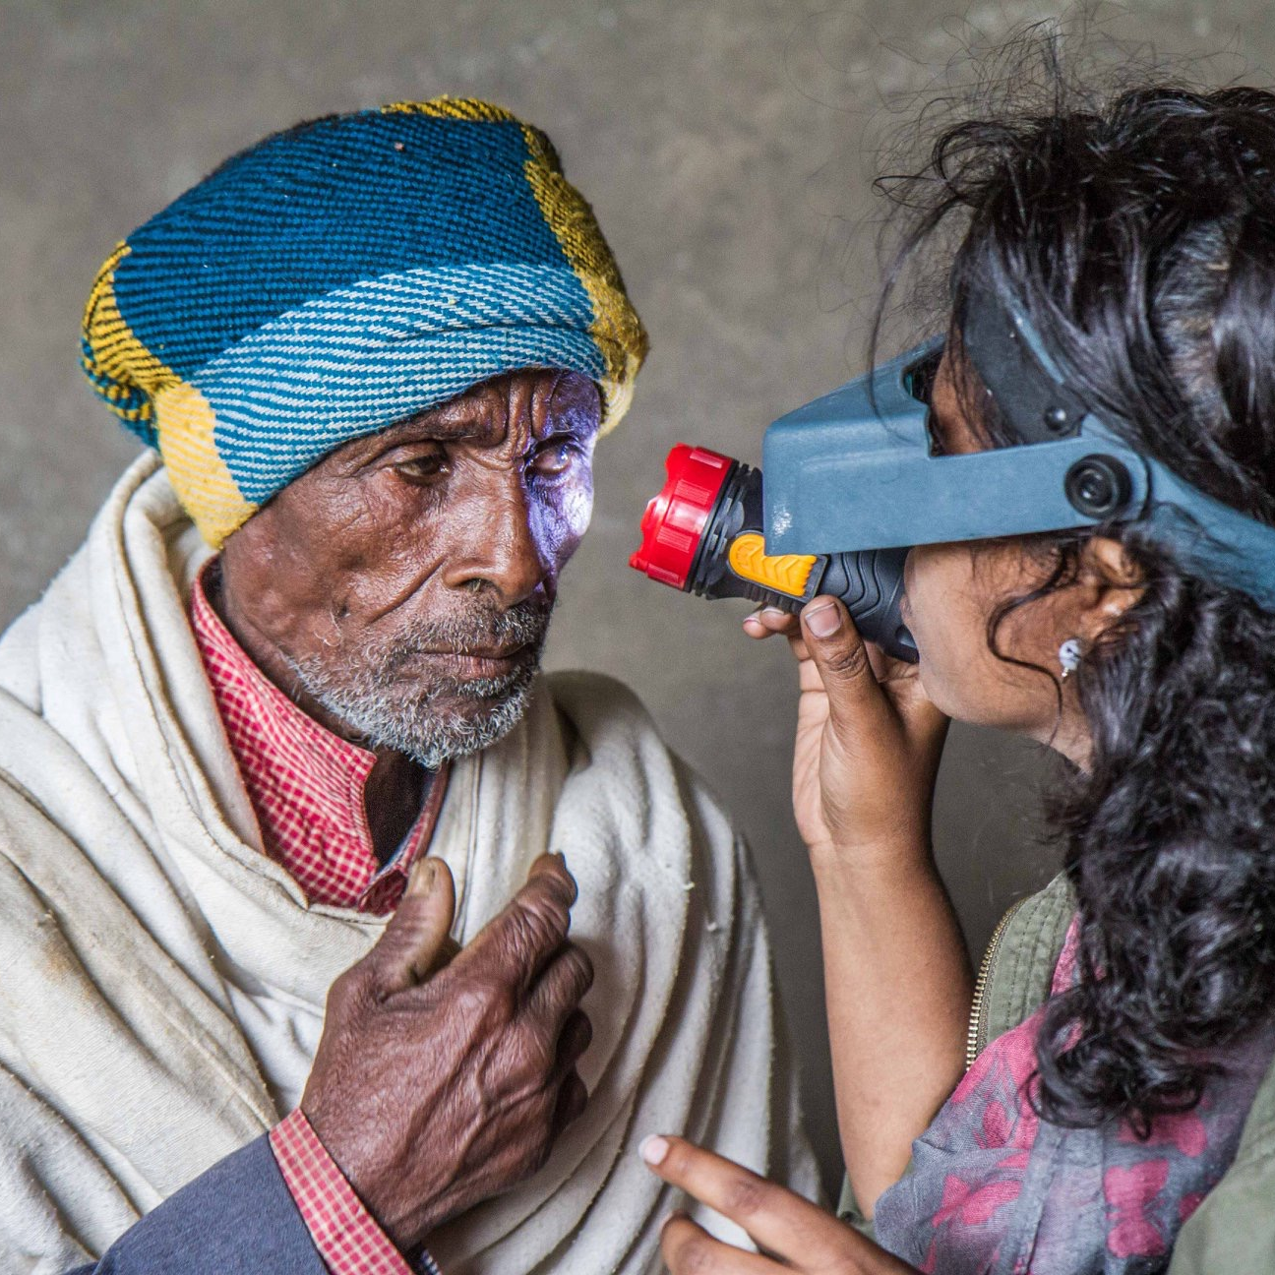
Challenges contd..
Changing demographics and lifestyles
inflating demand
Inadequate government prioritisation
Fragmented and verticalized eye care services, poorly integrated into health systems
Inequities in access
Understated promotive, preventive and rehabilitative aspect of eye care services
Insufficient and uncoordinated workforce
Lack of resources and financial protection
Gaps in data
Photo Credit: Ellen Crystal for IAPB WSD Photo Competition

Slide 4
IPEC Advocacy Landscape
World Report
on Vision, 2019
WHA 73.4,
2020
74 WHA,
2021
UN GA resolution
on vision, 2021
Launched by WHO in 2019
Recommend four strategies for implementation of IPEC
‘Integrated people-centred eye care, including preventable vision impairment and blindness’
Urges member States to make eye care an integral part of UHC and to implement people-centred eye care in health systems.
Recommended IPEC global targets for 2030
40% point increase in effective coverage of refractive error
30% point increase in effective coverage of cataract surgery
‘Vision for Everyone, accelerating action to achieve the Sustainable Development Goals”
Eye health championed as a major component in achieving SDGs
Recommends countries to adopt a whole of government approach to eye care

Slide 5
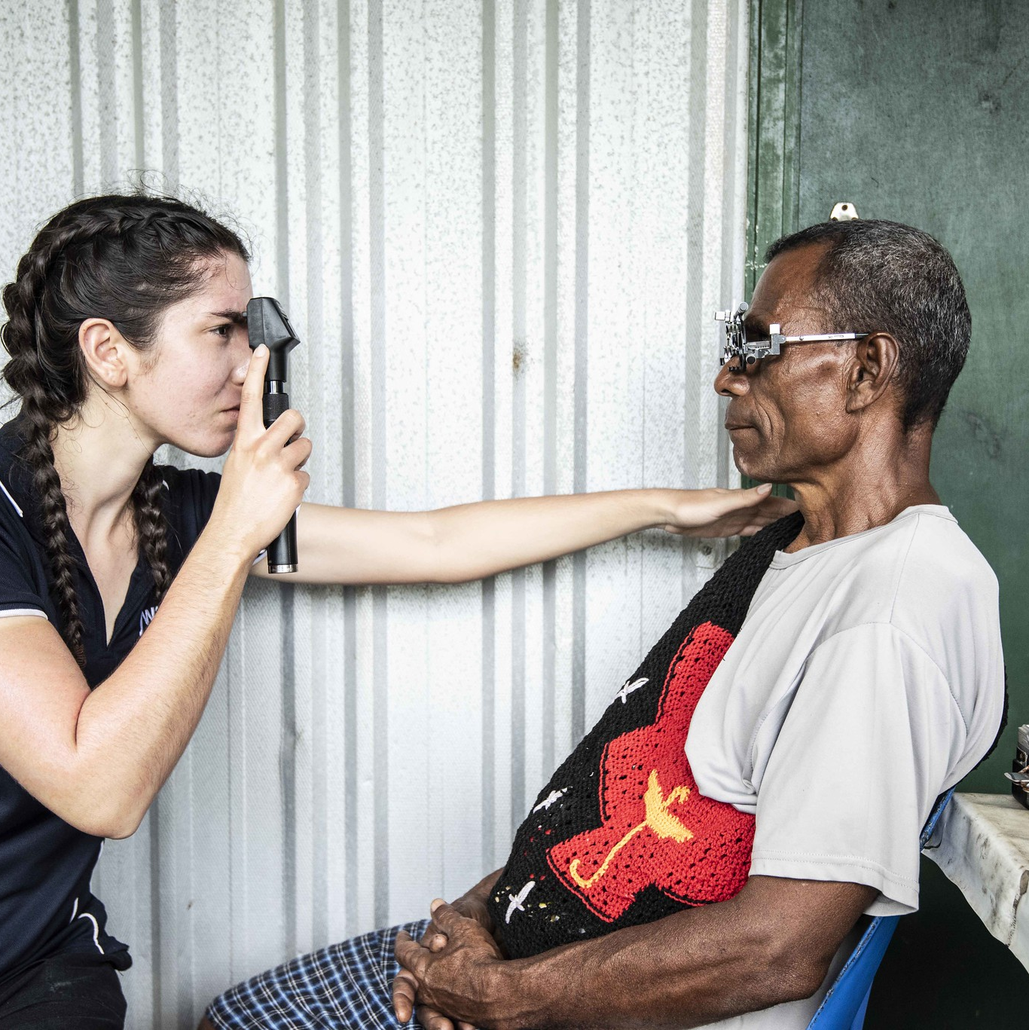
World Report on Vision -
Strategic Framework on IPEC
Make eye care an integral part of Universal Health Coverage
Implement Integrated
People-centred Eye Care in health systems
So that all people have access to the eye care they need, where and when they need it without suffering financial hardship
Photo Credit: Harry Woods for IAPB WSD Photo Competition

Slide 6
The World Report on Vision defines IPEC
Integrated people-centred eye care (IPEC) refers to eye care services that are:
  managed and delivered to assure a continuum of promotive, preventive, treatment and rehabilitative interventions against the spectrum of eye conditions,
  coordinated across the different levels and sites of care within and beyond the health sector, and
  according to people’s needs throughout the life course.

Slide 7
An integrated people-centred approach is needed for:
Resilience
Strengthening the entire health system, increasing the capacity of health actors, institutions and population to prepare & respond to public health crises
Equity in access
For everyone, everywhere to access the eye care services they need, when and where they need them
Responsiveness and participation
Coordinated around people’s needs, respects their preferences, and allows for participation in their eye health
Efficiency
Services provided in the most cost-effective setting with the right balance between health promotion, prevention, treatment, and rehabilitation
Quality
Safe, effective and timely eye care that responds to people’s comprehensive needs

Slide 8
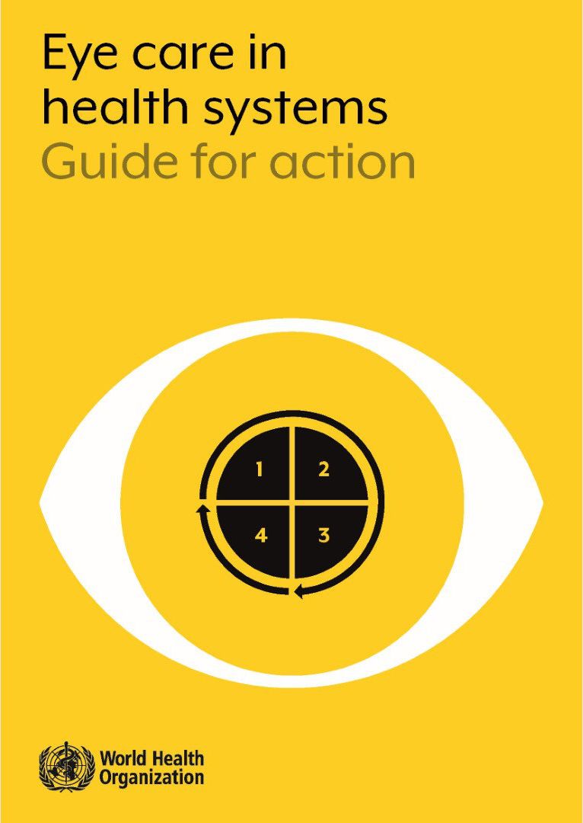
WHO’s Eye care in health systems: Guide for Action
A manual for health planners, outlining strategies and approaches that are proposed by WHO for the planning and the implementation of IPEC

Slide 9
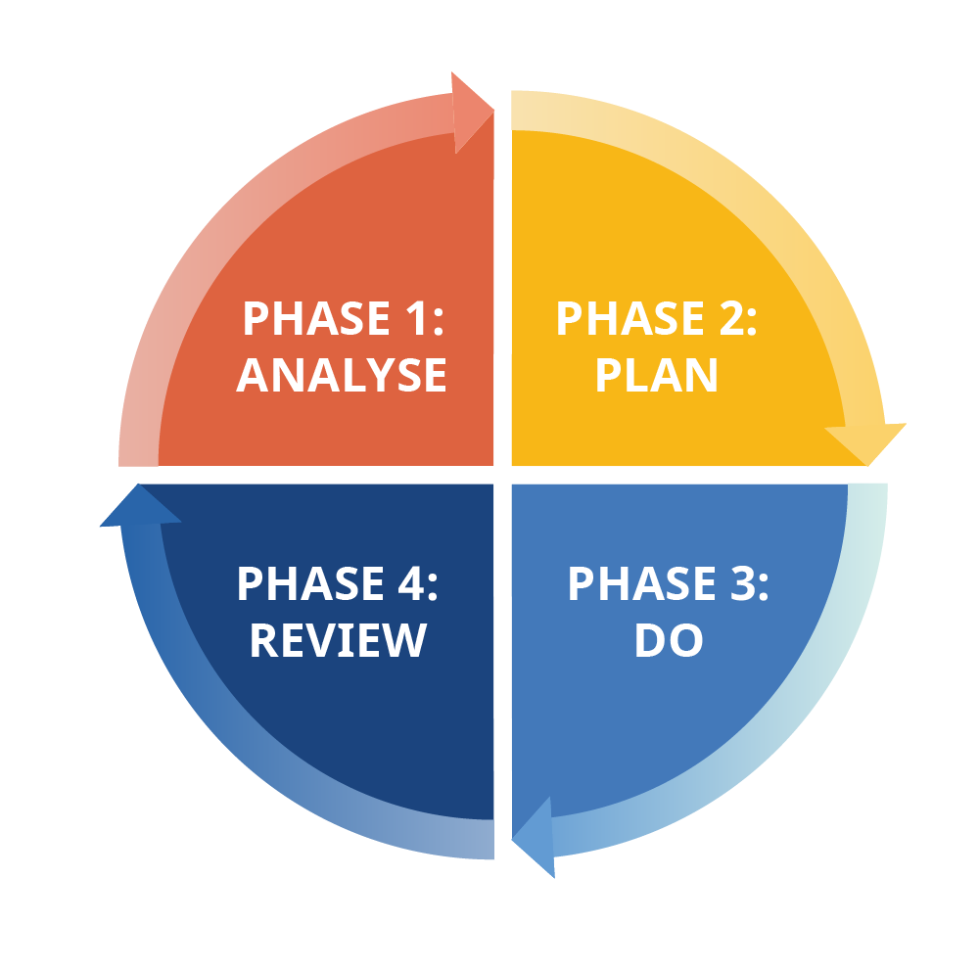
Phases of IPEC Implementation
WHO Guide for action suggests-
Phase 1: Analyse - Carry out a situation analysis of the eye care sector to establish priorities
Phase 2: Plan- Use the priorities to develop an eye care strategic plan and related monitoring framework
Phase 3: Do- Operational planning to define activities, timelines and budget at national, sub-national and institutional level to implement the eye care strategic plan
Phase 4: Review- Establish ongoing review processes to correct actions

Slide 10

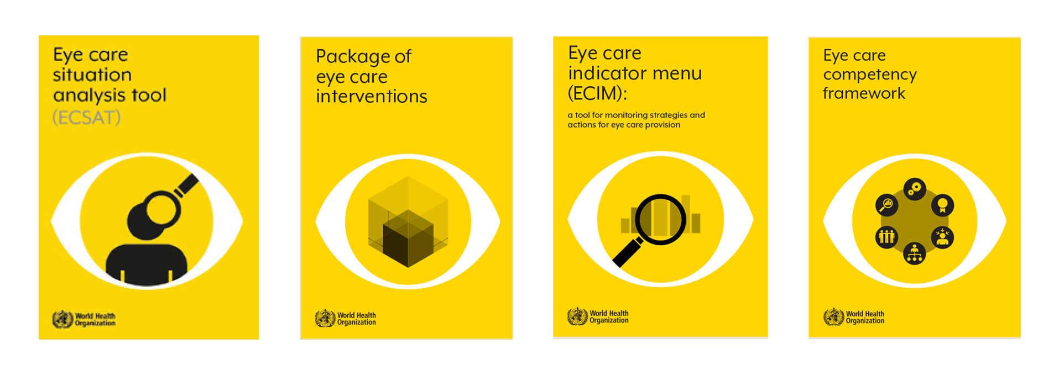
New WHO Tools

Slide 11
New WHO Tools
WHO Tools | Description | IPEC steps
Eye Care Service Assessment Tool | Designed to answer what is current situation of eye care sector, what priority areas need to be addressed in strategic planning and what are the possible activities to address gaps | PHASE 1: Analyse Situation Analysis
Eye Care Indicators Menu | A comprehensive set of input, output, outcome and impact indicators, to facilitate monitoring of strategies and actions for eye care at national and sub-national level | PHASE 2: Plan Strategic planning and development of monitoring framework
Package of Eye Care Interventions | Facilitate countries’ decisions on which interventions to prioritize, how these can be budgeted and integrated into national health services packages and policies | PHASE 3: Do Operational planning
Eye Care Competency Framework | A key mechanism to align the eye care workforce with population needs | PHASE 3: Review Operational planning

Slide 12
Thank You!
WWW.IAPB.ORG/LEARN/KNOWLEDGE-HUB/IPEC/

