Slide 1
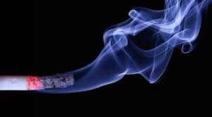
Tobacco and Vision Loss
WHO Tobacco Knowledge Summaries

Slide 2
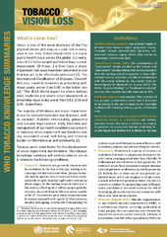
TOBACCO AND VISION LOSS
WHO Tobacco Knowledge Summary
World Health Organization
International Agency for the Prevention of Blindness

Slide 3
What is vision loss?
Vision impairment is a major public health issue across the globe
Currently, around 2.2 billion people worldwide have a vision impairment, of those 1 billion could have been prevented or has yet to be addressed
Major cause of vision loss in 2020¹
  Uncorrected refractive error
  Cataract
  Age-related macular degeneration
  Glaucoma
  Diabetic Retinopathy
¹ IAPB Vision Atlas, https://www.iapb.org/learn/vision-atlas/causes-of-vision-loss/

Slide 4
Tobacco use and vision loss
Nicotine contained in tobacco is highly addictive
Tobacco use is a risk factor for the development of vision impairment and blindness²
Tobacco use is related to eye conditions like cataract, glaucoma and macular degeneration
² United States Department of Health and Human Services. How tobacco smoke causes disease: the biology and behavioral basis for smoking-attributable disease: a report of the Surgeon General. (https:// www.ncbi.nlm.nih.gov/books/NBK53017/)

Slide 5
Forms of Tobacco use
Smoked tobacco product
any product made or derived from tobacco which generates smoke.
Eg: cigarettes, rollyour- own tobacco, cigars, shisha (also known as waterpipe), kreteks and bidis
Second-hand smoke
the combination of mainstream smoke exhaled by the smoker and side-stream smoke emitted into the environment from the burning end of a cigarette or from other smoked tobacco products
Smokeless tobacco
any product that consists of cut, ground, powdered or other that is intended to be placed in the oral or nasal cavity
Eg: snuff, chewing tobacco, gutka, mishri & snus
Electronic nicotine delivery system (e-cigarettes):
any battery operated device that heats a solution, or e-liquid, to generate an aerosolized mixture containing flavoured liquids and nicotine that is inhaled by the user

Slide 6
Pathophysiology of tobacco use in vision loss³
Single breathe inhales hundreds of toxins
Damages the lungs
Passes to the bloodstream
Reaches to various organs including eyes
Tobacco smoke also irritates the eyes and worsens dry eye syndrome in smokers and bystanders exposed to second-hand smoke, particularly among contact lenses wearers⁴
³ US Department of Health and Human Services. How tobacco smoke causes disease: the biology and behavioral basis for smoking-attributable disease: a report of the Surgeon General. (https:// www.ncbi.nlm.nih.gov/books/NBK53017/)
⁴ Xu L et al. Smoking and the risk of dry eye: a meta-analysis. Int J Ophthalmol. 2016;9(10):1480–6. doi:10.18240/ijo.2016.10.19.

Slide 7
Tobacco smoking & Age-related macular degeneration (AMD)
Meta-analysis (17 studies)
4 x increase risk for neovascular AMD and
2 -3 x increase in the risk of atrophic AMD
One study
dose-dependent association with the incidence of neovascular AMD
Smoking is the primary modifiable risk factor for the development & progression of AMD
Notes:
A meta-analysis from 17 studies found a

Slide 8
Tobacco smoking & Cataract
How does smoking cause cataract?
Increased risk
Free radicals generated by smoking raises the oxidative stress in the lens
inhibits ability to discard damaged proteins, resulting in cataract
which lowers the concentration of plasma in antioxidants
Association between smoking intensity and cumulative dose of smoking and an increased risk of requiring cataract surgery
Current smokers of more than 15 cigarettes per day had a 42% increased risk of undergoing cataract extraction as compared with never smokers⁵
⁵ Lindblad BE, Håkansson N, Wolk A. Smoking cessation and the risk of cataract. JAMA Ophthalmol. 2014;132(3):253–7. doi:10.1001/jamaophthalmol. 2013.6669.

Slide 9
Tobacco smoking & Glaucoma
In a cohort of smokers followed for 8.5 years, current smokers were found to be at increased risk of developing glaucoma as compared with never smokers
The same study also found a dose–response relationship between the number of cigarette pack-years and glaucoma incidence⁶
⁶ Pérez-De-Arcelus M, Toledo E, Martínez-González MÁ, Martín-Calvo N, Fernández-Montero A, Moreno-Montañés J. Smoking and incidence of glaucoma: the SUN cohort. Medicine. 2017;96(1):e5761. doi:10.1097/ MD.0000000000005761.

Slide 10
Other forms of tobacco and their association with vision loss
Smokeless tobacco
smokeless form of tobacco associated with development glaucoma (Chennai, India study)⁷
Second-hand smoke
In children found to be associated with choroidal thinning
People living with smoker for at least 5 years are twice as likely to develop AMD⁸
E-cigarettes
Dry eyes and instability in tear film
Studies report incidents of e-cigarette device exploded in the consumer’s mouth, causing chemical burns, decreased visual acuity along with long-term ocular trauma, such as severe corneal lacerations, and ocular tissue damage⁹
⁷ Raju P et al. Influence of tobacco use on cataract development. Br J Ophthalmol. 2006;90(11):1374–7. doi:10.1136/bjo.2006.097295.
⁸ Yuan N et al. Association of secondhand smoking exposure with choroidal thinning in children aged 6 to 8 years. JAMA Ophthalmol. 2019;137(12):1406–14. doi:10.1001/
jamaophthalmol.2019.4178.
⁹ Golla A et al. Association between e-cigarette use and visual impairment in the United States. Am J Ophthalmol. 2022;235:229–40. doi:10.1016/j.ajo.2021.09.014.

Slide 11
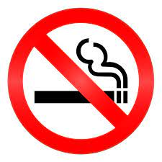
Stop smoking & tobacco use!
The effects of smoking are reversible!
Ex-smokers
  have a lower risk of AMD compared with current smokers (Meta analysis)¹⁰
  for at least 20 years reduce their risk of developing AMD to that of a non-smoker¹¹
  decrease the risk of needing a cataract surgery¹²
  lower the risk of other diseases, such as cardiovascular disease and diabetes mellitus, which can lead to vision loss.
¹⁰ Age-related macular degeneration (AMD). In: (https://www. nei.nih.gov/learn-about-eye-health/eye-conditions-and-diseases/agerelated- macular-degeneration, accessed 1 September 2022).
¹¹ US Department of Health and Human Services. The health consequences of smoking: 50 years of progress. a report of the Surgeon General, 2014.
¹² Lindblad BE et al, Smoking cessation and the risk of cataract. JAMA Ophthalmol. 2014;132(3):253–7. doi:10.1001/jamaophthalmol. 2013.6669.

Slide 12

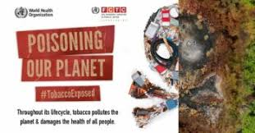
Prevention at Population level
Tobacco control advocacy campaigns, educating and informing people about the risk of tobacco smoking and vision loss,
Asks to government
  Implement WHO Framework Convention on Tobacco Control
  Raise taxes on tobacco products and
  Banning the advertisement, promotion and sponsorship of tobacco products
  Enforcing smoke-free environment,
  Mass-media campaigns and
  Ensuring availability of tobacco cessation services
  Implement WHO Guide for action for Integrated People centred eye care to increase access to eye care services

Slide 13
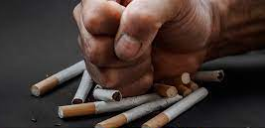
Prevention at Individual level
Quit smoking: has immediate benefit- improve blood circulation and lung function
Eliminate exposure to second-hand smoking
Keep home and work environment completely tobacco-free
Maintain your general health
Have regular eye tests

Slide 14
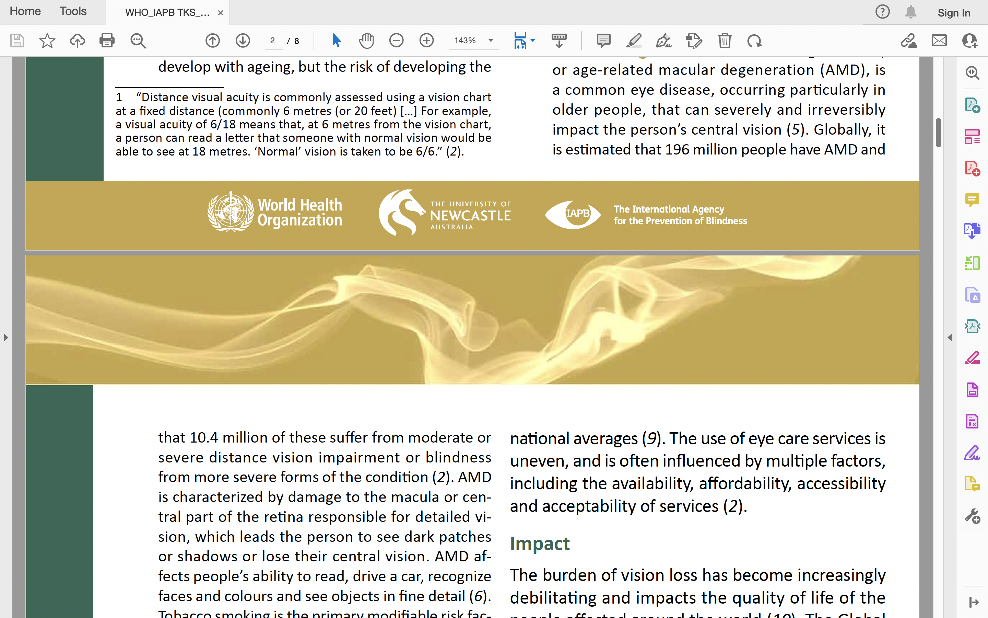
Based on the comprehensive literature search for systematic reviews and other articles investigating-
    the relationship between tobacco use, exposure to second-hand smoke and vision impairment,
    as well as a review of literature on e-cigarette use and its possible association with ocular health.
by WHO and co-authored and reviewed by the International Agency for the Prevention of Blindness and the University of Newcastle Australia

Slide 15

Find the WHO TKS online at: https://www.who.int/publications/i/item/9789240060708

