Slide 1


Effective Coverage of Eye Care
October 2022

Slide 2




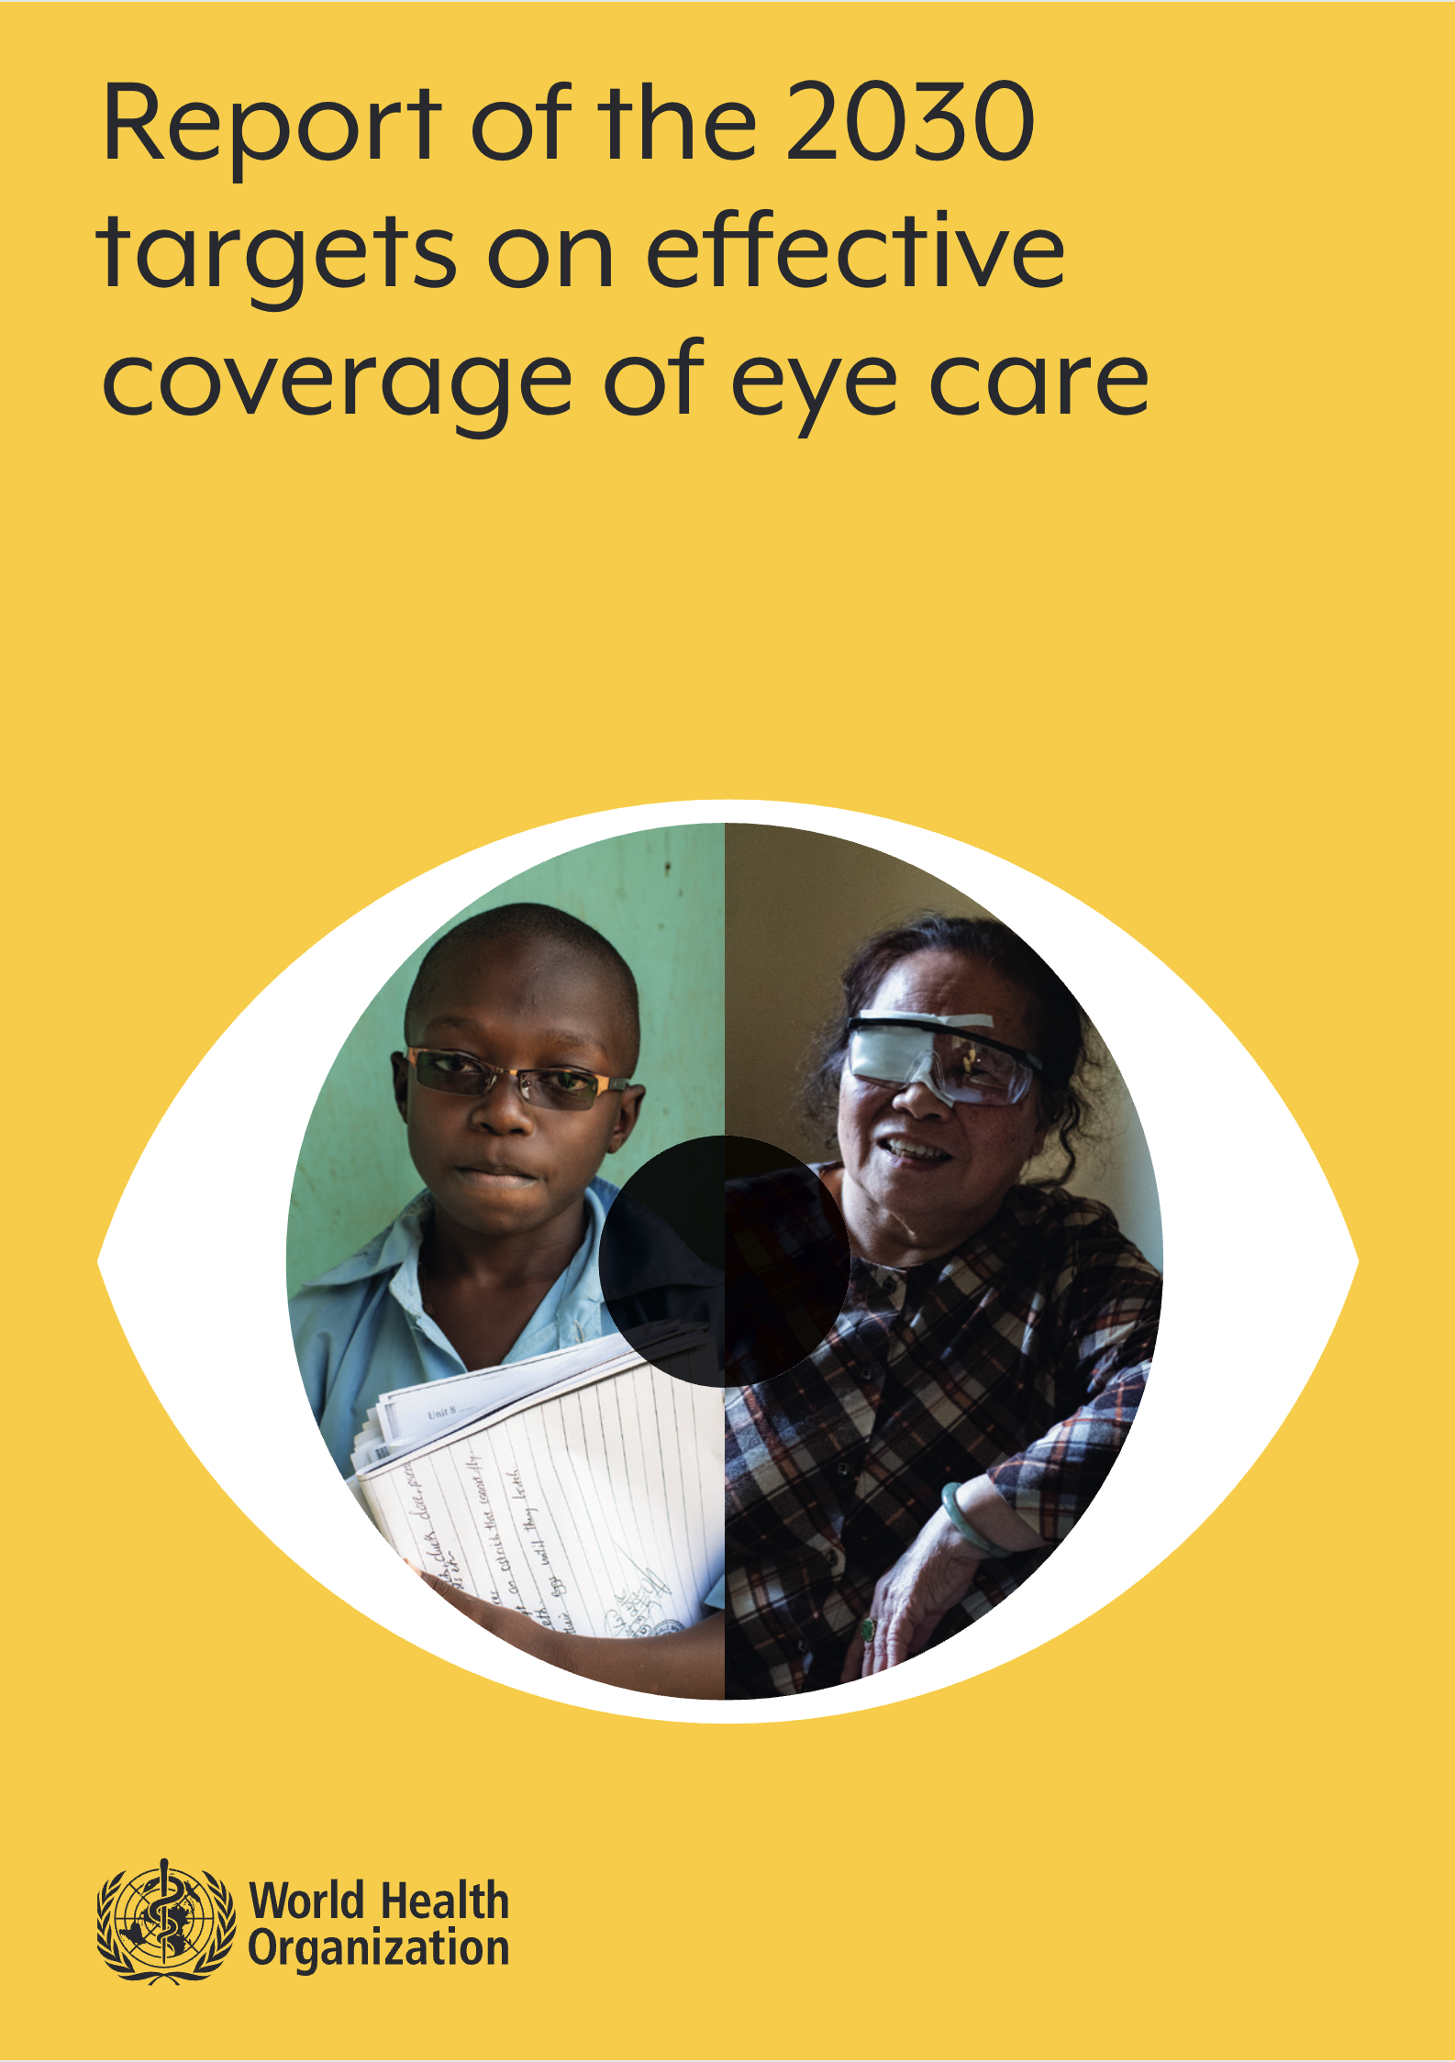
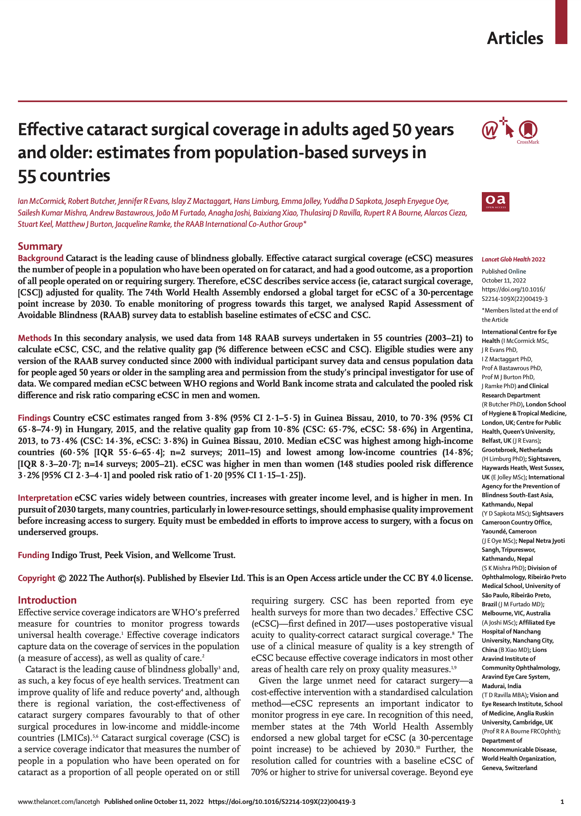
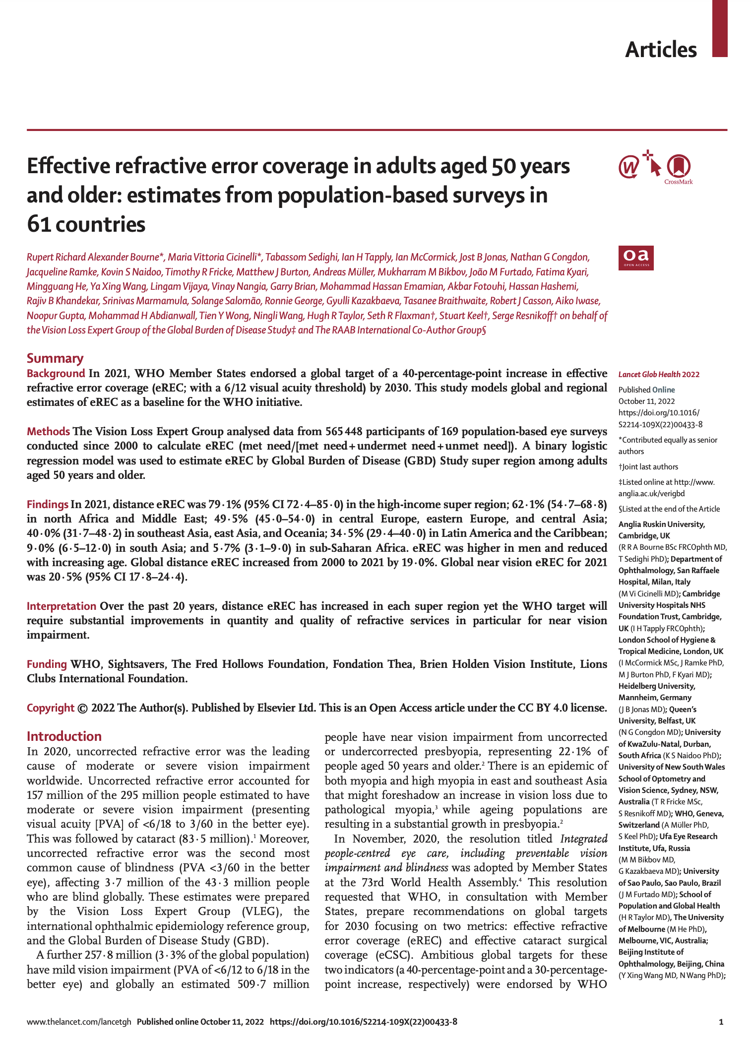
Effective coverage publications [October 2022]
World Health Organization. (2022). Report of the 2030 targets on effective coverage of eye care. https://www.who.int/publications/i/item/9789240058002
McCormick, I., Butcher, R., Evans, J. R., Mactaggart, I. Z., Limburg, H., Jolley, E., Sapkota, Y. D., Oye, J. E., Mishra, S. K., Bastawrous, A., … Zhang, X. J. (2022). Effective cataract surgical coverage in adults aged 50 years and older: estimates from population-based surveys in 55 countries. The Lancet Global Health, 0(0). https://doi.org/10.1016/S2214-109X(22)00419-3
Bourne, R. R. A., Cicinelli, M. V., Sedighi, T., Tapply, I. H., McCormick, I., Jonas, J. B., Congdon, N. G., Ramke, J., Naidoo, K. S., Fricke, T. R., Burton, M. J., Müller, A., B., … Zhang, X. J. (2022). Effective refractive error coverage in adults aged 50 years and older: estimates from population-based surveys in 61 countries. The Lancet Global Health, 0(0). https://doi.org/10.1016/S2214-109X(22)00433-8

Slide 3
Differences between publications….
Same dataset & analysis
Same dataset but different analysis
eCSC PAPER
Pooled value from 2000 - 2021:
eCSC only
Median value across all years (2000 – 2021)
Focusses on 6/18 threshold
  But provides some values for 6/12 threshold
Uses data from 148 RAAB studies
  24 national studies
  124 subnational studies
WHO Region & World Bank Income strata
WHO REPORT
Pooled values from 2000 - 2021:
eCSC and eREC
Median value across all years (2000 – 2021)
Focusses on 6/18 threshold
  But provides some values for 6/12 threshold
Uses data from 175 studies (most at 6/18 threshold)
  148 RAAB for eCSC
  175 for eREC
Does not report near eREC
WHO Regions & World Bank Income strata
eREC PAPER
Provides a ‘modelled estimate’ for 2021:
eREC only
Modelled estimates for 2021
Focusses on 6/12 threshold
Uses data from 169 studies
  22 comprehensive studies
  147 RAABs
Models near eREC
  10 studies
Reports historical eREC for 2000 and 2010
GBD Region & World Bank Income strata

Slide 4


How should these reports be used?
A starting point…
Demonstrate that it is possible to measure effective coverage globally
A starting point for measuring progress
More reliable data are needed to set baselines and 2030 targets
Notes:
2000: 35.7
2010: 39.1
2021: 42.9

Slide 5

Limitations of current datasets
Of the 335 RAABs conducted/registered*, only 44% have been shared with RAAB repository
Future analysis will:
Include additional historical datasets;
Focus on reporting at the 6/12 threshold for both the ‘need for intervention’ and good quality outcome’;
Focus on uncorrected visual acuity (rather than presenting VA)
Aim to address geographical and income level gaps
Strengthen estimates for Near eREC
*As of April 2022

Slide 6
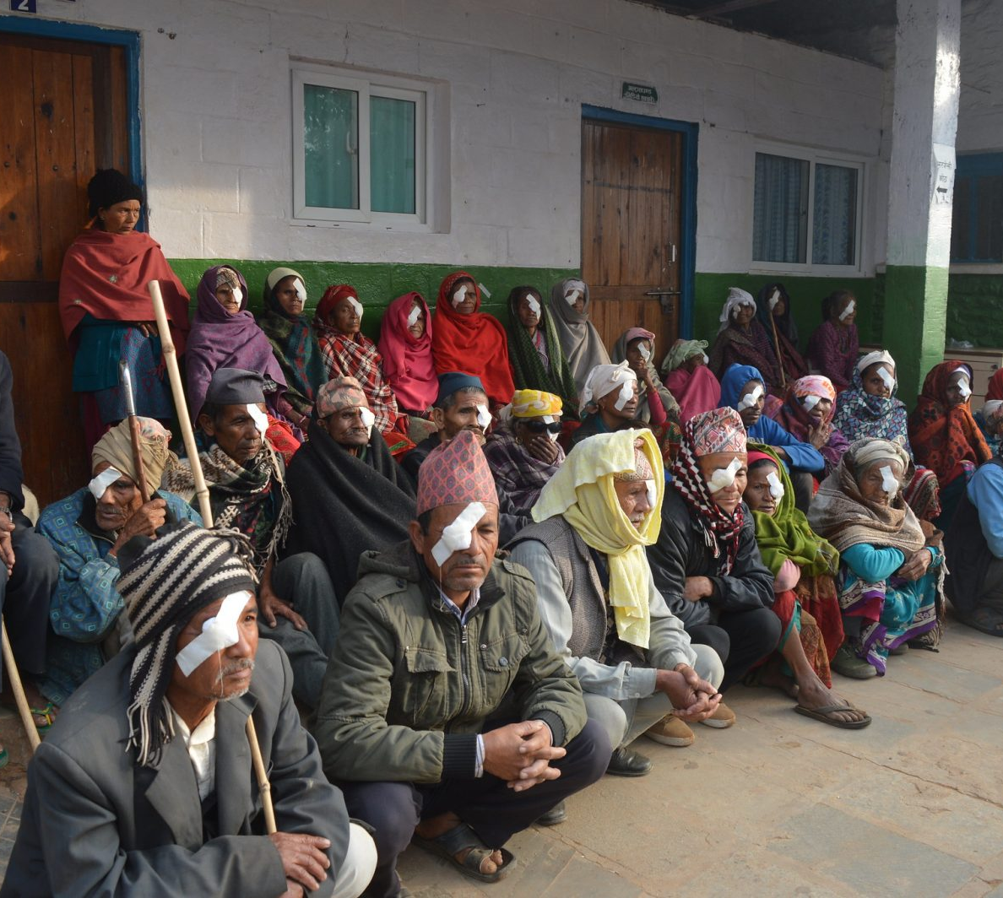


eCSC: Effective Cataract Surgical Coverage
eCSC:
Effective Cataract Surgical Coverage
Proportion of people who have received cataract surgery and have a resultant good quality outcome (6/12 or better) relative to the number of people in need of cataract surgery.
McCormick, I., Butcher, R., Evans, J. R., Mactaggart, I. Z., Limburg, H., Jolley, E., Sapkota, Y. D., Oye, J. E., Mishra, S. K., Bastawrous, A., Furtado, J. M., Joshi, A., Xiao, B., Ravilla, T. D., Bourne, R. R. A., Cieza, A., Keel, S., Burton, M. J., Ramke, J., … Zhang, X. J. (2022). Effective cataract surgical coverage in adults aged 50 years and older: estimates from population-based surveys in 55 countries. The Lancet Global Health, 0(0). https://doi.org/10.1016/S2214-109X(22)00419-3

Slide 7
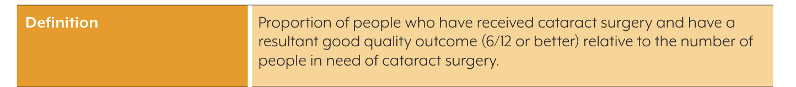

eCSC: Quality threshold
More data are needed at the 6/12 threshold
Threshold (Visual Acuity) | Studies (number) | Countries (number)
6/12 | 63 | 19
6/18 | 105 | 55
Threshold for both:
need for intervention &
good quality outcome
Only 42% of surveys use the 6/12 threshold
Mild vision impairment (<6/12–6/18) impacts peoples everyday functioning
6/12 is the threshold WHO/ICD-11 defines as vision impairment.
Notes:
2000: 35.7
2010: 39.1
2021: 42.9

Slide 8
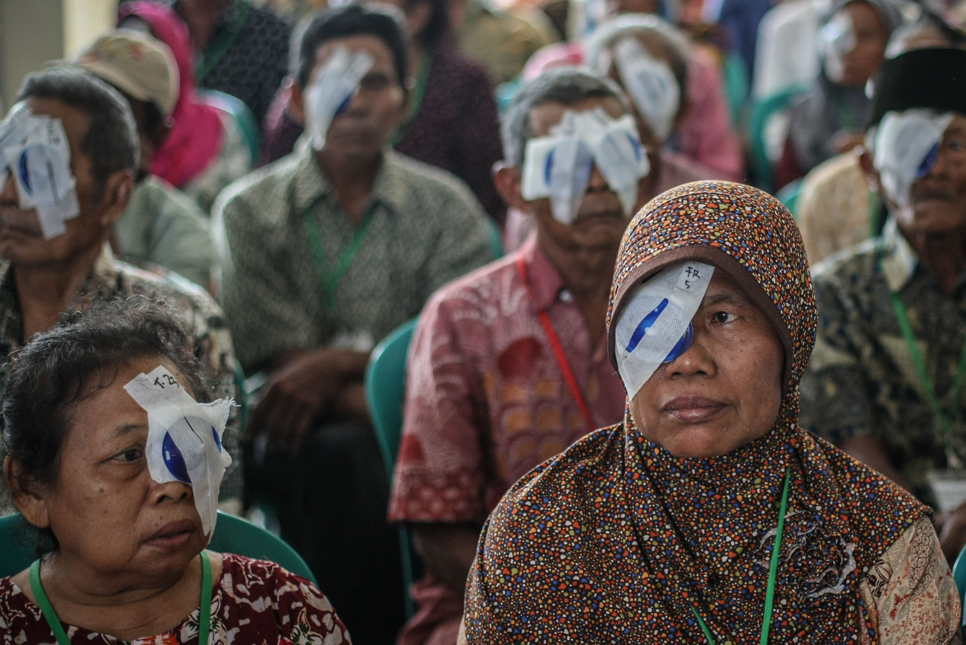
eCSC: Effective Cataract Surgical Coverage
eCSC: Effective Cataract Surgical Coverage
(2000 - 2021 pooled value)
Of all the adults 50+ years who need cataract surgery;
eCSC (6/12) = 17%
only 17% of those of those who needed and had accessed surgery were able to see 6/12 or better when assessed.
from 63 surveys in 19 countries
eCSC (6/18) = 25%
only 25% of those of those who needed and had accessed surgery were able to see 6/18 or better when assessed.
from 105 surveys from 55 countries

Slide 9
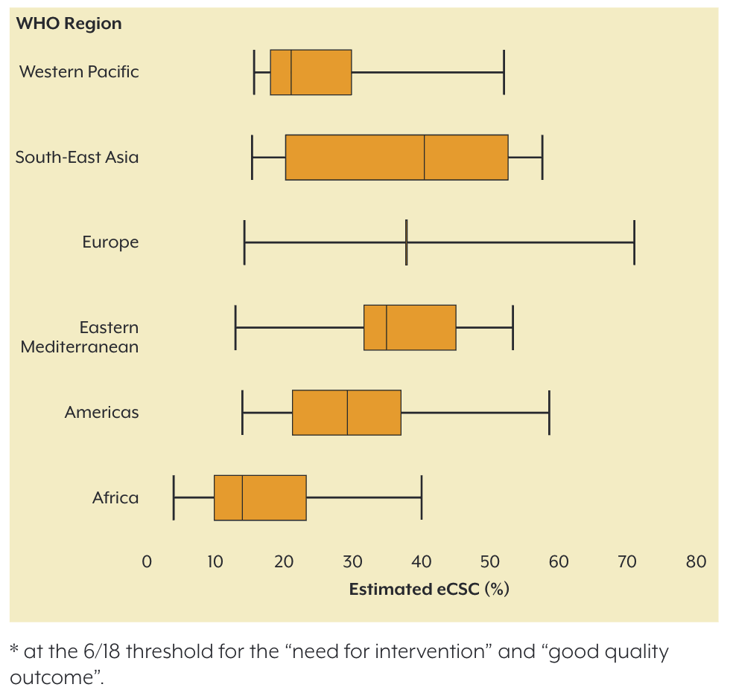
eCSC: Significant variation in coverage by WHO region (6/18)
Median eCSC (WHO Regions)
Lowest median: 14% in Africa
Highest median: 40% in South-East Asia

Slide 10
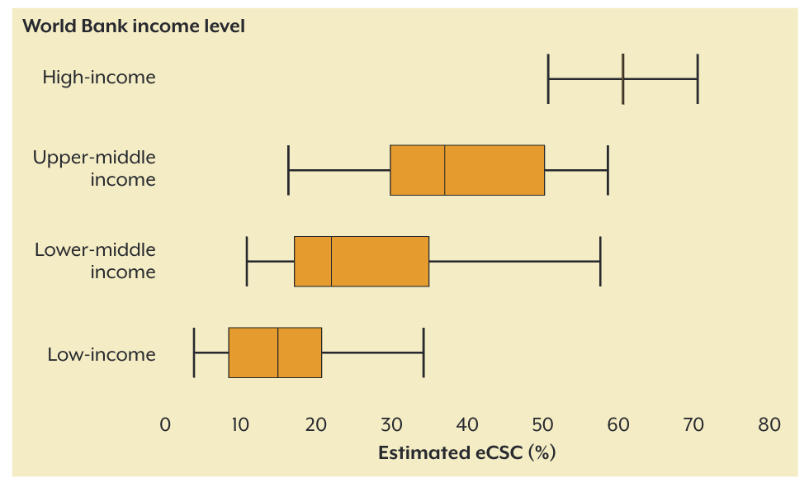
eCSC: Significant variation in coverage by income level (6/18)
Median eCSC (WB income)
Lowest median: 15% in Low-income
Highest median: 61% in High-income
15% eCSC in low-income
61% eCSC in high-income
(although only 2 surveys)

Slide 11

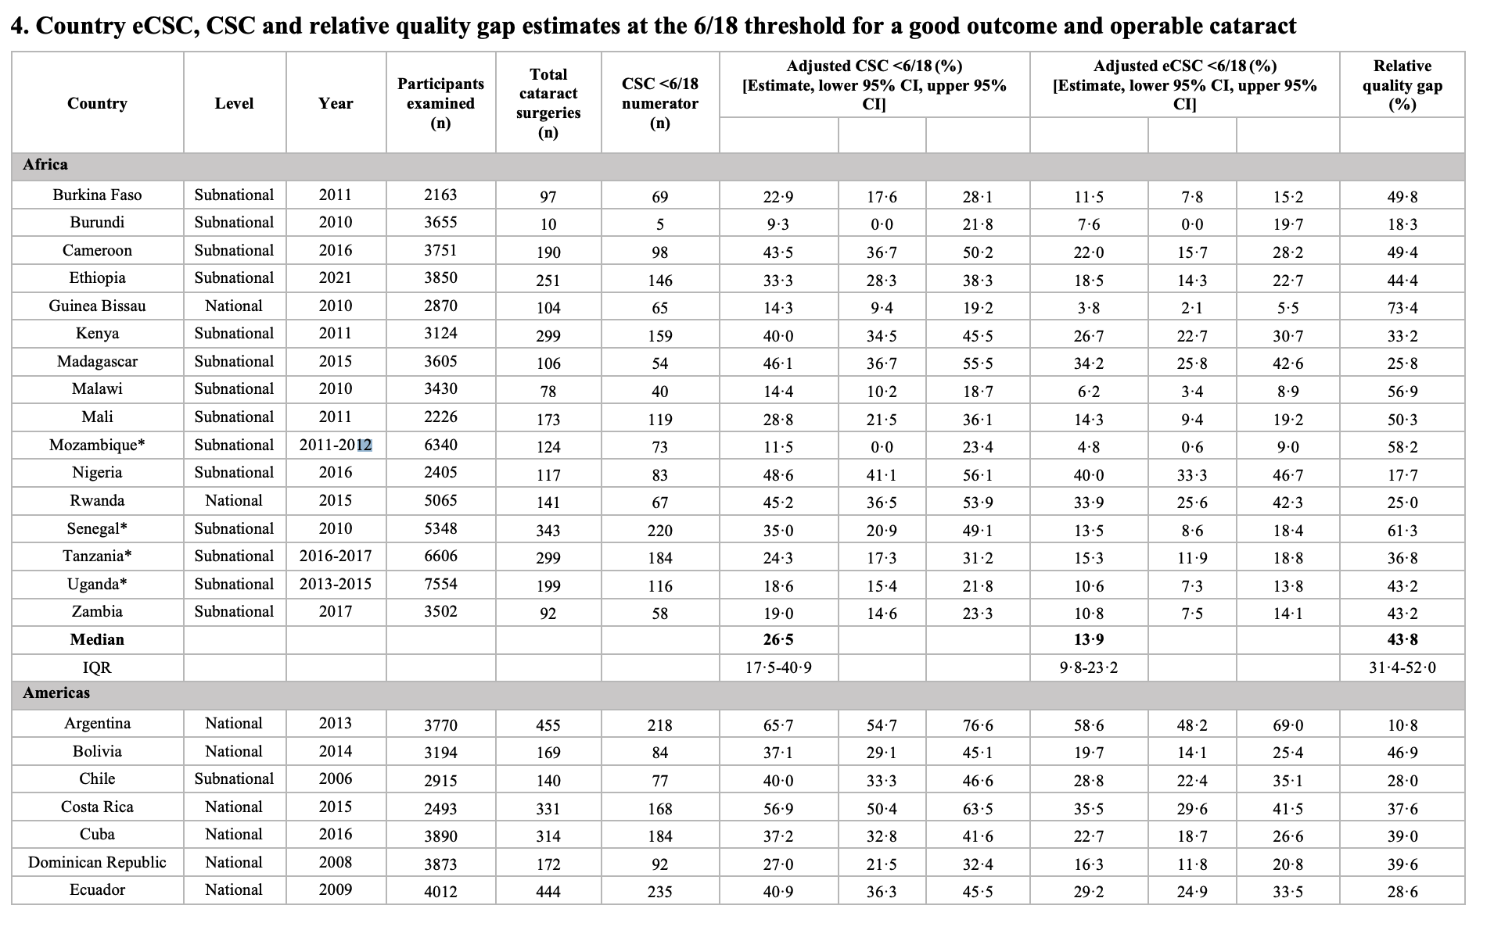
6/18 threshold
The eCSC publication provides reference estimates for 55 countries

Slide 12
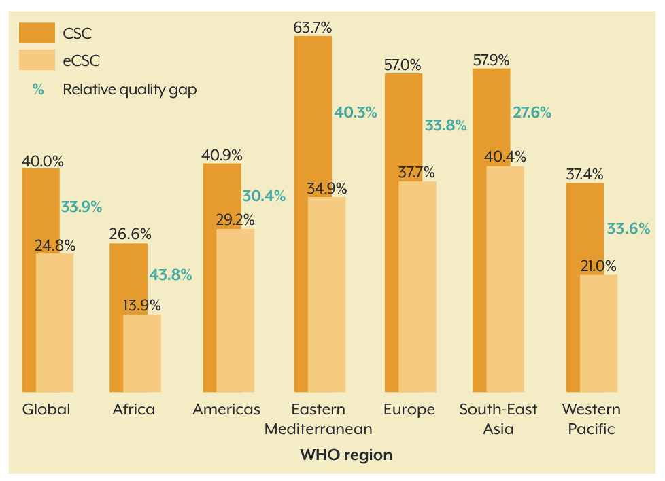
Relative eCSC Quality gap (6/18)
Median relative quality gap was 34%
34% of people that previously received cataract surgery were unable to see ≤ 6/18
Only 25% of those that need cataract surgery (6/18) have received surgery and had a resultant good quality outcome
Only 40% of those that need cataract surgery (6/18) have received surgery

Slide 13
Different intervention strategies are required:
Access:
Examples of interventions to improve access (quantity)
Focus on improving access – while maintaining or improving quality
Focus on historically underserved populations
Consider patient counselling, transport and subsidisations.
Include cataract surgery in service packages covered by pre-paid pooled financing.
Quality:
Examples of interventions to improve quality
Invest in quality improvement (e.g. biometry)
Countries with a large relative quality gap have an opportunity to make considerable progress by targeting quality alone.
McCormick, I., Butcher, R., Evans, J. R., Mactaggart, I. Z., Limburg, H., Jolley, E., Sapkota, Y. D., Oye, J. E., Mishra, S. K., Bastawrous, A., … Zhang, X. J. (2022). Effective cataract surgical coverage in adults aged 50 years and older: estimates from population-based surveys in 55 countries. The Lancet Global Health, 0(0). https://doi.org/10.1016/S2214-109X(22)00419-3

Slide 14
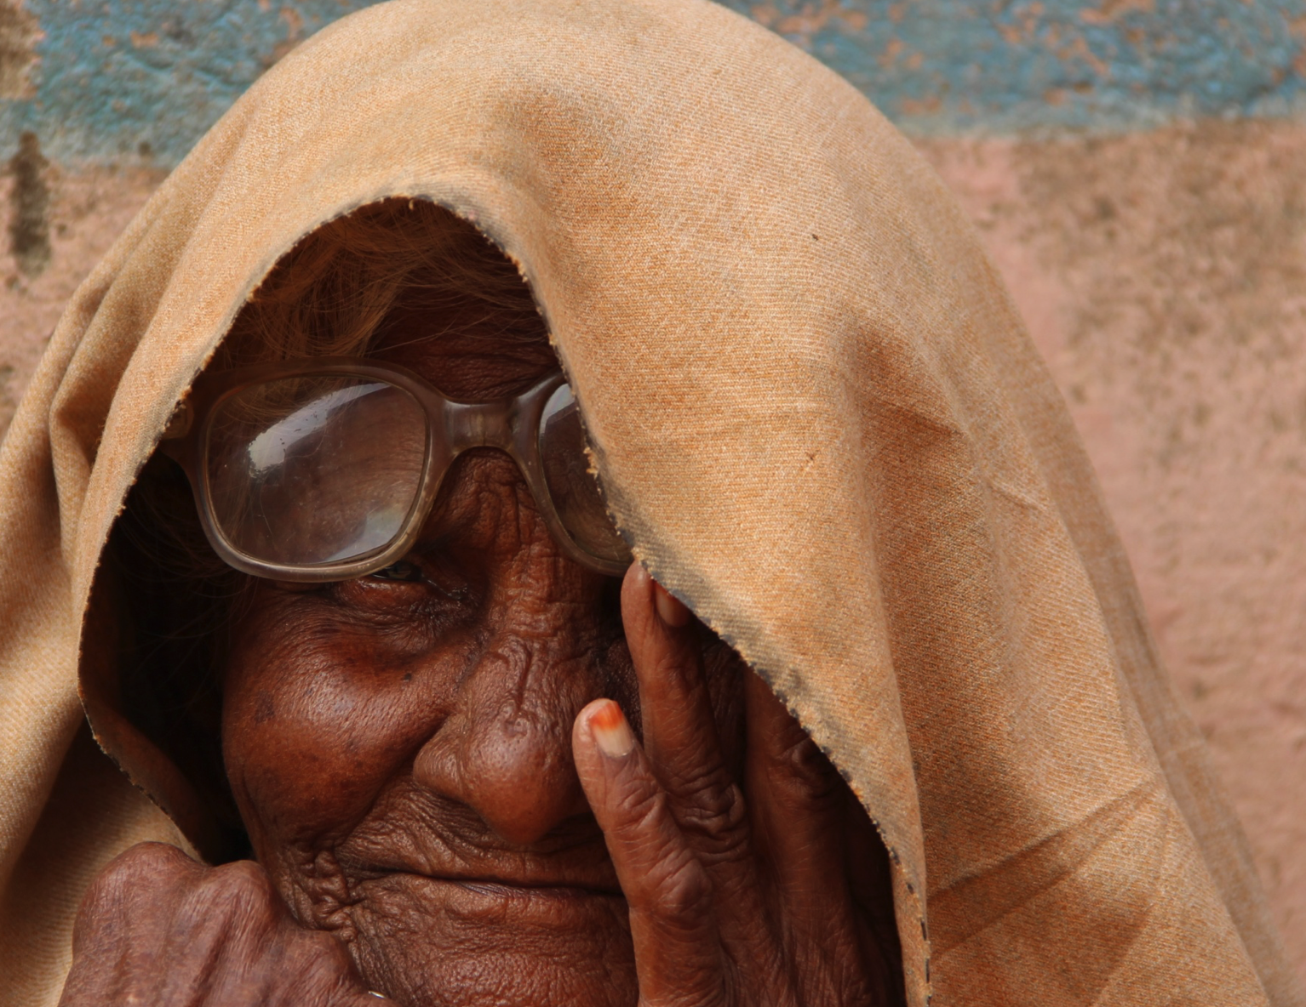
Effective Refractive Error Coverage
eREC:
Effective Refractive Error Coverage
Proportion of people who have received refractive error services (i.e. spectacles, contact lenses or refractive surgery) and have a resultant good quality outcome relative to the number of people in need of refractive error services.
Image credit: Aditya Sethi

Slide 15
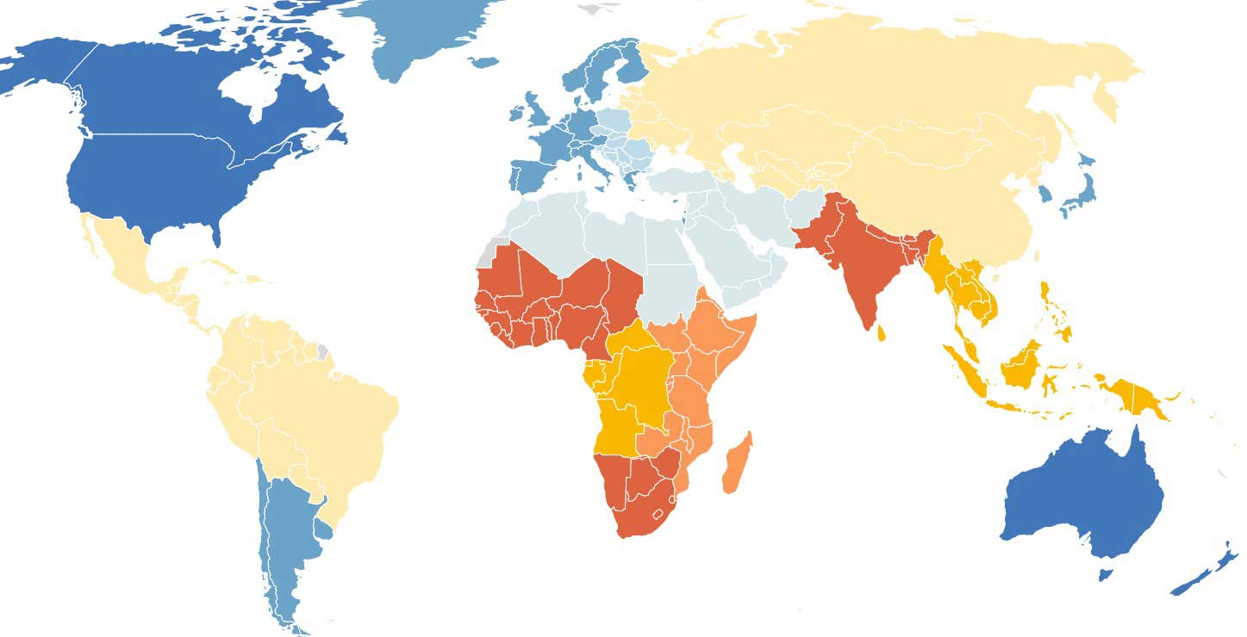
eREC: Effective Refractive Error Coverage
2000 - 2021 pooled value
Of all the adults 50+ years who have refractive errors;
eREC (6/12) = 36%
only 36% of those who needed and had accessed services were able to see 6/12 or better when assessed.
From 86 surveys in 26 countries
eREC (6/18) = 65%
65% of those who needed and had accessed services were able to see 6/18 or better when assessed.
From 175 surveys from 62 countries

Slide 16
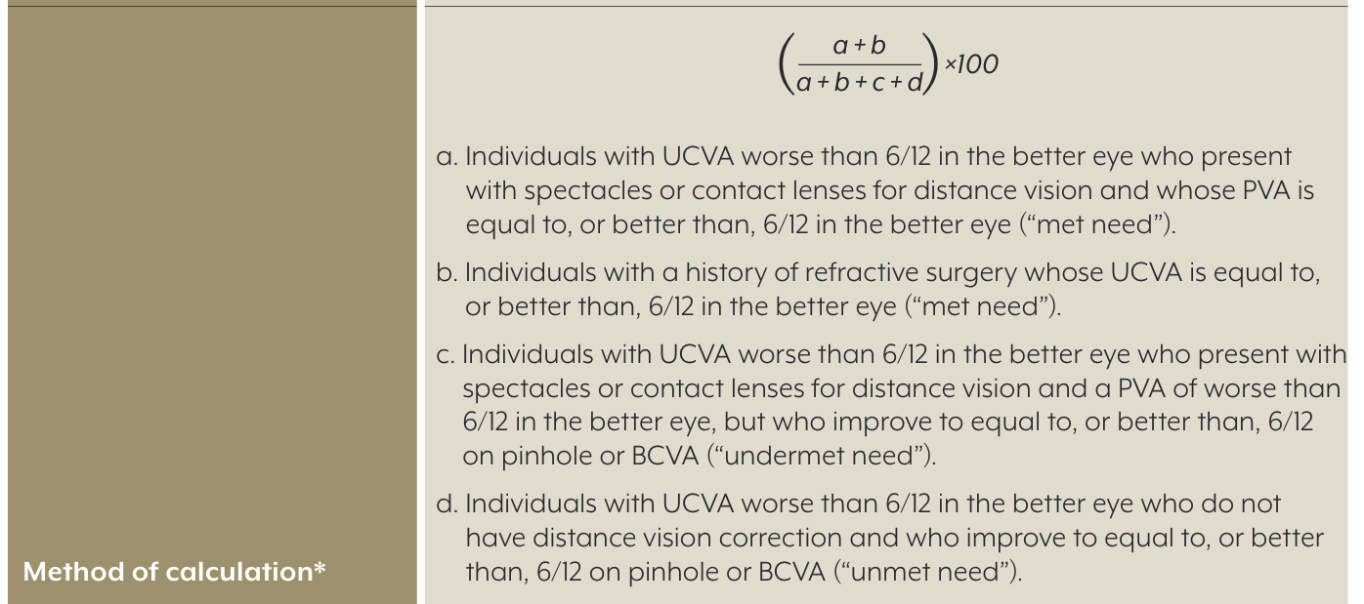
eREC: Quality threshold
More data are needed at the 6/12 threshold
Threshold (Visual Acuity) | Studies (number) | Countries (number)
6/12 | 86 | 26
6/18 | 175 | 62
Threshold for intervention and outcome
Only 49% of surveys used the 6/12 threshold
Mild vision impairment (<6/12–6/18) impacts peoples everyday functioning
6/12 is the threshold WHO/ICD-11 defines as vision impairment.
Notes:
2000: 35.7
2010: 39.1
2021: 42.9

Slide 17

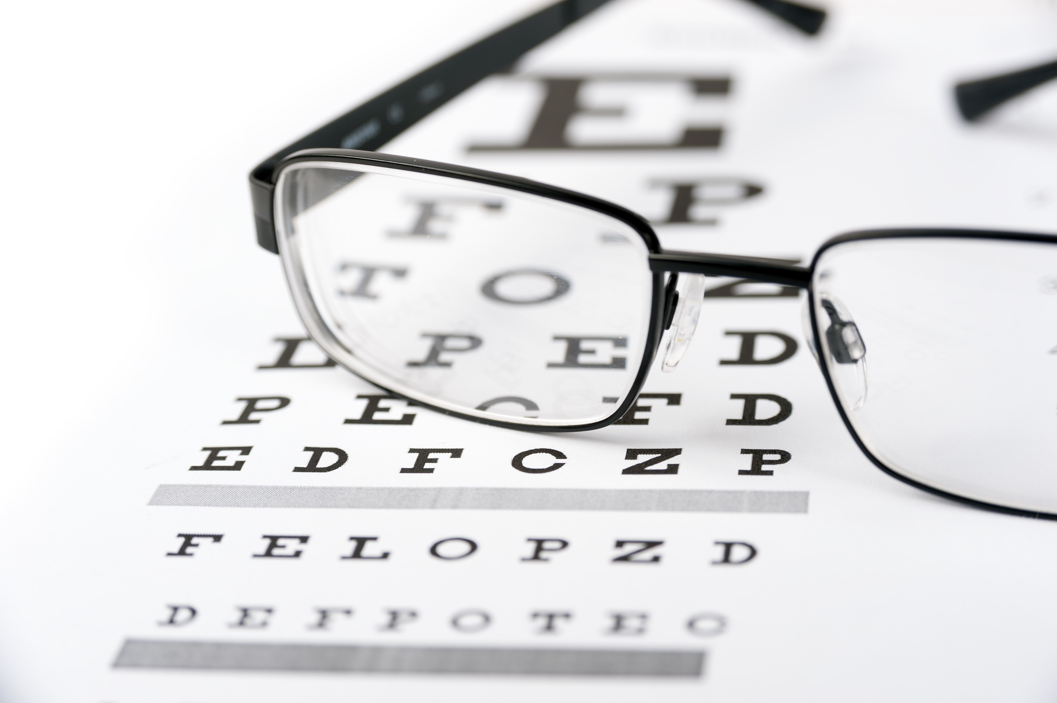
eREC Inequities
eREC Inequities
There are large variations in who receives good quality outcomes
Dramatic regional variations
Women have lower coverage for distance eREC
Coverage decreases with age after the age of 50

Slide 18
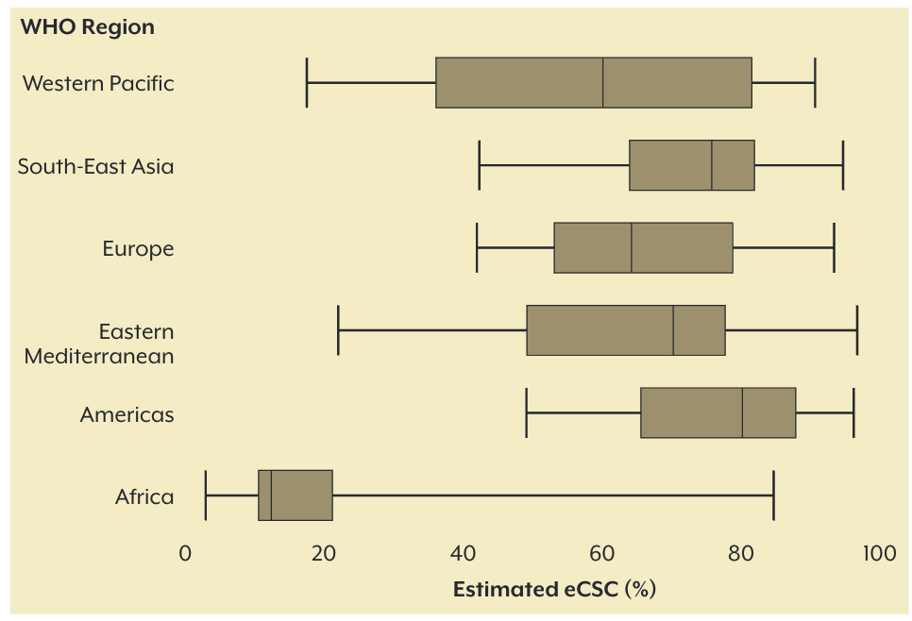

eREC: Significant variation in coverage by WHO region (6/18)
Median eREC (WHO Regions)
Lowest median: 12% in Africa
Highest median: 80% in Americas
Wide variation within regions
12% eREC in Africa region
80% eREC in Americas

Slide 19
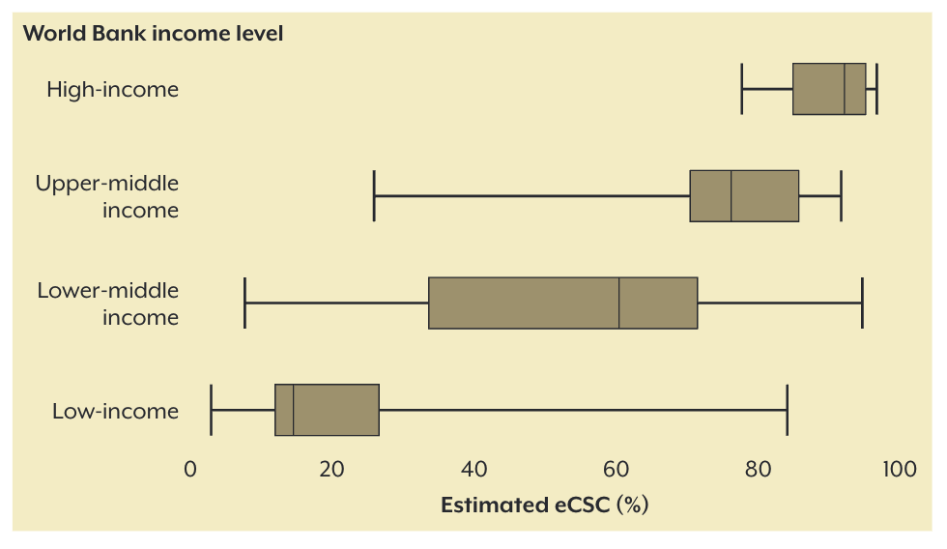
eREC: Significant variation in coverage by income level (6/18)
Median eREC (WB income)
15% in Low-income
92% in High-income
92% eREC in high-income
(although only 2 surveys)
15% eREC in low-income

Slide 20
Relative eREC: Quality gap
Region | Relative quality gap between REC and eREC ≥ (6/18)
African region | 5%
Americas | 4%
Eastern Mediterranean | 7%
European | 9%
South-East Asia | 3%
Western Pacific | 14%
Global | 7%
Median relative eREC quality gap
Only 7% of people who had received services were unable to see ≥ 6/18
But the 6/12 threshold better reflects the quality that should be obtained with correction

Slide 21

Different intervention strategies are required:
Access:
Examples of interventions to improve access (quantity)
Increase qualified human resources for refracting and dispense spectacles
Increase access points in low-income and middle-income countries (LMICs) in communities at schools, workplaces and primary care levels.
Subsidize service provision for patients
Produce more affordable, quality spectacles.
Quality:
Examples of interventions to improve quality
Better government oversight and
More clinical regulation for refraction and dispensing of spectacles,
Standardise refraction training
Bourne, R. (2022). Effective refractive error coverage in adults aged 50 years and older: estimates from population-based surveys in 61 countries. Lancet Global Heatlh.

