Slide 1
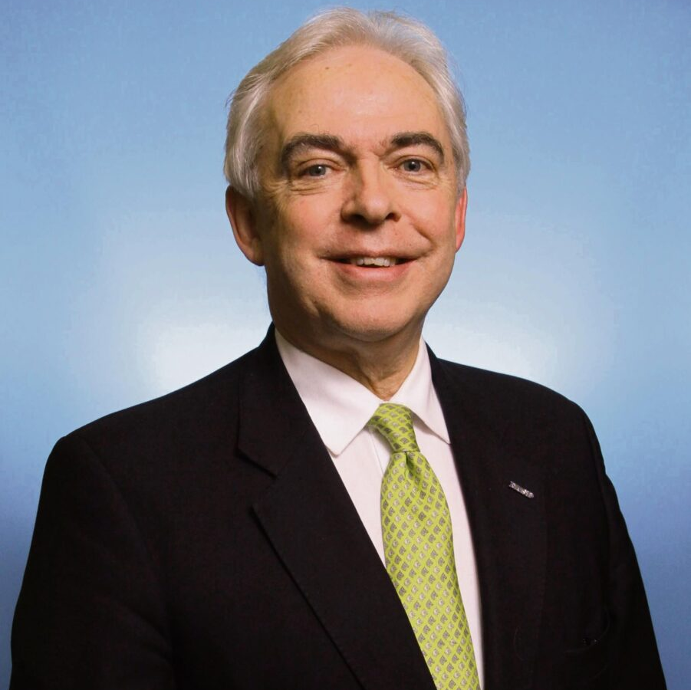
Protect tomorrow by investing in diabetes education today
Prof. Andrew Boulton
President,
The International Diabetes Federation

Slide 2
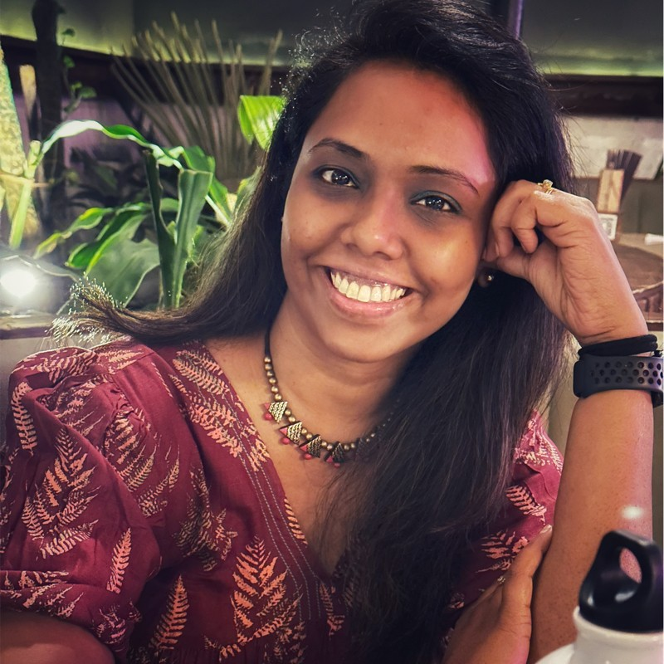
2nd Chitkara Optometry and vision science symposium
Harshada Kale
Head of Education and Operations,
Optometry Council of India

Slide 3
CBM rolls out health system strengthening programme in Kenya
Kennedy Odero Programme Coordinator Vision Impact Project, CBM
David Munyendo Country Director Kenya Office, CBM

