Slide 1

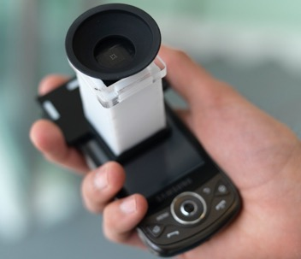

Validation of Near Eye Tool for Refractive Assessment (NETRA): A Pilot Study
.
Realising Nyaya…
Andrew Bastawrous MBChB MRCophth
Christopher Leak McOptom BMBS
Frederick Howard FBDO
B Vineeth Kumar FRCS (Ed Ophth)
Improving health worldwide
www.iceh.org.uk www.lshtm.ac.uk

Slide 2
Visual Impairment
106 million VI/6.5 million Blind
507 million presbyopes
Pascolini. BJO 2011
Notes:
Globally uncorrected refractive error accounts for 6.5 million blind & 106 million VI - (Does not include 507million presbyopes)

Slide 3
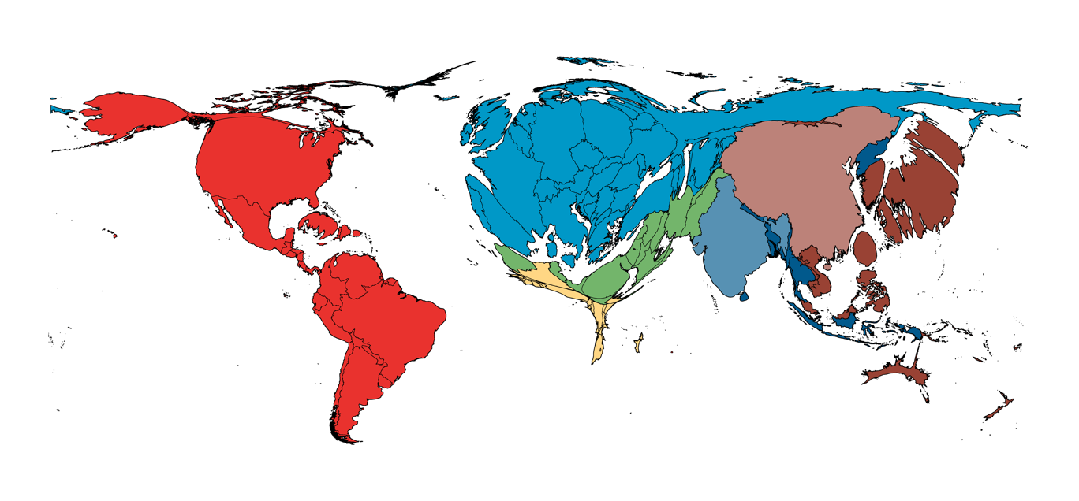
Inverse Care Law
Bastawrous & Hennig. BJO 2012
Notes:
Follows Inverse care law - 90% in low-middle income countries, but only 10% global resources
In low-middle income countries ratio of refractionist to population 1:100,000 - 1 million

Slide 4


Global Cost
Notes:
Global estimated economic cost over next 8 years US$36 Billion

Slide 5
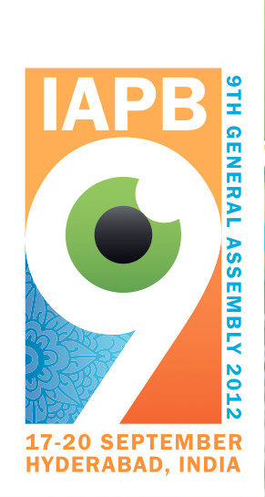

VISION2020/IAPB
VISION2020 aims to eliminate “avoidable visual impairment due to uncorrected refractive errors ”
IAPB “provide comprehensive refraction services with provision of suitable correction tools that are available at all levels, including during outreach activities”

Slide 6
VISION2020/IAPB
VISION2020 aims to eliminate “avoidable visual impairment due to uncorrected refractive errors ”
IAPB “provide comprehensive refraction services with provision of suitable correction tools that are available at all levels, including during outreach activities”

Slide 7

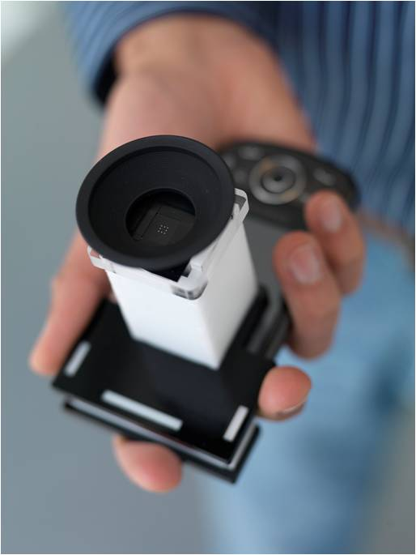
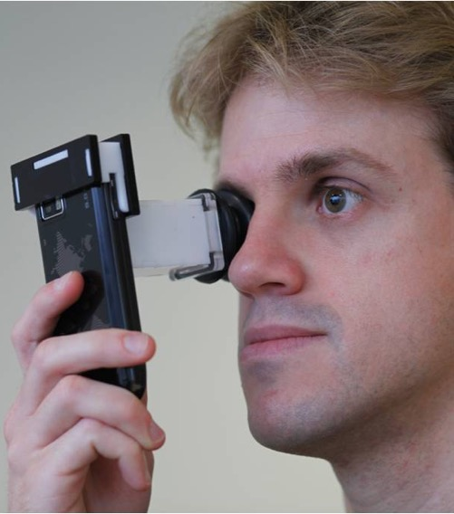
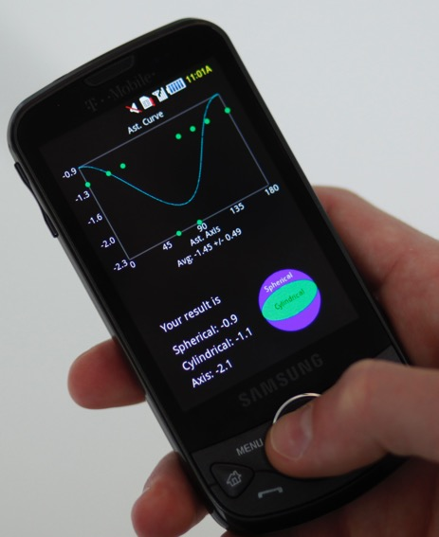
NETRA:
Near Eye Tool for
Refractive Assessment
Notes:
We call our tool NETRA: near eye tool for refractive assessment
such as nearsightedness/far/astigmatism
Basic idea is to create a unique interactive lightfield display near the eye and is possible due to the highresolution of modern LCDs.
7

Slide 8
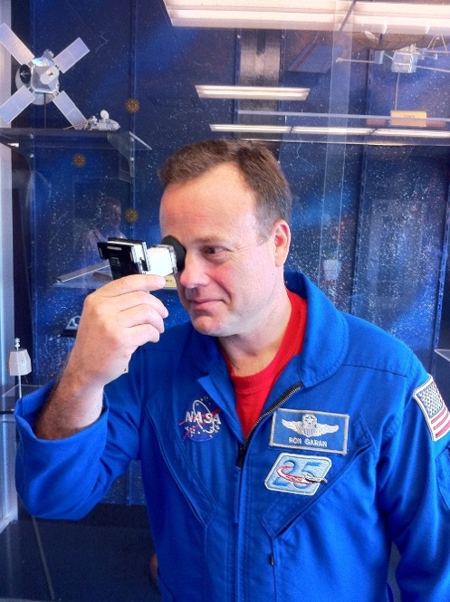
NETRA
Scheiner principle, from 1619.
creates virtual objects
alignment task rather than blur as an indicator of misfocus.
Hybrid: combines both estimation and verification in a single step

Slide 9
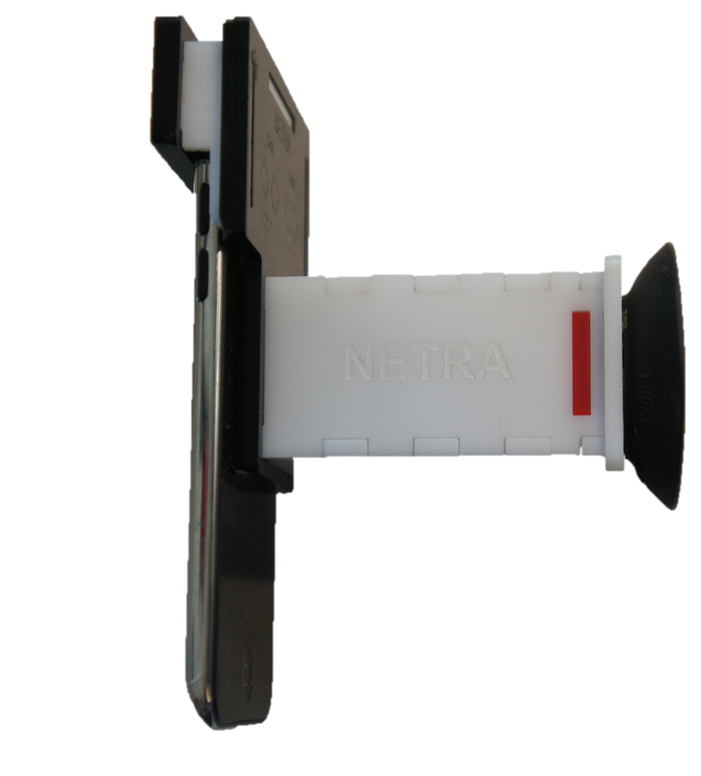
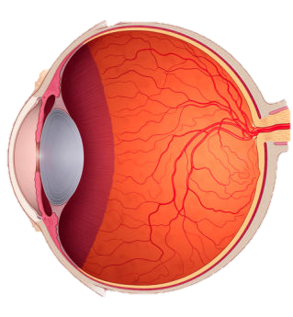

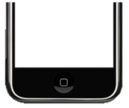

Slide 10
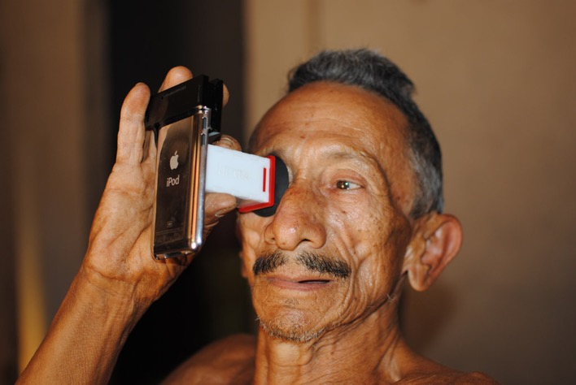
NETRA display

Slide 11
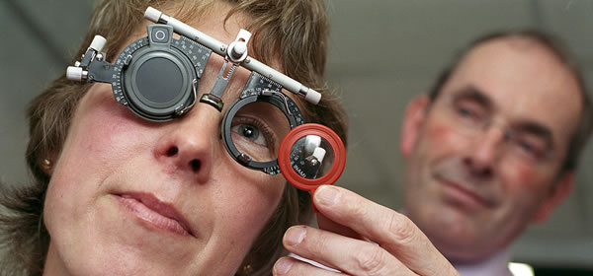
Pilot study - Methods
34 eyes of 17 sequential adult patients attending a community optometrist
Visual acuity, non-cycloplegic subjective refraction and best corrected visual acuity assessment by a single, senior, optometrist.

Slide 12
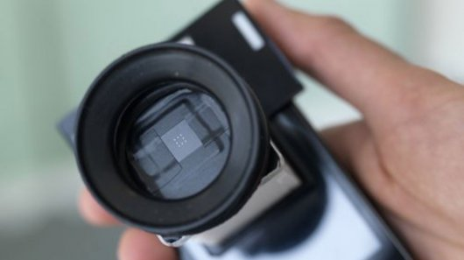
Pilot study - Methods
NETRA assessment using iPod Touch (gen4) with the assistance of the lead researcher who provided only the information sheets.
NETRA results displayed on screen were then used in a trial frame
NETRA corrected visual acuity was recorded

Slide 13
Pilot Study - Analysis
Differences in spherical equivalent(DSE):
DSE = (SN + 0.5xCN) – (SS + 0.5xCS)
Change in recorded visual acuity

Slide 14


Pilot Study - Results
The mean Spherical Equivalent were not statistically different (p=0.1036, 95% CI±0.29)
Mean difference in DSE= 0.24D, (95%CI ±0.29)

Slide 15
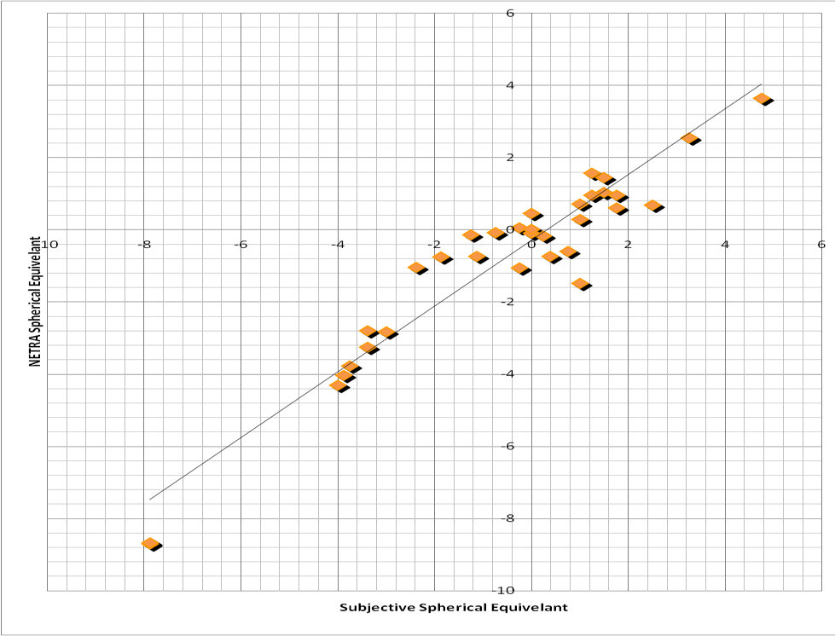


Correlation
Spherical Equivalent r=0.96

Slide 16
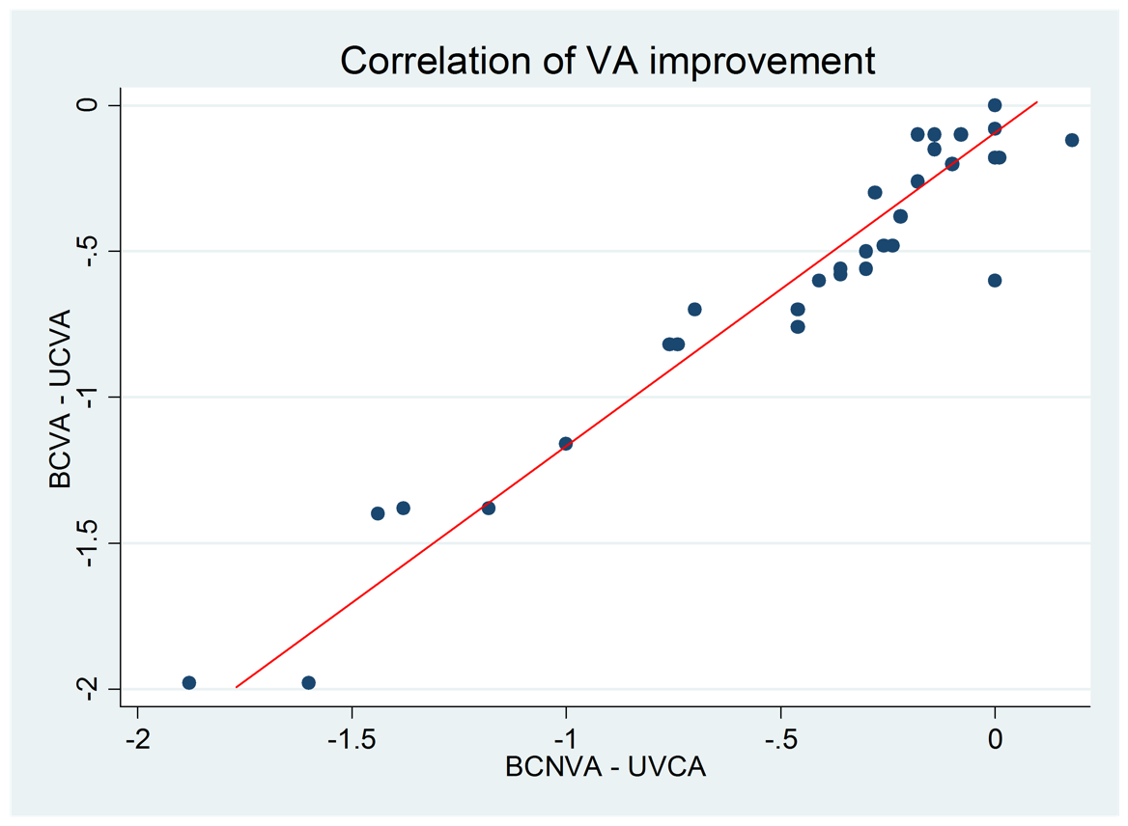


Correlation
Δ VA r= 0.95

Slide 17
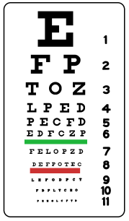
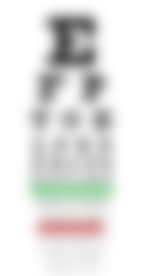
Pilot Study - Results
Improved 6 lines of vision
Improved 4 lines of vision

Slide 18
Limitations
Difficult to prevent accommodation
Over Minus
Off axis results are poor
Testing in children required
Refraction only one barrier
Future prototypes likely to deal with these issues
Warrants further testing in low-income settings

Slide 19
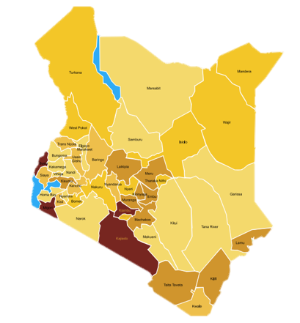
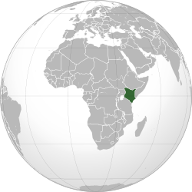
Future
Plans to be tested in a population based study in Kenya commencing next month

Slide 20
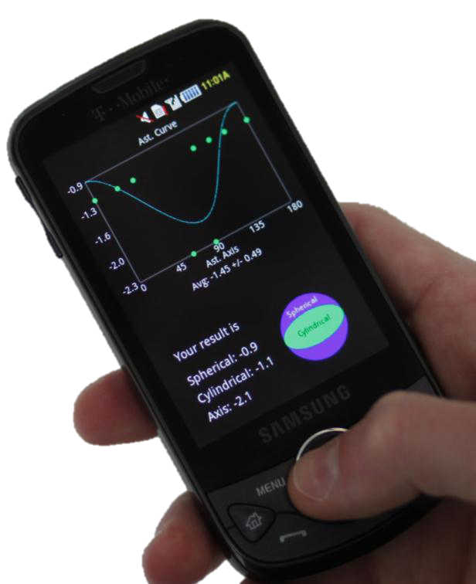
NETRA
NITHI
NYAYA

Slide 21
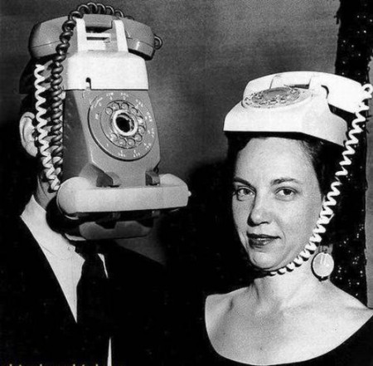

Questions
A. Bastawrous, C. Leak, F. Howard, BV Kumar. Journal of Mobile Technology in Medicine. In Press 2012
Andrew.bastawrous@lshtm.ac.uk for further
information

