Slide 1
Dr A K Grover, MD, MNAMS, FRCS Chairman, Department of Ophthalmology, Sir Ganga Ram Hospital, New Delhi & Chairman, Vision Eye Centres New Delhi
Going solo…… High volume, stringent
quality, total control !

Slide 2
Why solo practice ?

Slide 3
WHY SOLO PRACTICE?
Freedom

Slide 4
FREEDOM
To pursue your dreams

Slide 5
FREEDOM
To pursue success

Slide 6
FREEDOM
Of thought and action
not bound by straitjacket of physical and mental constraints

Slide 7
FREEDOM
To choose work environment
Quality assurance
To pursue academics
Financial freedom

Slide 8
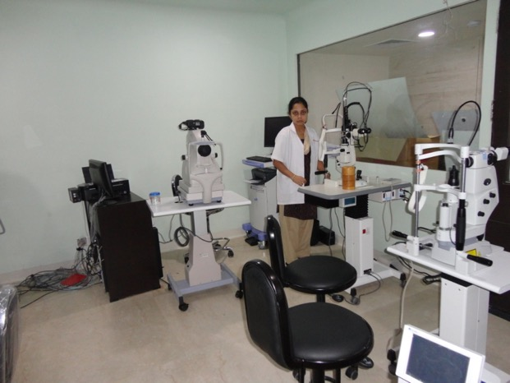
FREEDOM
To develop your work environment
Work place
Aesthetics
Equipment
Employees
Work culture

Slide 9
Work Place

Slide 10
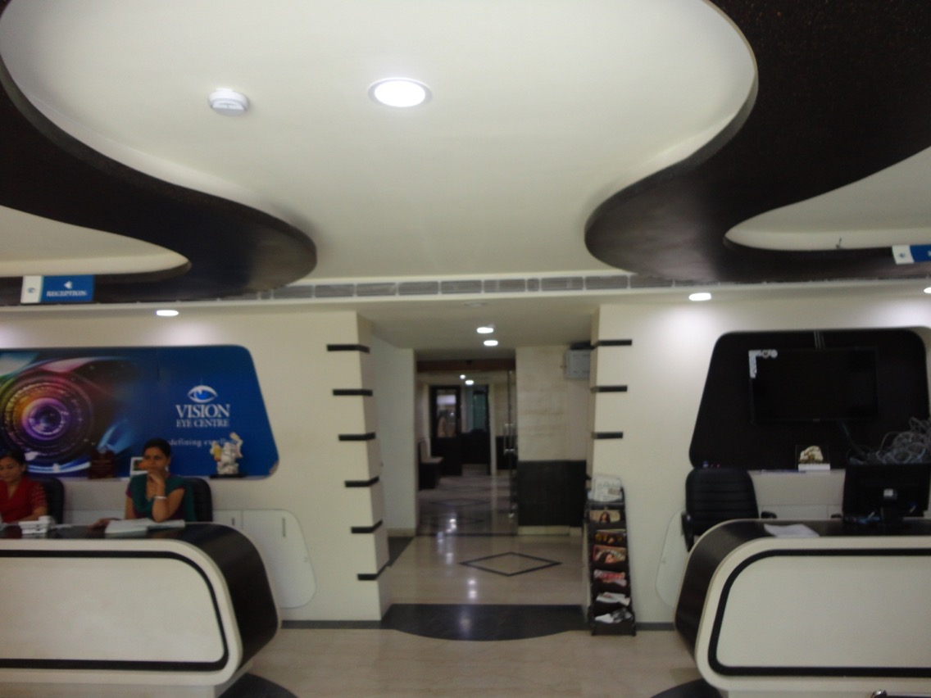
Work Place Aesthetic set up

Slide 11
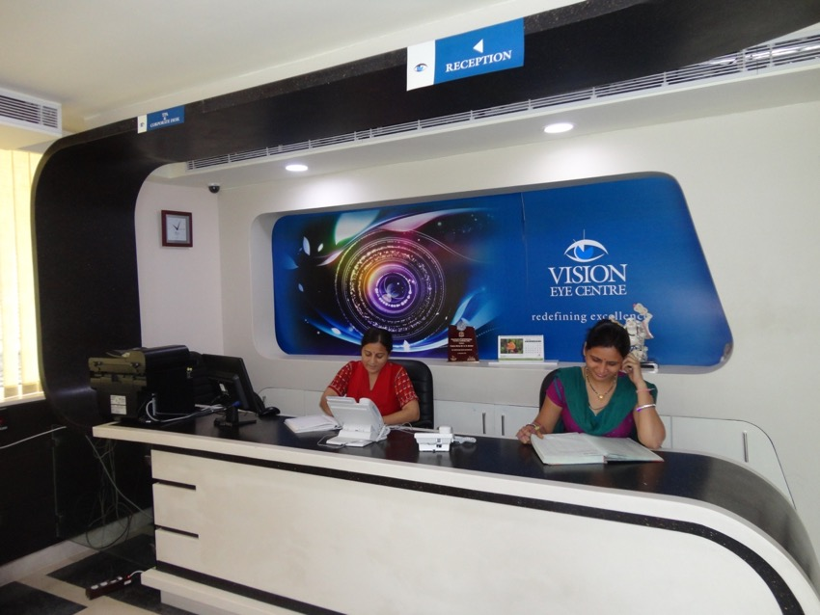
Work Place
Front office

Slide 12
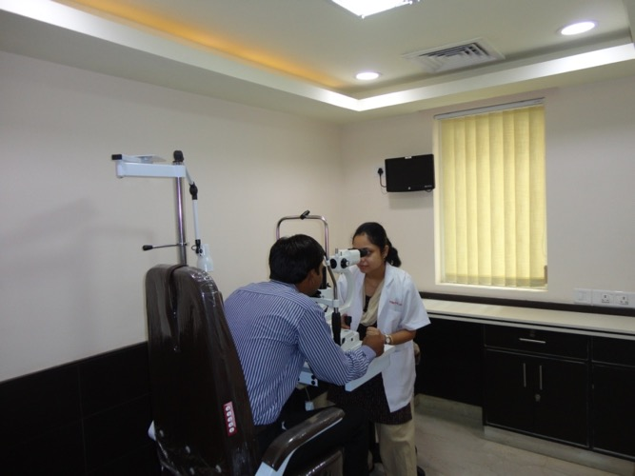
Work Place
Outpatient services

Slide 13
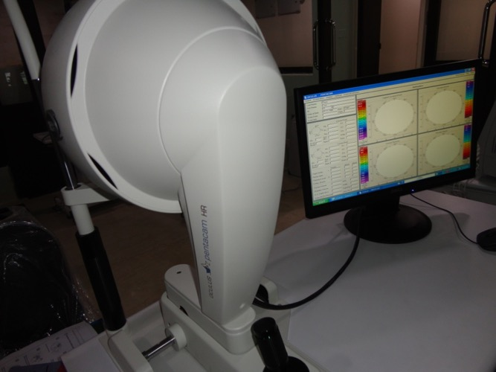
Work place Equipment

Slide 14
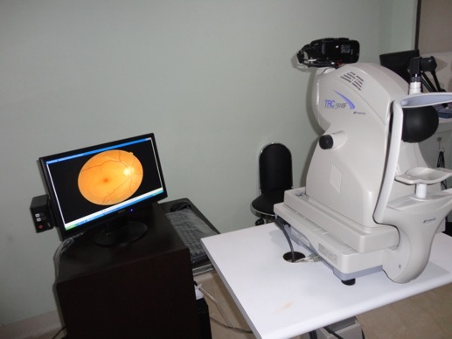
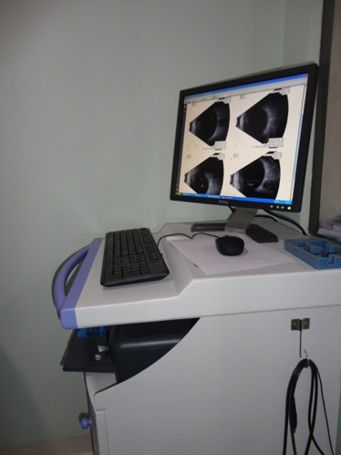
Work Place Speciality services

Slide 15
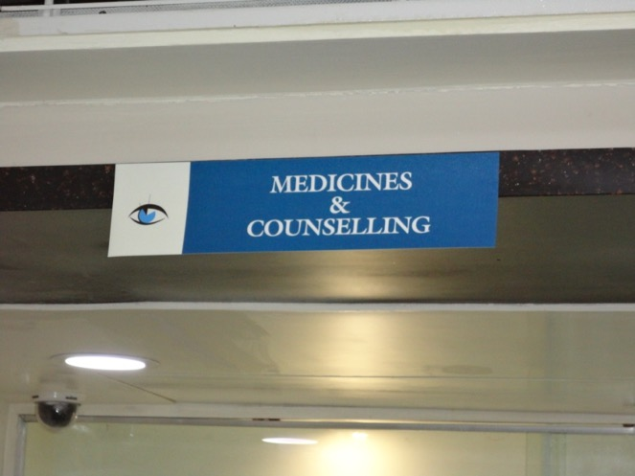
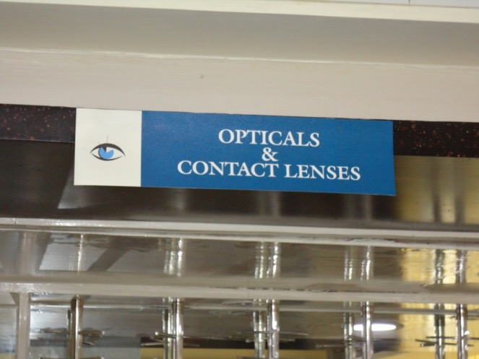
Work Place
Ancillary Services

Slide 16
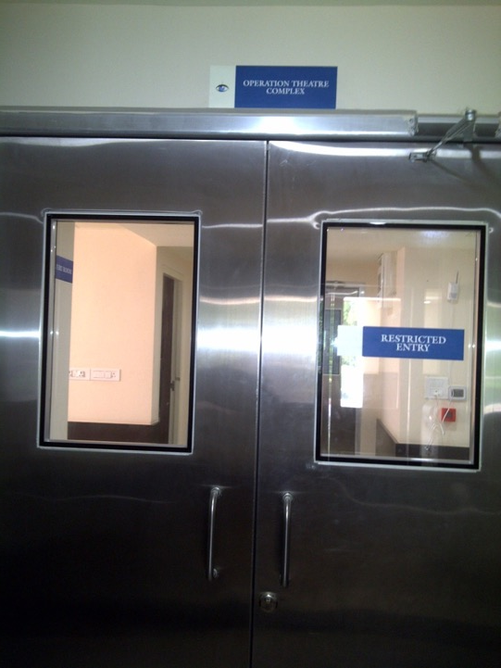
Work Place Operation theatres

Slide 17
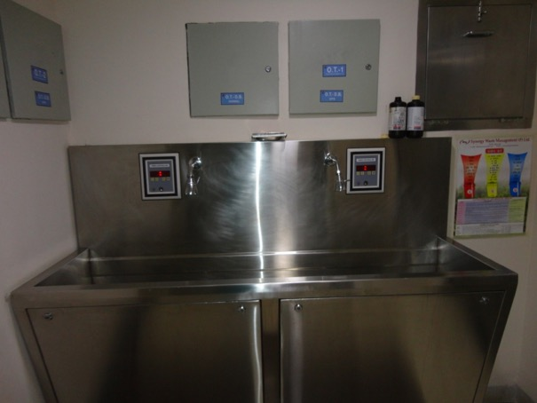
Work Place Operation theatre

Slide 18
Work Place Post operative Patient care areas

Slide 19
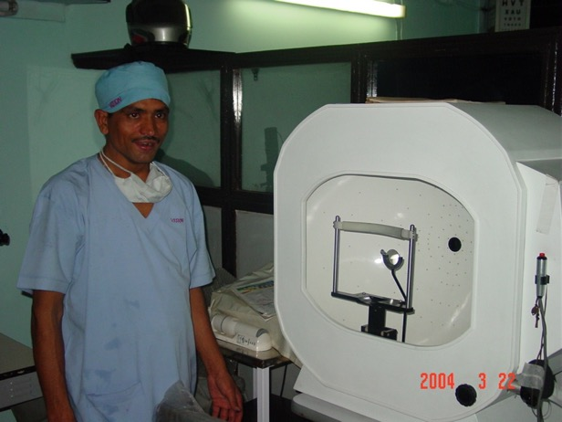
Work Place Human Resource

Slide 20
Work Culture
Quality assurance

Slide 21
Quality assurance
Ensuring availability of and adherence to protocols
Accreditation

Slide 22
Work Culture
Courtesy and behaviour

Slide 23
FREEDOM TO PURSUE ACADEMICS
Attend conferences /
Other academic activities of your choice.

Slide 24
FREEDOM Management of finances
Ensuring profitability

Slide 25
Role of finances
“A hospital should also have a recovery room….. adjoining the cashier’s office”
Francis O’ Walsh

Slide 26
FINANCIAL FREEDOM
To invest in
Your work place
Your equipment
Your books
/Journals.

Slide 27
FINANCIAL FREEDOM
To give amenities to your family
To give the best education to your children
To enjoy comforts
To enjoy vacations
Live life the way you want to.

Slide 28
SUCCESS DEPENDS ON
Your initiative
Your ability
Your effort.

Slide 29
SUCCESS DOES NOT DEPEND ON
Your ability to impress
(? butter up) your boss.
Your c.R’s.

Slide 30
THE SKY IS THE LIMIT TO SUCCESS

Slide 31
WHAT TO ENSURE BEFORE YOU BEGIN

Slide 32
Questions to ask yourself !
How much income am I willing to risk till practice develops?
How much debt am I willing to incur to reach a sustainable cash flow?

Slide 33
Questions to ask yourself !
Do business decisions and tasks really interest me ?
Is my family ready to fully support me and make necessary sacrifices ?

Slide 34
ENSURE

Slide 35
KNOWLEDGE

Slide 36
ABILITY

Slide 37
CONFIDENCE

Slide 38
RIGHT ATTITUDE

Slide 39
RESOURCES

Slide 40
Strategy
Good Services
Courtesy
Waiting Time
Quality of patient care and surgery
Honesty to self and patient

Slide 41
Strategy
Surgery
Undertake what you
can do COMPETENTLY…
Refer others

Slide 42
How does solo practice weigh against institution / group practice

Slide 43
Institutional / group vs Individual Practice Differences pertain to:
Clinical Practice
Academics
Personal & Social Life

Slide 44
Institutional / group Practice Disadvantages
Administrative Responsibilities
Paper Work

Slide 45
Institutional / group Practice Disadvantages
Unable to mould the place totally according to one’s desire
Justification to be given for each equipment purchase
More accountability related to surgical output

Slide 46
Institutional / group Practice Disadvantages
Jealousies / Back biting

Slide 47
Institutional / group Practice Disadvantages
Financially much less lucrative

Slide 48
Solo Practice Advantages
Ability to build / mould a place of your own
-Can give expression to your ability / creativity

Slide 49
Solo Practice Advantages
Flexibility in working
Greater control on working of staff

Slide 50
Solo Practice Advantages
Better financial returns

Slide 51
Solo Practice Disadvantages
More work
More Responsibilty

Slide 52
Solo Practice Disadvantages
Increased hassles
Management of the set-up
Purchases
Inventories
Stock checking
Thefts

Slide 53
Solo Practice Disadvantages
More financial liabilities
House tax
Electricity bills
Water bills
Telephone bills
Maintenance costs
Insurance of equipment & space

Slide 54
Solo Practice Disadvantages
Official problems
NH recognition (need to fulfill requirements)
Hassles from civic agencies
Commercial rates of electricity, water, house tax, telephone

Slide 55
Solo Practice Disadvantages
Official problems
Accreditation hassles
Empanelment hassles
TPA & Insurance hassles

Slide 56
Magic Mantras
Need to work hard
There are no short cuts in life

Slide 57
Magic Mantras
Plan well
Understand the market !!!!

Slide 58
Magic Mantras
Plan well
Understand the financial implications

Slide 59
Magic Mantras
Patient comes first…….ALWAYS
Patient’s interest is YOUR INTEREST…..

Slide 60
Magic Mantras
“ There are just two rules for success
1. Never tell all you know.
2.
Robert H. Lincoln

Slide 61
Patient Satisfaction is the Key!!
Thank You

Slide 62
Private practice
Have to do?
Want to
do ?

Slide 63
Comfort / Courtesy for patient…..

Slide 64
Staff Co-operation

Slide 66
Practice of Medicine Definition
“ Medicine may be defined as the art or the science of keeping a patient quiet with frivolous reasons for his illness and amusing him with remedies good or bad until nature kills him or cures him”
Gilles Menage (1613-92)
God heals and the doctor takes the fee
Proverb

Slide 67
“ Medicine is a noble profession but a damn bad business”
Humphrey Rolleston (1862-1944)

Slide 68
Medicine is the only profession that labours incessantly to destroy the reason for its existence
Sir James Bryce (1838-1922)

Slide 69
Increasing volumes Ensuring better patient satisfaction
Improved patient services
(Clinical,surgical, ancillary and courtesy)
Better relationship with patients
Greater word of mouth publicity
Higher recommendation ratio
Better return rate of patients

Slide 70
Growing one’s practice Strategies to expand range of services
Developing infrastructure
Developing subspecialities
Training manpower

Slide 71
Strategies to expand range of services Developing Infrastructure
Adding equipments
Financing
Cost sharing basis with the specialist or as a group practice
Agreement with suppliers
Financing
Deferred payment
Per case basis payment

Slide 72
Strategies to expand range of services Developing subspecialities
Getting subspecialists for services
Salary basis
As part time consultants
Visiting consultants
Sharing basis

Slide 73
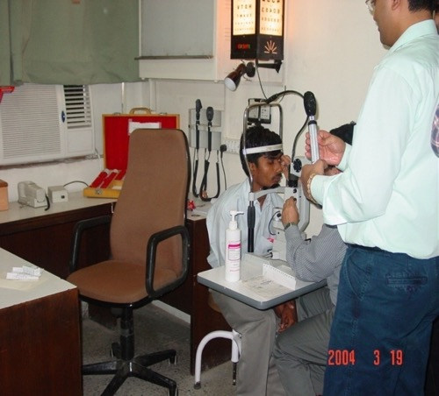
Strategies to expand range of services Developing subspecialities
Ensuring cost effectiveness by tie ups
Vitreo retina - with Diabetes specialists
Neuro ophthalmology/
squint – Neurologists

Slide 74
Strategies to expand range of services Developing subspecialities ensuring cost effectiveness of subspecialities by tie ups
Pediatric Ophthalmology – with pediatricians
Aesthetic surgery – with plastic surgeons/ dermatologist/ cosmetic clinics

Slide 75
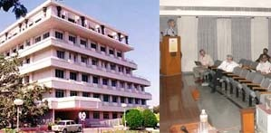
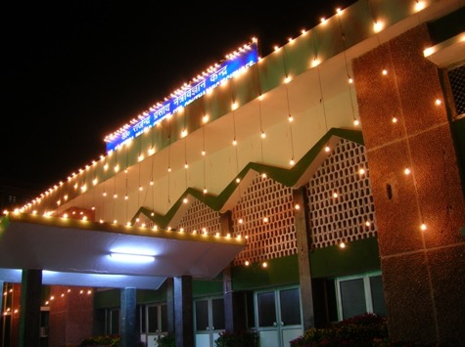
Strategies to expand range of services Developing subspecialities
Training manpower
Fellowships at centres of excellence
Inviting specialists for short duration

Slide 76
Role of finances
“A hospital should also have a recovery room….. adjoining the cashier’s office”
Francis O’ Walsh

Slide 77
“ There are just two rules for success
1. Never tell all you know.
Robert H. Lincoln

Slide 78
Institutional Practice or Individual Practice: Pros & Cons
Dr A K Grover, MD, MNAMS, FRCS
Chairman, Department of Ophthalmology,
Sir Ganga Ram Hospital, New Delhi
&
Director, Vision Eye Center, New Delhi

Slide 79
Institutional vs Individual Practice Differences pertain to:
Clinical Practice
Academic Work
Personal & Social Life

Slide 80
Institutional Practice Advantages
Clinical Practice
Good Equipment / Set-up (cuts down investment needed;)
Assistance in outpatients evaluation / surgery
Quality Work

Slide 81
Institutional Practice Advantages
Clinical Practice
Support of other sub-specialities in cases of mishap / difficult cases / work-up
ICU / CCU back-up – Can take up difficult cases
Cross Referrals from other specialities

Slide 82
Institutional Practice Advantages
Clinical Practice
Shared Work & Responsibility
Cushion against patient misbehavior / litigation – Back-up available
Also ensures ethical practice

Slide 83
Institutional Practice Advantages
Academics
Teaching Environment
Assistance in academic presentation / writing books / writing papers

Slide 84
Institutional Practice Advantages
Academics
Access to Library / Internet / Latest modalities of management
Set-up + assistance for conducting conferences / work-shops

Slide 85
Institutional Practice Advantages
Academics
Support in research work

Slide 86
Institutional Practice Advantages
Academics
Ability to conduct exams (ICO / FRCS / NBE)
Can be an examiner (NBE / FRCS)

Slide 87
Institutional Practice Advantages
Personal & Social Life
Name & Prestige
Abilities / Skills get known to a lot of people

Slide 88
Institutional Practice Advantages
Personal & Social Life
Unit System – Ability to take VACATIONS

Slide 89
A judicious mix of the two

Slide 90
FREEDOM OF THOUGHT AND ACTION.
NOT BOUND BY STRAIT JACKET OF PHYSICAL AND MENTAL CONSTRAINTS.

Slide 91
TO DEVELOP YOUR WORK ENVIRONMENT

Slide 92
Work Place Own Set-up……How does it help?……
Patient at ease in a smaller set-up

Slide 93
Aesthetic set up
Courtesy
Ambience

Slide 94
Work Place Equipment

Slide 96
Quality Assurance
-Ensuring availability of and adherence to protocols

Slide 97
What do I suggest?

Slide 98
Own Set-up ……How does it help ?
Freedom
Independence
Ability to mould set-up

