Slide 1
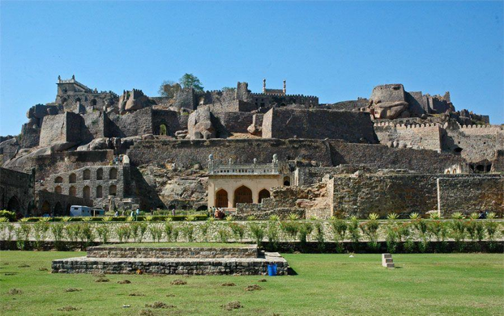
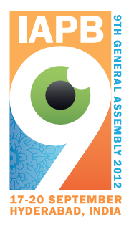
Impact of Successful Low Vision Projects
Dr Haroon Awan
CEO
Avicenna Consulting

Slide 2
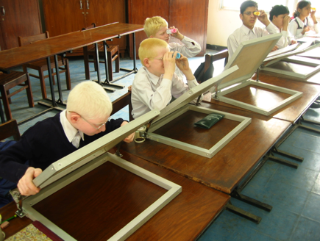
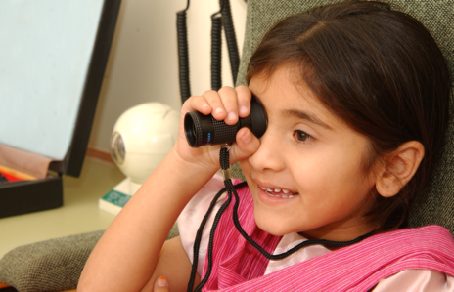
Moments that move us ….!

Slide 3
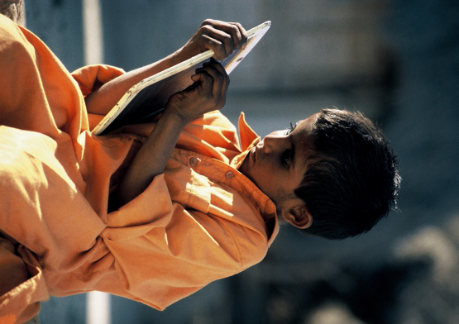
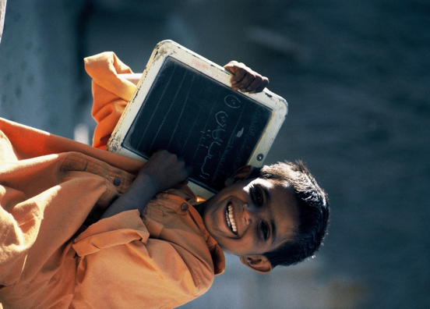
Moments that move us ….!

Slide 4
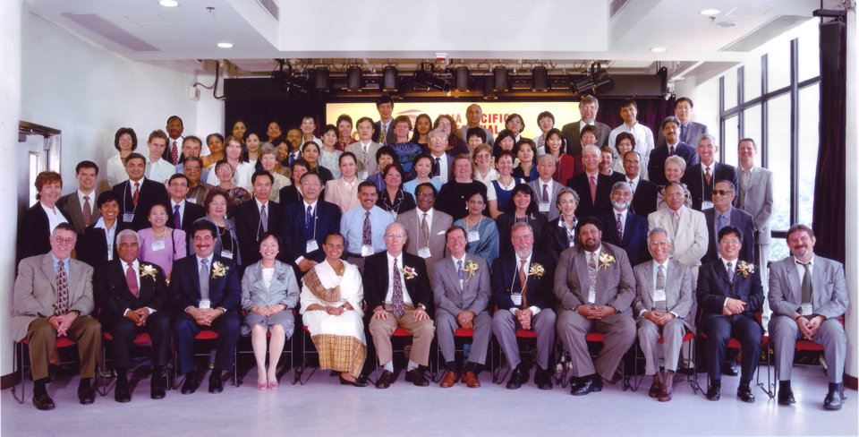
Asia Pacific Low Vision Meeting in Hong Kong in 2001

Slide 5
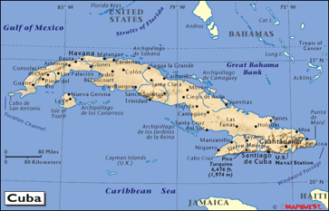
Low Vision Services
in Cuba
1980s - LV services in Havana
1995 - Specialists trained in Spain – trained 50 ophthalmologists in LV care
CBM – 2001 initiated LV project
Train 300 ophthalmologists, rehabilitators, optometrists, optical labs
Awareness – 10,000GPs
CBM Supported Project
P – 11 m
Per capita GDP - $ 5100
HDI - 51
Increased Coverage and Access

Slide 6
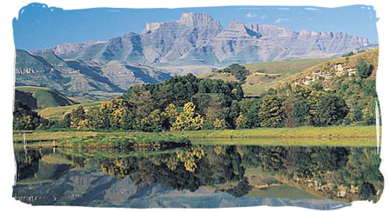
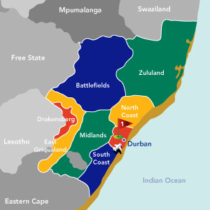
Giving Sight to
Kwa Zulu Natal
SCB Seeing is Believing Project
Advocacy
School
Clustering
Human
Resources
District Based
7 hospitals
RE and LV services
0 to 30 Optometrists
Global
Resource
Centre
Dept of Health
P – 10 m (KZN)
Per capita GDP - $ 4767
HDI - 123
Going to Scale

Slide 7
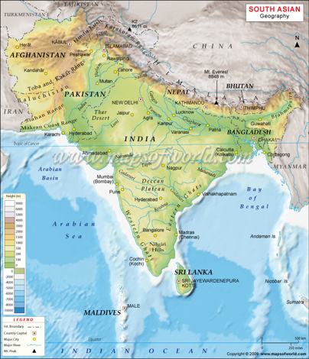
NEPAL
Low vision services at 13 hospitals and 31 primary care centres
CBR workers and special school teachers
PAKISTAN
LV driver for optometry training programme
Tertiary care and links with education
R&D
BANGLADESH
Tertiary and secondary services
Primary level CBR and CAHD integration
SRI LANKA
Tertiary level care
Focus on secondary services
INDIA
Mushroom growth
Vision centre model
Optometry linkages
Coverage increasing from <1% to 10%

Slide 8
Conclusion
Programming
Training
Curricular Frameworks
Inclusive Practices
Nodes and Clusters
Specialist Services
Health and Education
Low Vision in Transition

Slide 9
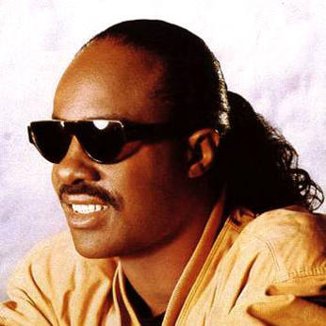
People hand in hand
Have I lived to see the milk and honey land?
Where hate's a dream and love forever stands
Or is this a vision in my mind?
Stevie Wonder

