Slide 1
Course 10
Global Burden of Disease:
Impact of Vision Loss
Contribution of the GBD and dissemination of results
Serge Resnikoff MD, PhD
On behalf of the GBD Vision Loss Expert Group

Slide 2
Why do we need data?
1. To support Advocacy
“Advocacy is the process of influencing decision-makers to create change”
Requires best possible information for
  making effective policy decisions
  mobilizing more resources

Slide 3
Why do we need data?
2. To support priority setting, planning, monitoring and evaluation
Especially for quantifying how much needs to be prevented and treated
Implies:
  cause-specific data
  country level data
  periodically updated data
  comparable data over time for trends analysis

Slide 4

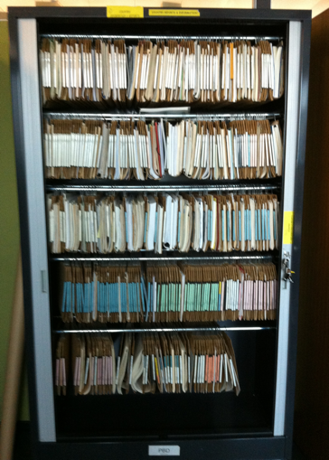
In the Past
WHO/PBD Data Bank, initiated by AD Negrel.
  Two closets in a corridor
  Two papers published: lists of publications

Slide 5
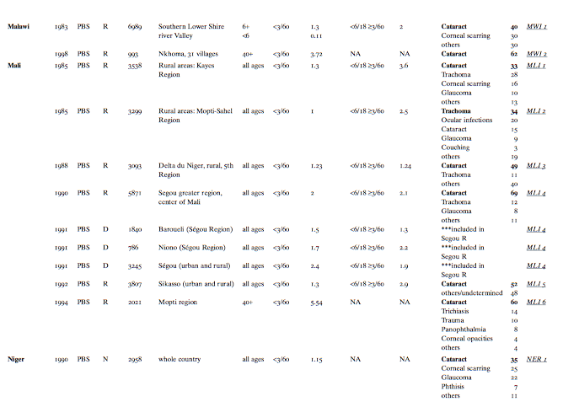
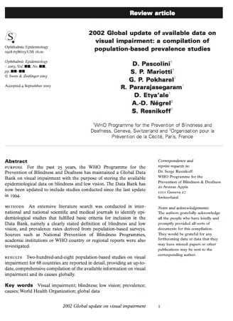
WHO/PBD Data Bank

Slide 6
In the Past
WHO/PBD Data Bank, initiated by AD Negrel.
  Two closets in a corridor
  Two papers published: lists of publications
  2006: attempt of integration in the WHO InfoBase

Slide 7
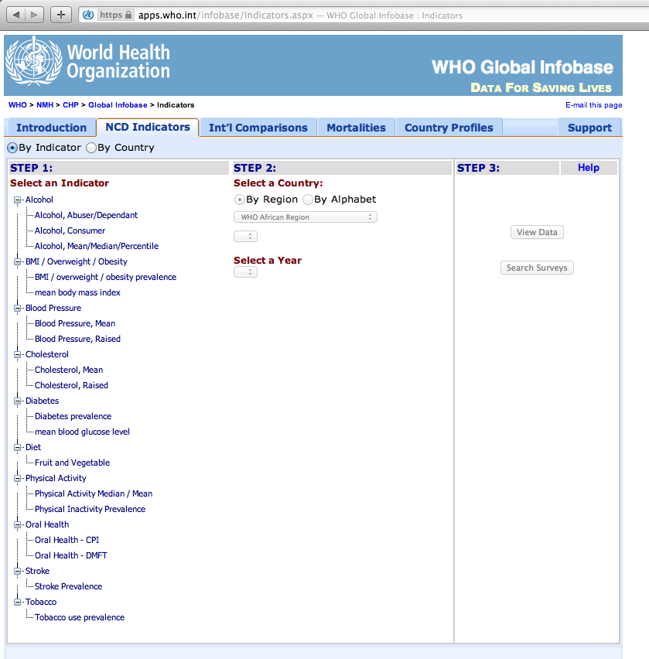

Slide 8
In the Past
WHO/PBD Data Bank, initiated by AD Negrel.
  Two closets in a corridor
  Two papers published: lists of publications
  2006: attempt of integration in the WHO InfoBase
Used to generate periodic “global (and regional) estimates of Blindness and Visual impairment”
  1970, 1976, 1990
  1996, 2002, 2004, 2008, 2010

Slide 9
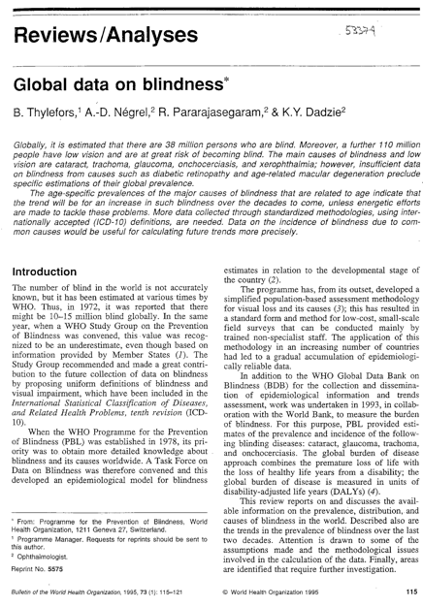
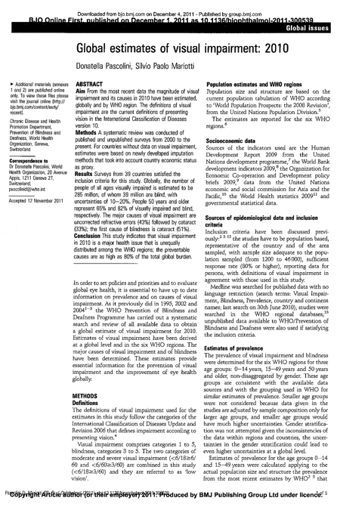
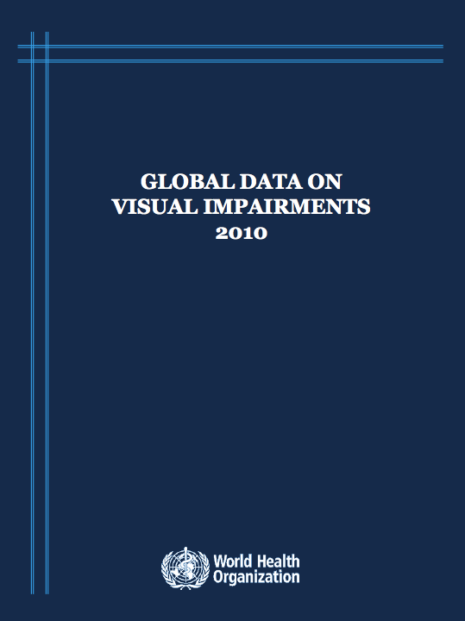

Slide 10
Contribution
WHO Global Estimates
  initially used for the first GBD exercise
  then used to feed the WHO annual statistical report (part of World Health Report) – till 2004

Slide 11

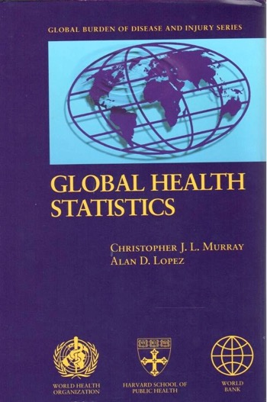
1996

Slide 12
1990 (WDR 1993)
VAD
Sense Organ
Cataract
Glaucoma
Oncho
Trachoma

Slide 13










W
WHR 2003
Glaucoma
Cataract
Vision loss, age related and other

Slide 14
Contribution
WHO Global Estimates
  major role in the genesis of V2020 (avoidable blindness, trends due to ageing, magnitude of URE)
  Mainly used for advocacy and communication
Previous GBD data (1990/96, GBD 2004)
  Based on WHO/PBD estimates
  high impact on Cost Effectiveness analysis (cataract, oncho, VAD…)
  major role in “ranking” VI against other conditions (issue of groupings)

Slide 15

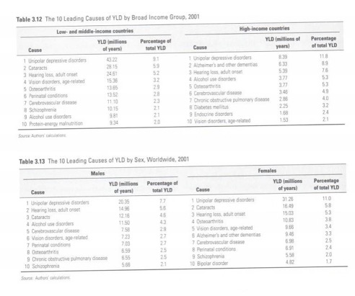
Top 10 Causes of Years Lived with Disability
Cataract
Vision disorders, Age-related
2
4
3
2
6
4
GBD 2001 (2006)

Slide 16

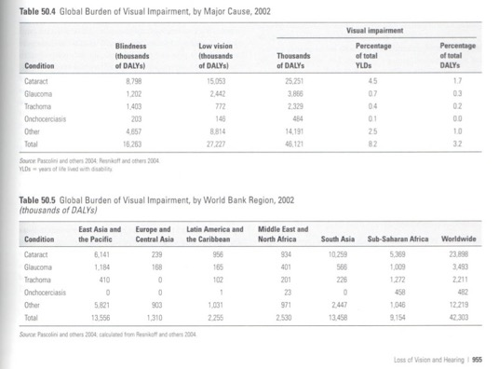
Cataract
Glaucoma
Trachoma
Onchocerciasis
Other
3.2% of total DALYs
Second Edition (2006)

Slide 17
Major issue: data are not directly comparable
Resnikoff & Keys, IJO 2012

Slide 18
How do the findings differ?

Slide 19
Dissemination challenges:
What is needed?
country level data (prevalence and causes) for advocacy, priority setting, planning and monitoring.
data easy to understand and visualize

Slide 20
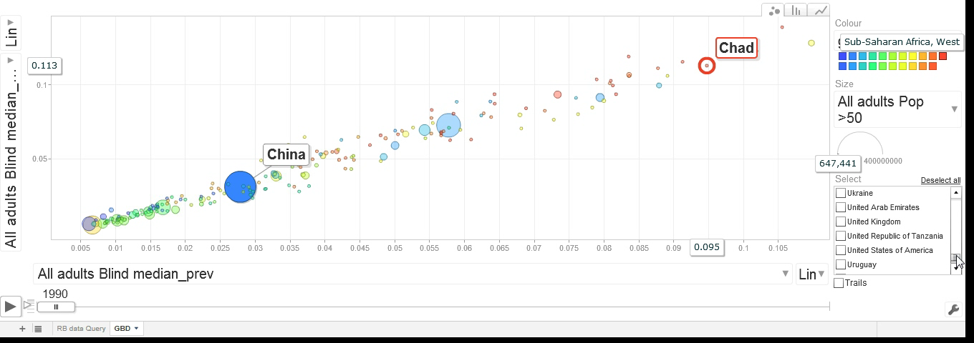
Visualisation

Slide 21
Dissemination challenges:
What is needed?
country level data (prevalence and causes)
data easy to understand and visualize
data easy to access and use (web based)
data regularly updated (as for mortality or demographic data) – implies specific resources and organization

Slide 22
Dissemination: Publication plan
Published:
Editorial: Global Burden of Visual Impairment and Blindness. Bourne R, Price H, Stevens G. Arch Ophthalmol. 2012;130(5):645-647.
Accepted for publication :
The Global Burden of Disease Project: Rationale and Methodology of the Systematic Review by the Vision Loss Group. Bourne R, Price H, Taylor H, Leasher J, Keeffe J, et al. Ophthalmic Epidemiology. Accepted 1 Sept 2012.
Submitted:
Global Prevalence of Vision Impairment and Blindness: Magnitude and Temporal Trends, 1990-2010. Stevens G, White R, Flaxman S, Price H et al. PLoS Medicine

Slide 23
Dissemination: Publication plan
Planned:
  Cause specific data – at global level
  Regional papers combining causes with prevalence of Vision Impairment and Blindness
Also capstone papers from the GBD Core group on:
  Disability Weights
  DALYs.

Slide 24
Plan for the Future (5 years)
Maintain the global data base and provide periodic updates:
  Update the database by annual extensions of the systematic review
  Release an interim update in 2014/15.
  Revisit the statistical model and provide a 5 year update in 2017 .
Create an internet-based portal to:
  provide access to population-based prevalence data by age, by sex, by region, by country, and by cause.
  model the data temporally, both retrospectively and prospectively.
  also provide additional parameters such as GDP and other metrics to develop visualisations.
Project is supported by BHVI

