Slide 1
The Alan Johns Memorial Lecture
Serge Resnikoff MD, PhD

Slide 2
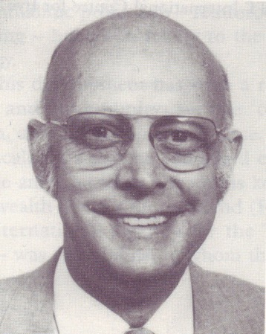
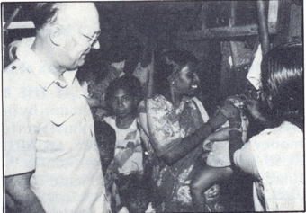
Alan Johns CMG OBE
1931 – 1995
Bangladesh 1983

Slide 3
The Alan Johns Memorial Lecture
13 Years After: are we still on track?

Slide 4
Global blindness
1998 - 2020
Million
blind
x 2
Scenario without additional action

Slide 5
Global Distribution of Blindness by Cause
(WHO/PBL, 1995)
Other
28 %
URE ?
DR ?
AMD ?
Oncho.
1 %
Glaucoma
14%
Cataract
42 %
Trachoma
15 %

Slide 6
The Global Initiative for the
Elimination of Avoidable Blindness
Countries
NGOs
TF IAPB
WHO
The Global Initiative
for the Elimination of Avoidable Blindness
by 2020
Aim: “to intensify and accelerate present prevention of blindness activities
so as to achieve the goal of eliminating avoidable blindness by the year 2020”

Slide 7
The Global Initiative for the
Elimination of Avoidable Blindness
Trend
Million
blind
The Global
Initiative

Slide 8


“VISION 2020 - the Right to Sight”
launched on 18 February 1999
by Dr G. H. Brundtland
WHO Director General

Slide 9
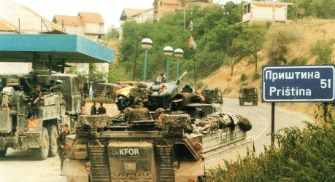
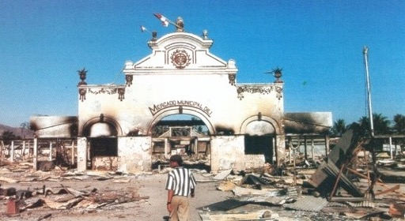
1999
Kosovo
East Timor

Slide 10
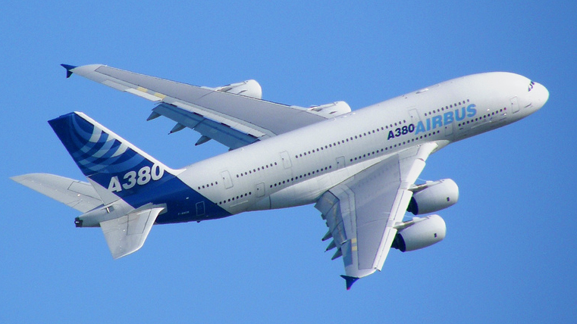
1999
Decision taken…

Slide 11
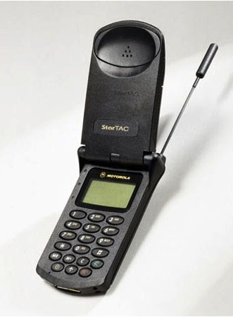
1999

Slide 12
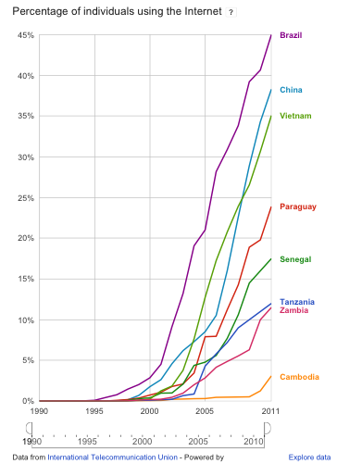
1999 - 2012
Percentage of individuals using the Internet
VISION 2020

Slide 13
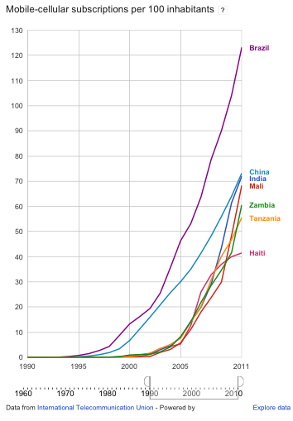
1999 - 2012
Mobile-cellular subscriptions per 100 inhabitants
VISION 2020

Slide 14
NASDAQ Composite index Feb 1999 – Sept 2012
VISION 2020

Slide 15
Eye Care 1999 - 2012
ICCE
ECCE
SICS
Phaco
Femto L. ?
Anti-VEGF

Slide 16

Global cataract targets
Cataract
operations
(millions)

Slide 17
Global cataract targets
Cataract
operations
(millions)

Slide 18
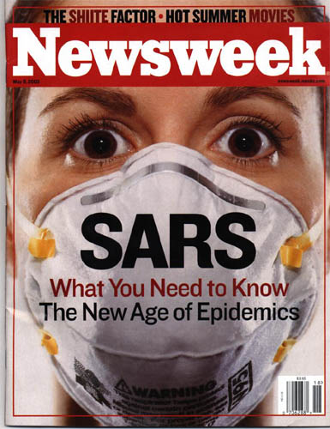
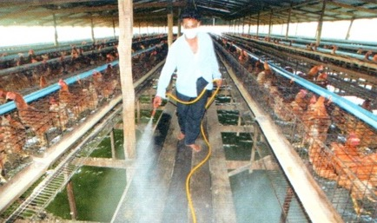
Global Health 1999 – 2012

Slide 19
Obsession with epidemic outbreaks
SARS in 2003 : 8000 cases, 800 deaths
Avian Flu H5N1 in 2004:
  “could kill 150 Mo people” (Chief Avian Flu Coordinator for the United Nations)
  $10 Billion spent in a couple of weeks
  46 cases, 32 deaths
Swine Flu H1N1 panic in 2009
  Case fatality rate 1/3 of seasonal flu
Contrast with little interest in chronic conditions

Slide 20









Pre-VISION 2020
Main International Players
1946 (Relief in Europe)
1944 (reconstruction)
1948
1969
1987
1996
1999: 300+ organizations listed as active in International Health

Slide 21













Post-VISION 2020
New Major International Players
Aug 1999 - $ 2.5 Bo
2002 - $ 3 Bo
2000 – 2006 - $ 3 Bo
2001 – IDF
NCDs
UHC
2006 - $ 1.5 Bo
ADFm
2009
2002 – $ 161 Mo
2001, 2006, 2010

Slide 22



Current Major International Players
2012: 500+ organizations listed as active in International Health

Slide 23
Trends in Development Assistance for Health
$27 Bo
« Shift in the balance of contributions between the different channels, with UN agencies playing a smaller role and the Global Fund, GAVI, US and UK bilateral aid, and the Gates Foundation growing in importance ».
« Funding for HIV/AIDS continued to rise, while programmes targeting maternal, newborn, and child health received the second largest share. Non-communicable diseases received the least amount of funding compared with other health areas »
Ch J L Murray et al. Lancet Jul 2011

Slide 24
Misfinancing global health: a case for transparency in disbursements and decision making
Devi Sridhar, Rajaie Batniji, Lancet 2008
*
Visual Impairment

Slide 25




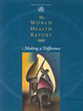

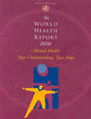
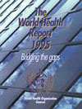
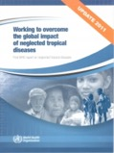
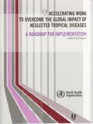



1999 - 2012

Slide 26
1999 - 2012
Social Determinants of Health

Slide 27
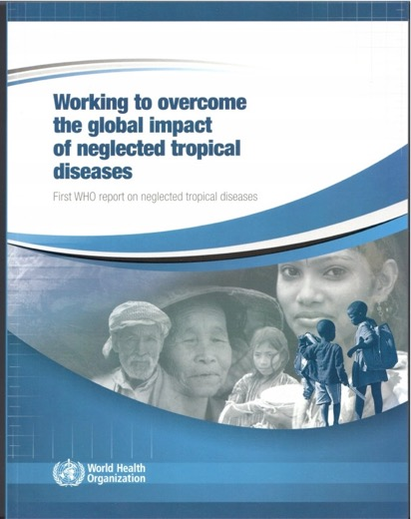
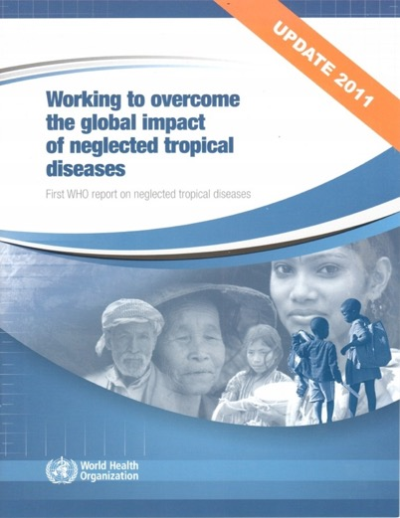

NTDs
2003
2010
2011
2012

Slide 28

Risk Factors
Attributable fractions
Population level
Intervention

Slide 29
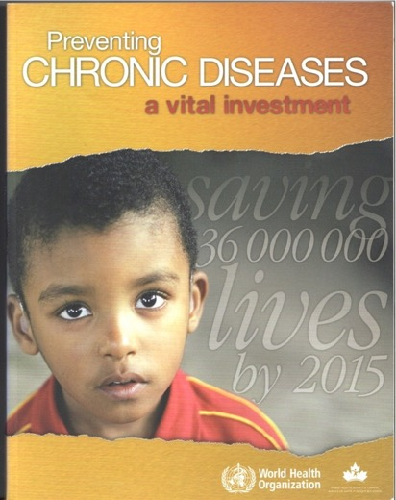
NCDs and Chronic Diseases
Risk Factors Approach
Population-based
Interventions
2005

Slide 30
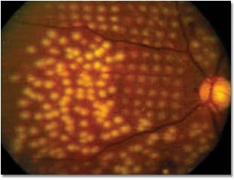
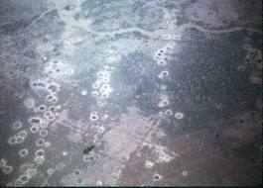
Pan Retinal Photocoagulation
Carpet-Bombing
Diabetes Primary prevention
In addition to
Diabetic Retinopathy management

Slide 31
New metrics for
Health System Performance
(Fairness, Responsiveness…)
Focus on importance of
Health System Financing and
Out of Pocket Expenditures

Slide 32
  10% improvement in life expectancy is associated with annual economic growth increases of 0·3–0·4%
« Improved health contributes to economic growth »
CMH: 2000 - 2008

Slide 33
WHR 2010

Slide 34
WHR 2010

Slide 35
Universal Health Coverage “Movement”
Universal Health Coverage:
“everyone can use the health services
that they need ”
At the centre of UHC is a package of services that are available when needed without causing financial hardship to the user

Slide 36
UHC: no longer a distant dream?
The 25 wealthiest nations all now have some form of universal coverage (apart from the USA).
Also several middle-income countries: e.g. Brazil, Mexico, and Thailand
Lower-income nations are making progress e.g. the Philippines, Vietnam, Rwanda, and Ghana, India, South Africa, and China
Cross-country learning have developed, e.g. the Joint Learning Network (Ghana, Mali, Nigeria, Kenya, Vietnam, Thailand, India, Indonesia, the Philippines, and Malaysia)
Adapting rather than adopting what others do.

Slide 37
Lessons learnt
UHC in isolation is no guarantee of effcient care.
UHC reforms must be accompanied by measures to ensure that :
  services are available and of good quality;
  health workers are well trained, motivated, and close to people;
  drugs and equipment are available and distributed appropriately.
UHC requires multi- sectoral collaboration with ministries and institutions dealing with fiscal and monetary policy, education, labour and social security
Strong political leadership and commitment is important to make such collaboration work.

Slide 38
Where is the money coming from?
Is International Aid needed?
On the one hand, UHC has to be driven by forces from within a country, not from outside. In that respect Aid is not the answer.
  Government expenditures for health from countries’ own sources: US$410 Bo in the developing world in 2009, i.e. 16 times larger than the total development assistance for health. Even in the African region, external sources represent only 11% of the funds spent on health.
On the other hand, International Aid is necessary in lowest income countries ($40 billion per year)

Slide 39
Issues related to the package of services
UHC is always defined in terms of coverage of a minimum basic package of health needs
Usually prioritises effective low-cost interventions for the excess disease burden of the local population
Typically:
  group I diseases (Comm. D. and MCH conditions)
  and a subset of group II (NCD) and group III (trauma) diseases that can also be addressed with high effectiveness at low cost.

Slide 40
Issues related to User Fees
« Direct out-of-pocket payments levied at the time when people need services not only inhibit the poor and disadvantaged from seeking health care, but are also a major cause of impoverishment for many who obtain it » (David Evans et al. WHO, Lancet, 2012)

Slide 41
Issues related to User Fees
« Regardless of the euphemism chosen to describe shared payments, they are in reality a locked gate that prevents access to health care for many who need it most. They should be scrapped » (Lancet, Editorial 8 Sept 2012)
End of cost-recovery?

Slide 42
Great transitions in health
First: demographic transition
Second: epidemiological transition
Third: Universal Health Coverage
Health is a Right
Health is a Collective Good
Is Sight a Collective Good (?)

Slide 43
Many things have changed
However, …

Slide 44
Global Causes of Blindness
1995
2010
Oncho.,
1
Other
28
Glauc.,
14
Cataract
42 %
Cataract
51 %
Tra.,
15

Slide 45
Global Causes of Visual Impairment
Cat + D & N URE = 91%
+
Presbyopia
Cat + URE = 75%
WHO/NMH/PBD/12.01

Slide 46
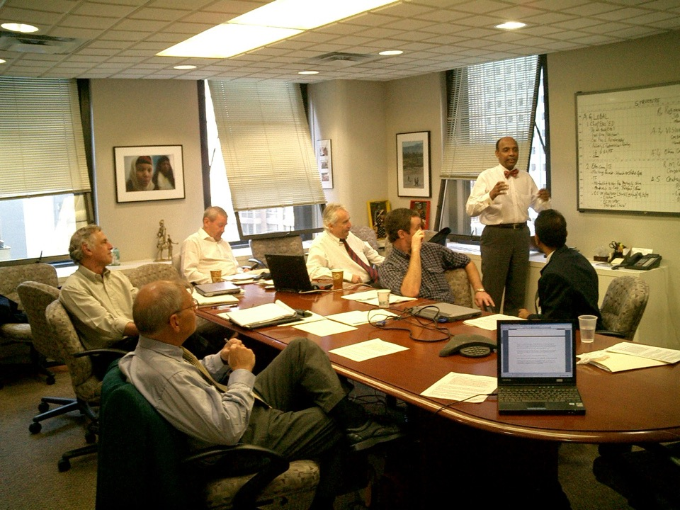
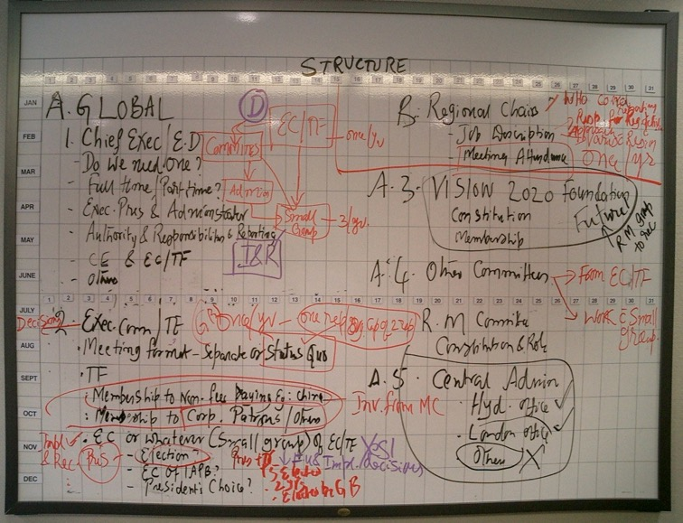

Slide 47
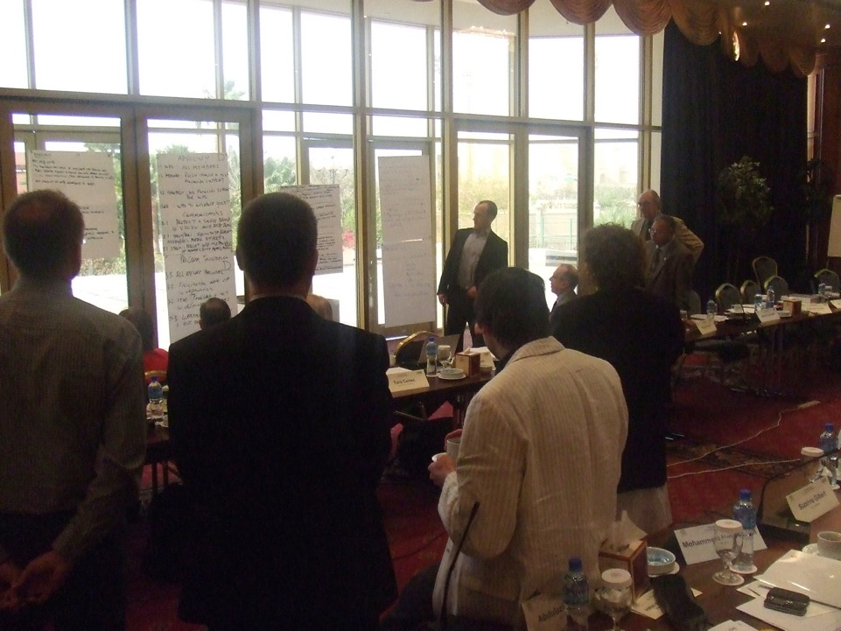

Slide 48

Thank you

