Slide 1
ONCHOCERCIASIS CONTROL & ELIMINATION:
LESSONS LEARNT AND
OPPORTUNITIES FOR COLLABORATION
Mectizan Donation Program
25th year Anniversary Lecture
9th General Assembly, IAPB
Hyderabad, 19 September 2012

Slide 2
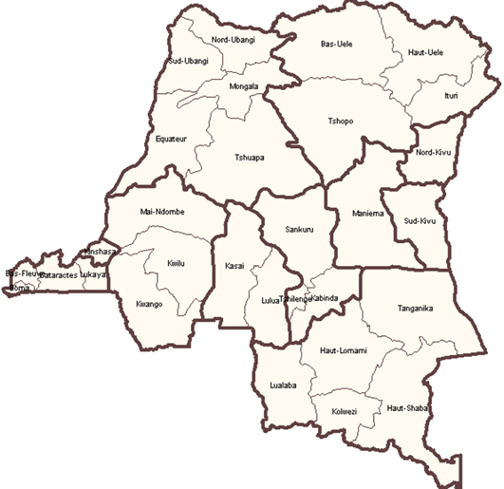
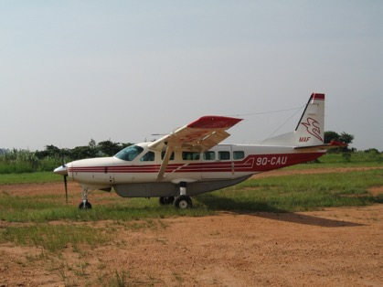
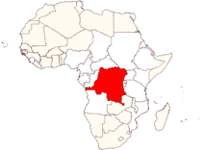
The Democratic Republic of Congo (DRC)…
Malingwiya
Nyankunde
April 1987
Kinshasa

Slide 3
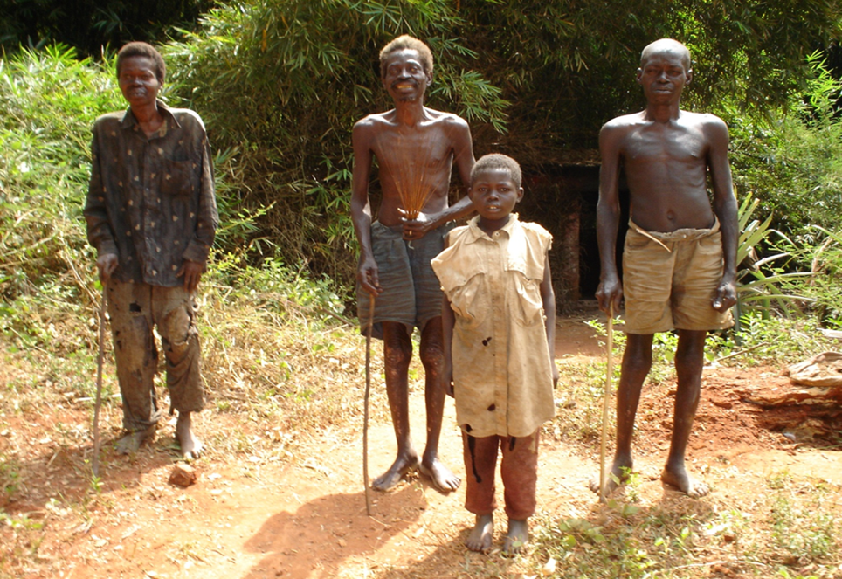
First eye safari to Malingwiya...
Indicators | Malingwiya
Number of blind patients examined | 40
Number of blind people from onchocerciasis | 22
Percentage | 60 %
Credit: Dr Tepage

Slide 4
Next steps…
Joint meeting of OSEA and ISGEO: August 1988 in Nairobi, Kenya: "Blindness in northeastern DRC"
Attendance in the Diploma course in CEH in London in 1989: Proposal for Ivermectin Mass Distribution in the Ueles in northeastern DRC
MDA first attempt in Dingila Health Zone from 1991 to 1995

Slide 5
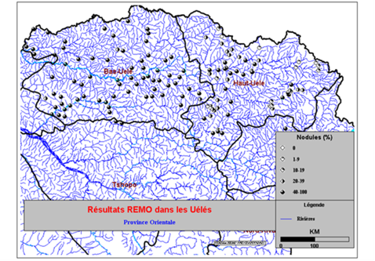
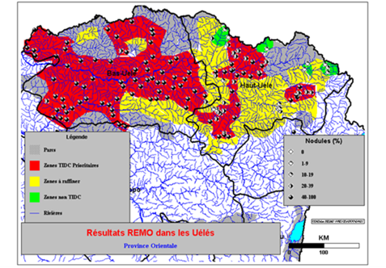
At the later stage……
Launching of APOC in December 1995
REMO (WHO/TDR)
(Jan – March 1998): 135 villages surveyed
Launching of Uele CDTI project in December 2003
Evaluation in Dec 2012

Slide 6
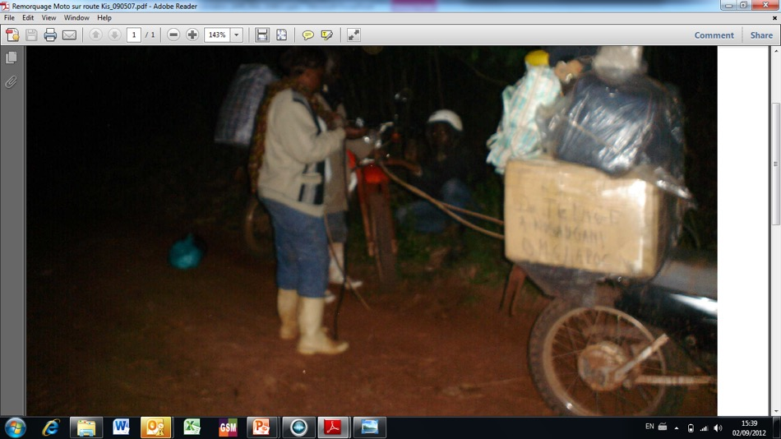
Dr Tepage & Mrs Nyawali from Uele CDTI project transporting Mectizan from Kisangani to Buta…

Slide 7

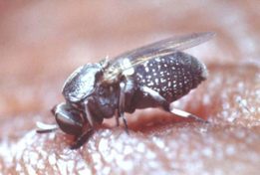
Onchocerciasis…?
A skin & eye disease caused by a filarial worm: "Onchocerca volvulus"
It is transmitted by a small black fly of the genus of Similium which breeds in fast-flowing streams & rivers. This is why the risk if blindness in higher close to these rivers

Slide 8
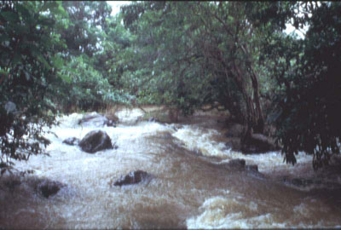
Breeding site…

Slide 9
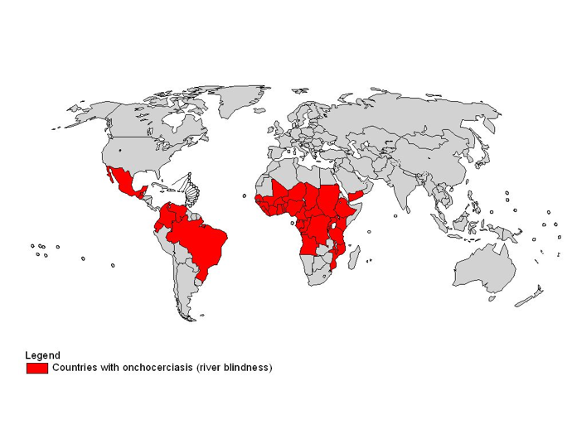
Geographical distribution…?
99 % in 31 countries in Africa
Yemen
Latin America: 13 foci in 6 countries

Slide 10
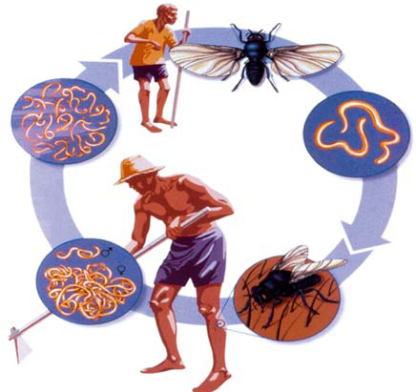
Life cycle of O. volvulus…
A blackfly bites an infected human host and ingests the baby worm (microfilariae)
The microfilariae
migrate into the skin,
eyes and other organs
of the human host
Over 6-12 days,
the microfilariae
mature to infectious
larvae inside the fly (L3 stage)
Maturing inside the human
host, male and female adult
worms gather and produce
thousands of microfilarae
The blackfly bites another
human, transmitting the infectious larvae
Source: ENCYCLOPEDIA BRITANICA

Slide 11

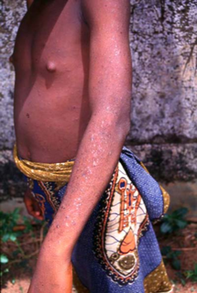
Skin lesions…(1)
Itching: severe, intense, terrible, incessant, etc…
Dermatitis (papulae, rash, etc…)

Slide 12
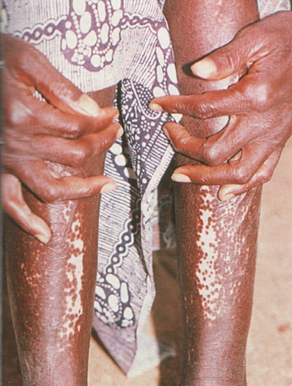
Skin lesions…(2)
Pigmentation disorders (mainly depigmentation or leopard skin)
Atrophy which can lead to hanging groin and elephantiasis of the genitals

Slide 13
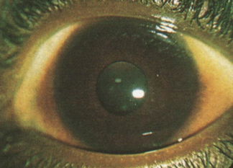
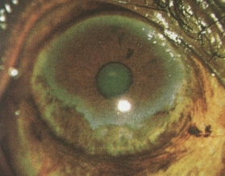
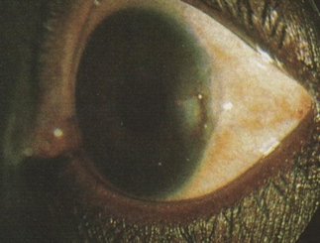
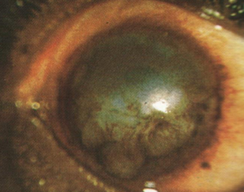
Eye lesions (Anterior segment)…
Punctate keratitis
Sclerosing keratitis

Slide 14
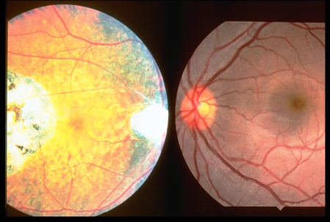
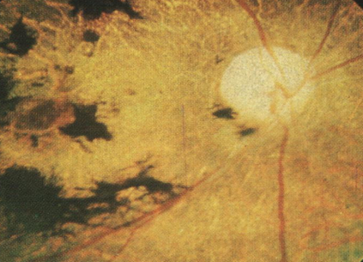
Eye lesions (Posterior segment)…
Optic atrophy
Ridley chorioretinitis

Slide 15
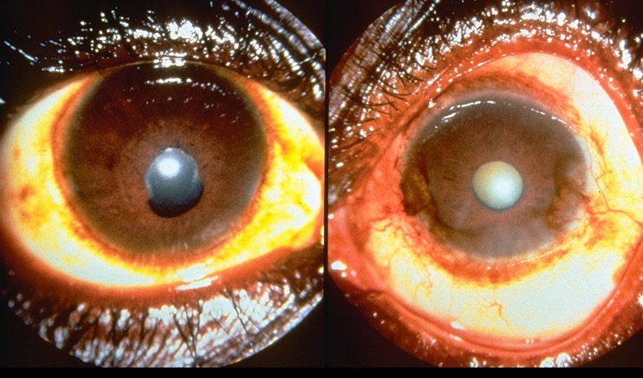
Iritis & secondary cataract…

Slide 16
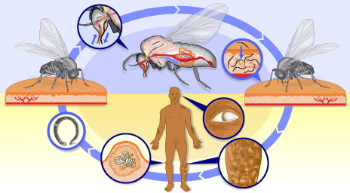
Intervention strategies…
Kill the vector
The last two interventions are the only available interventions to control or eliminate onchocerciasis: vector control & treatment with microfilaricidal drugs. Mectizan® is the only safe and effective drug to date.
Kill the Macrofil.
Kill the microfil.
Source: TDR/Wellcome Trust

Slide 17
Actions of the international communities…
The Onchocerciasis Control Programmes (OCP)
The Onchocerciasis Elimination Program for the Americas (OEPA) and
The African Programme for Onchocerciasis Control (APOC)

Slide 18
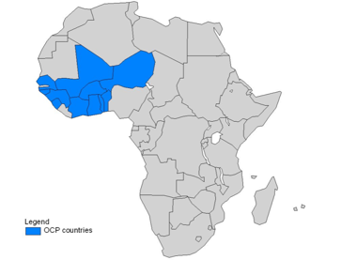
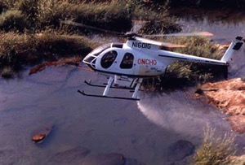
Ex-Onchocerciasis Control Programme (ex-OCP)…
Launched in 1974 in 11 countries in West Africa
Main strategy: vector control
From 1988, ivermectin mass treatment (Mectizan®)
Closure in 2002, except in 5 Special Interventions Zones (SIZ) up to 2007 (Benin, Togo, Ghana, Guinea & Sierra Leone)
Surveillance activities in most countries
Ghana, Côte d'Ivoire & Sierra Leone: MDA continues

Slide 19
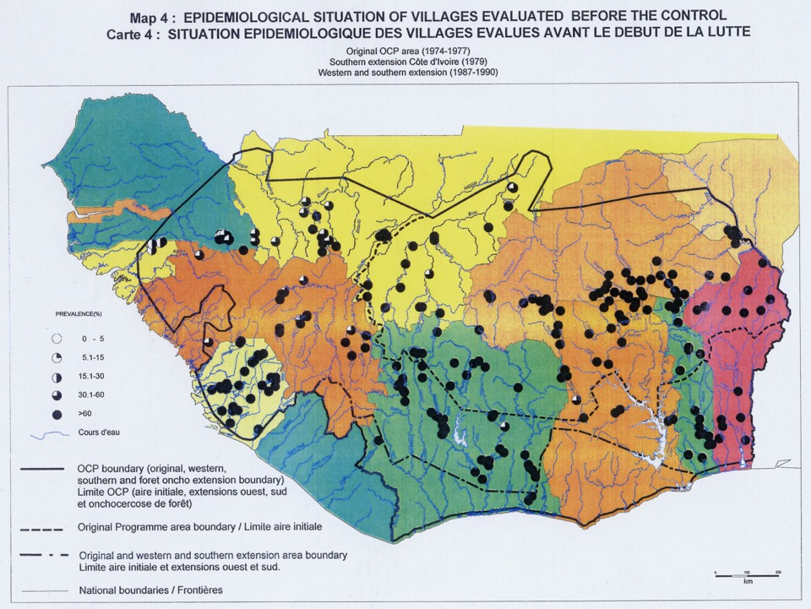
Notes:
19

Slide 20
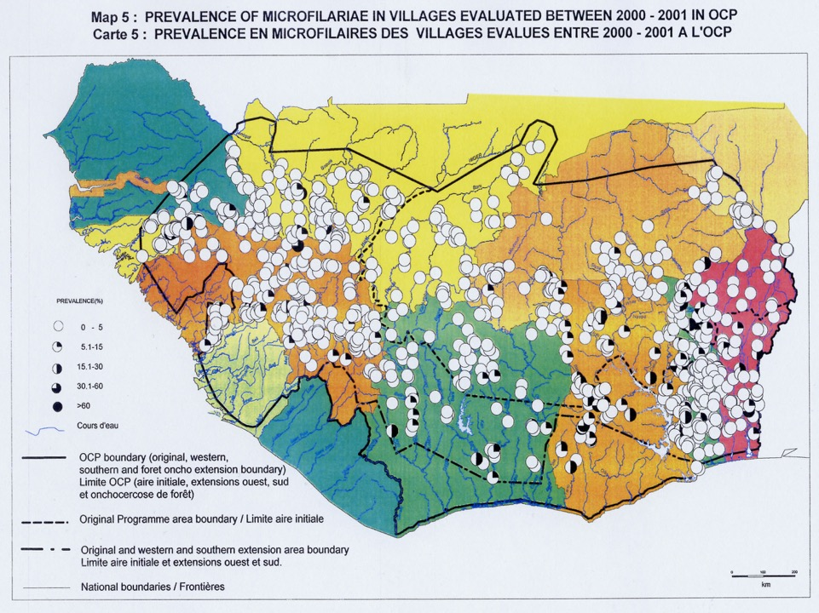
Notes:
20

Slide 21
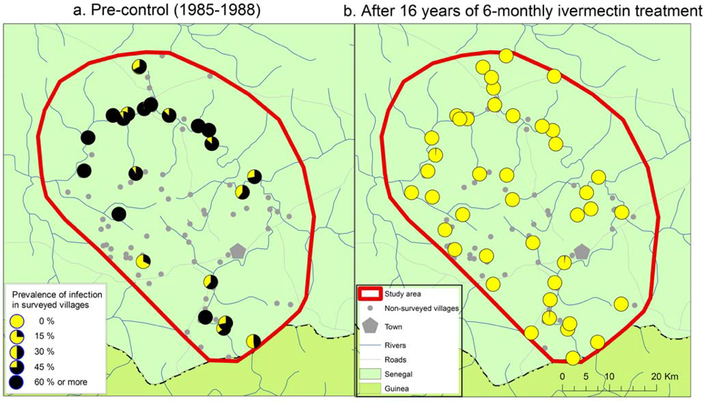
Feasibility of Onchocerciasis Elimination with Ivermectin Treatment in Endemic Foci in Africa: First Evidence from Studies in Mali and Senegal (Part 1)
Diawara L, et al. (2009). PLoS Negl Trop Dis 3(7): e497.

Slide 22
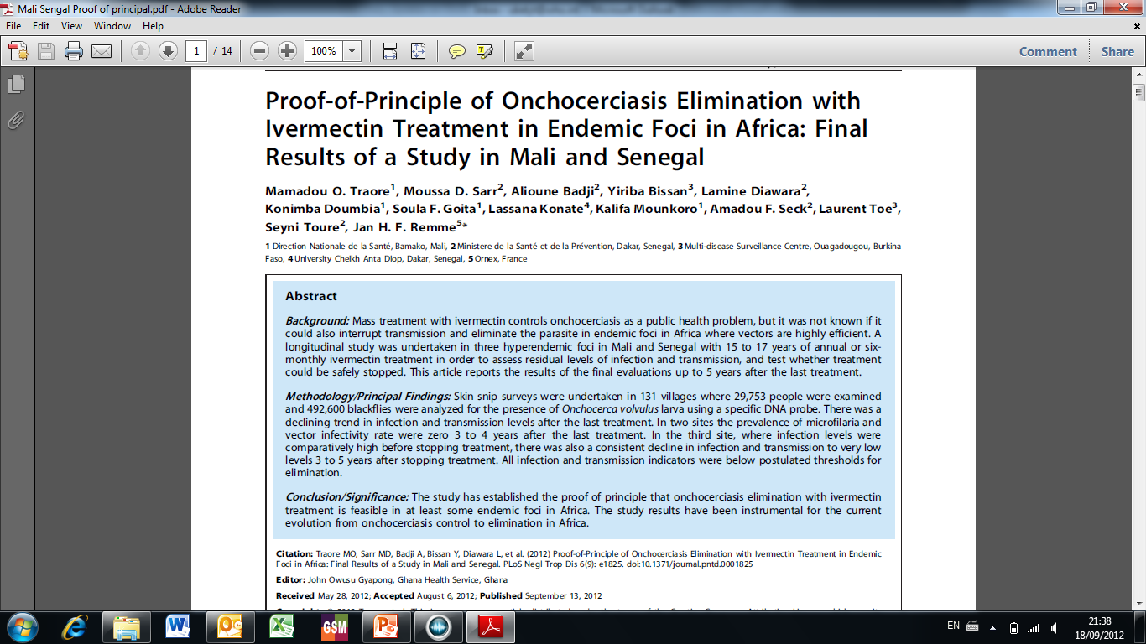
Proof-of-Principle...

Slide 23
OCP Partnership…
4 UN Agencies : WHO, the World Bank, FAO & UNDP
11 Endemic countries
More than 20 donors
NGDO Group: HKI, OPC, Sightsavers MDP & CNTD
WHO/PBD/NGDO Coordination Group for Onchocerciasis Control
23

Slide 24
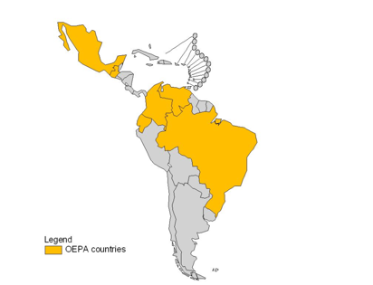
Onchocerciasis Elimination Programme for the Americas (OEPA)…
Launched in 1991 in 6 countries in Latin America in 13 isolated foci
With about 400,000 people at risk
Semi-annual ivermectin mass treatment with the objective of achieving elimination by 2015
To date, MDA has been halted in 10 out of 13 foci (4 out of 6 endemic countries)
Columbia: certification of elimination request in 2011
WHO/PBD/NGDO Coordination Group for Onchocerciasis Control

Slide 25
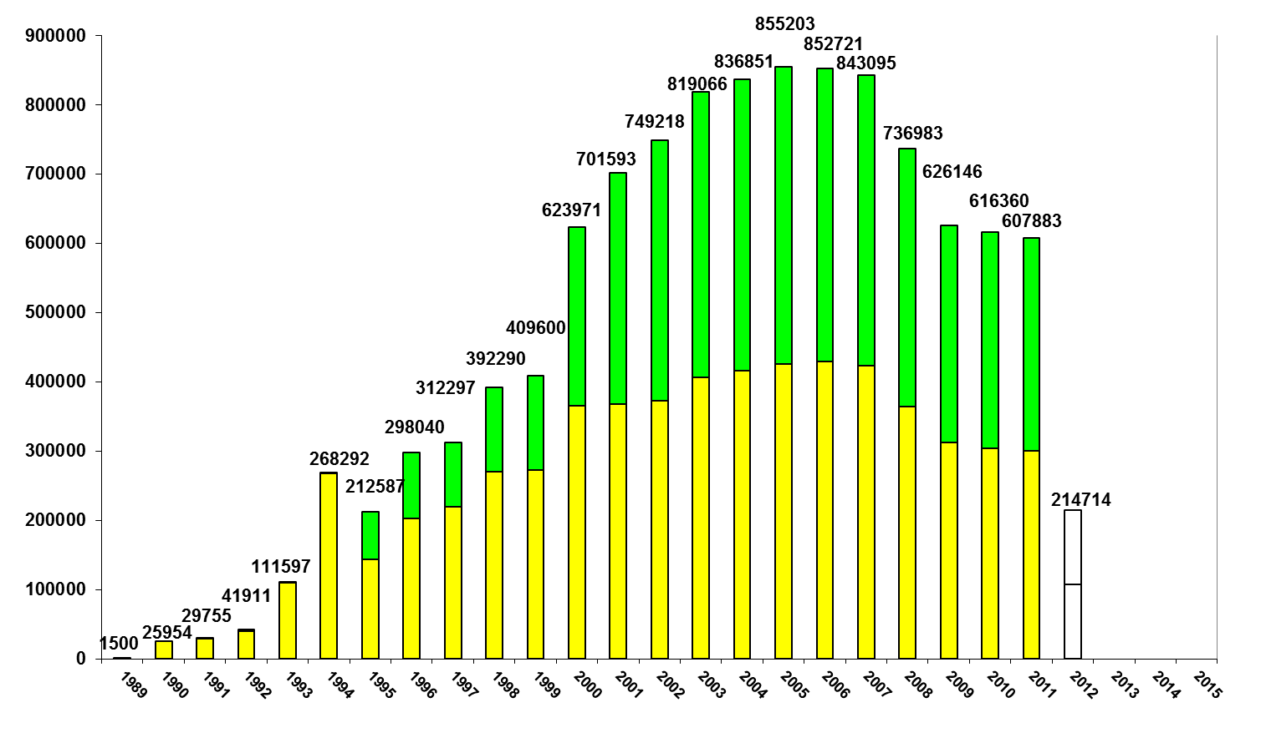
Ivermectin Treatment Figures within OEPA partnership…
Source: OEPA

Slide 26
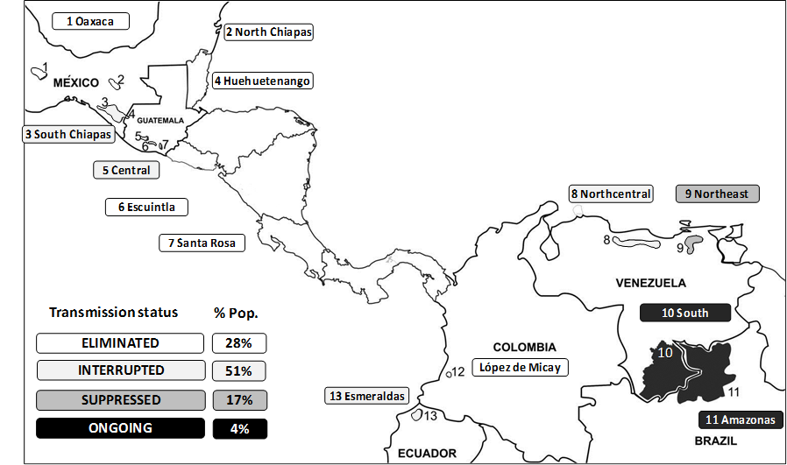
Onchocerciasis Elimination status as per 2012…
Source: OEPA

Slide 27
OEPA partnership…
MoH of endemic countries
The Carter Center
The Pan American Health Organization (PAHO)
Lions Clubs Internat. Foundation(LCIF)
CDC
The Bill & Melinda Gates Foundation
Several universities
Mectizan Donation Program (MDP)

Slide 28
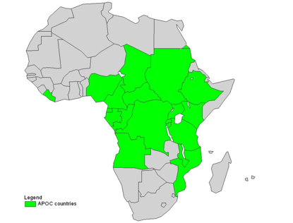
African Programme for Onchocerciasis Control (APOC)…
Launched in 1995 initially in 19 countries; South Sudan has recently joined as the 20th country
Population at risk: 102 million
CDTI: mainly annual ivermectin mass treatment except in Sudan & Uganda
Delayed treatment in loiasis co-endemic & in post-conflict areas
WHO/PBD/NGDO Coordination Group for Onchocerciasis Control

Slide 29
Number of people treated from 2005 to 2010 within APOC partnership…
Source: APOC

Slide 30
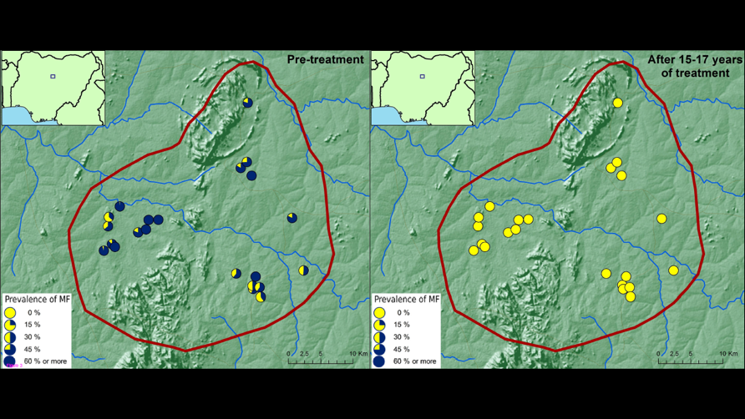
Impact of long-term treatment of onchocerciasis with ivermectin in Kaduna State, Nigeria: first evidence of the potential for elimination in the operational area of the African Programme for Onchocerciasis Control
Tekle et al.: Parasites & Vectors 2012, 5:28

Slide 31
Projected elimination status of APOC countries by 2015 and 2020
Source: APOC
Country | Population of CDTi projects | National Elimination by the year
 |  | 2015 | 2020
Angola | 950,346 | No | Yes
Burundi | 1,406,983 | No | Yes
Cameroon | 6,473,620 | No | Yes
Chad | 1,871,174 | No | Yes
Congo | 759,199 | No | Yes
Ethiopia | 7,644,144 | No | Yes
Malawi | 1,978,306 | No | Yes
Mozambique | 0 | No | Yes
Nigeria | 33,283,450 | No | Yes
Sudan | 444,655 | No | Yes
Tanzania | 2,207,132 | No | Yes
Uganda | 3,248,975 | No | Yes
Subtotal | 60,267,984
Central African Republic | 1,408,824 | No | No
Democratic Republic of Congo | 27,137,104 | No | No
Eq. Guinea | 80,206 | No | No
Gabon | 0 | No | No
South Sudan | 5,605,726 | No | No
Subtotal | 34,231,860
By 2020,
12 APOC countries may achieve elimination
protecting more than 60 million people

Slide 32
Projected elimination status of APOC countries by 2015 and 2020
Source: APOC
Country | Population of CDTi projects | National Elimination by the year
 |  | 2015 | 2020
Angola | 950,346 | No | Yes
Burundi | 1,406,983 | No | Yes
Cameroon | 6,473,620 | No | Yes
Chad | 1,871,174 | No | Yes
Congo | 759,199 | No | Yes
Ethiopia | 7,644,144 | No | Yes
Malawi | 1,978,306 | No | Yes
Mozambique | 0 | No | Yes
Nigeria | 33,283,450 | No | Yes
Sudan | 444,655 | No | Yes
Tanzania | 2,207,132 | No | Yes
Uganda | 3,248,975 | No | Yes
Subtotal | 60,267,984
Central African Republic | 1,408,824 | No | No
Democratic Republic of Congo | 27,137,104 | No | No
Eq. Guinea | 80,206 | No | No
Gabon | 0 | No | No
South Sudan | 5,605,726 | No | No
Subtotal | 34,231,860
Five countries
May not achieve elimination by 2020 because of
  loiasis or
  treatment challenges in post-conflict areas
They should be supported with
  strengthening CDTi
  prevention of cross border transmission
  evaluation of long term impact of treatment

Slide 33
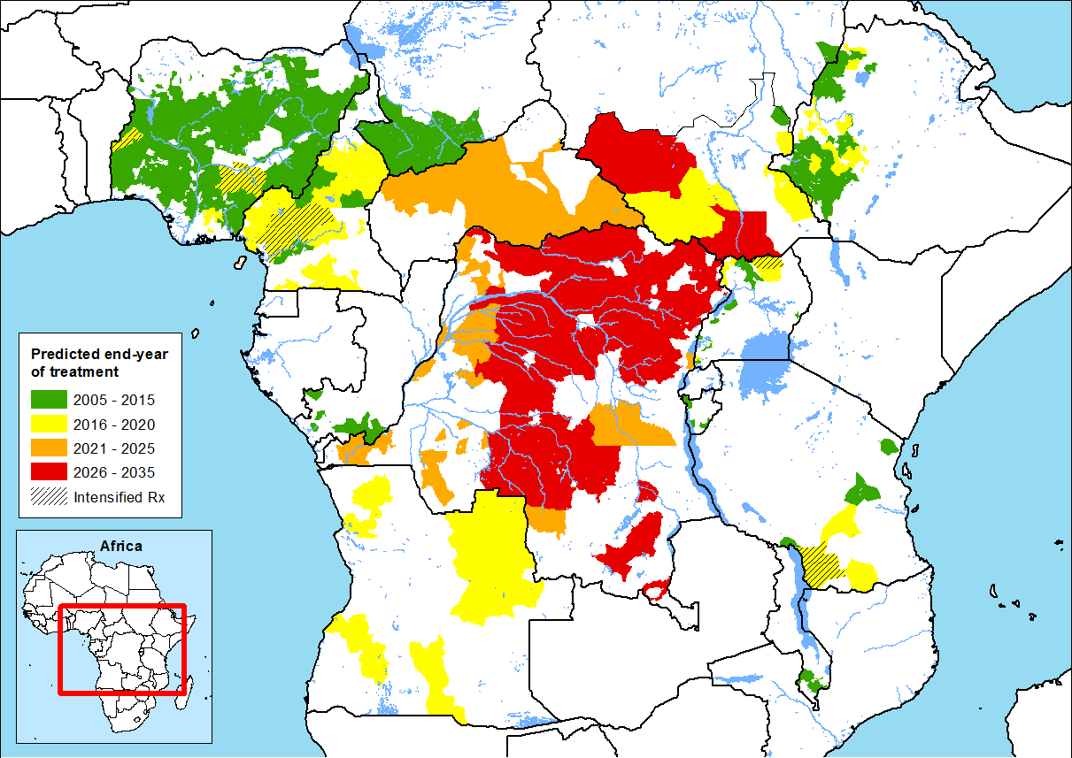
Predicted End Year of Treatment for APOC Projects
Source: APOC

Slide 34
APOC partnership…
UN Agencies: WHO & the World Bank
Donors (more than 20)
20 Ministries of Health & Affected Communities
CBM, HKI, IAPB, IEF, LCIF, LfW, MDP, Sightsavers, the Carter Center & Others
Private sector

Slide 35
Lessons learnt
&
Opportunities for collaboration

Slide 36
1. Partnership…
Public-private partnership: key for success in onchocerciasis control & elimination
Other partnerships in PBL such as GET2020, Vision 2020, etc…
Partnership in Vision 2020: Theme of GA7 of the IAPB in September 2004 in Dubai
Other partnerships in NTDs: GAELF, MEC/AC, NTD NGDO Network
At the country level?
  Urgent need to focus on national managers
  Expansion to provincial/regional & community levels

Slide 37
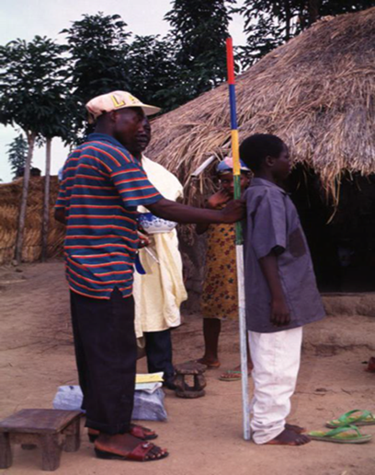
2. Community involvement, participation & empowerment…
Communities are requested to choose their own drug distributors: Community-Directed Distributors (CDDs)
Roles of CDDs:
  Conduct the census
  Collect drugs
  Distribute drugs
  Record keeping
  Reporting
Credit: Dr Nana Kwadwo Biritwum

Slide 38
CDDs in APOC countries in 2010…
CDDs trained
Ratio of 1CDD per 100 people
Female CDD more effective
Source: APOC

Slide 39
Major Health interventions co-implemented by CDDs in APOC countries in 2010…
Source: APOC

Slide 40
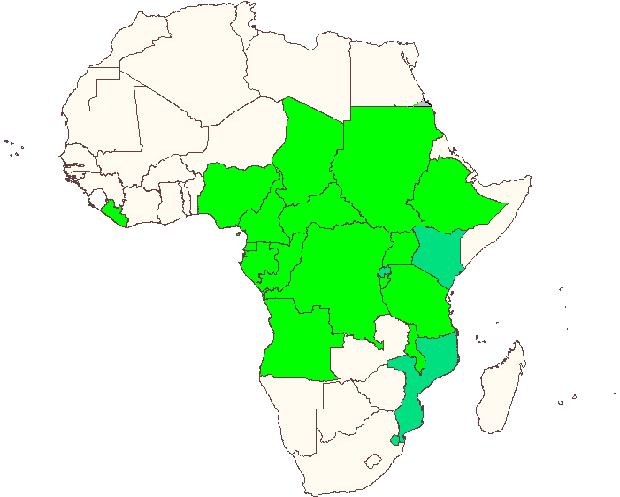
More than 85 % of the CDDs trained in 2010 were found in 5 countries…
Approximately 450,000
Ethiopia: 66,623 CDDs
Nigeria: 183,476 CDDs
Uganda: 63,808 CDDs
Cameroon: 40,678 CDDs
DRC: 102,537 CDDs

Slide 41
3. Advocacy…
Advocacy: one of the main activities of Sir John Wilson
One of the three support activities of Vision 2020
Recent high momentum for NTDs
Government financial contributions
Few projects and countries with success

Slide 42
Uganda success story in advocacy for "Nodding syndrome"…
Since 2008, the NOCP reported on increased cases of "nodding syndrome" in Pader and Kitgum districts
Involvement of MPs since October 2011
High profile as a political problem with a flooding of information through the media
Release of Government funding to address the needs
Implication of international communities

Slide 43
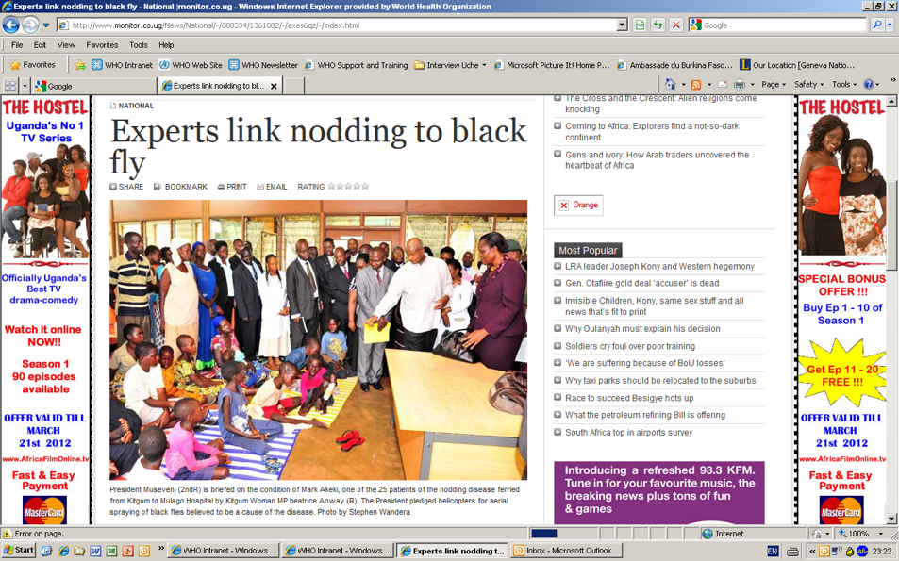
Local newspapers…

Slide 44
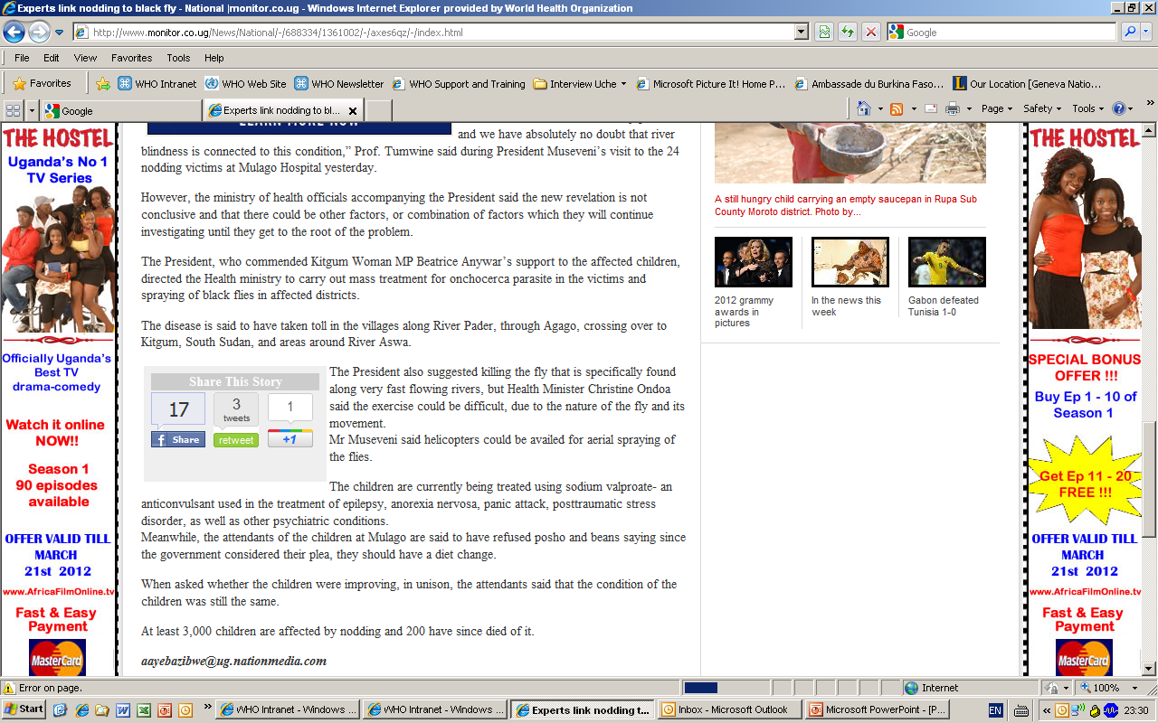
The President who commended Kitgum Woman MP Beatrice Anywa's support to the afflicted children…
Mr Museveni said helicopters could be availed for areal spraying for flies.

Slide 45
Take Home Messages…
Strengthen partnership at the country level
Community participation, involvement, empowerment…
Advocacy reinforcement

Slide 46
Conclusions…
Need for additional support from all the partners to finish the job of onchocerciasis elimination
Apply the key messages at the country level, from the national managers up to the community level by involving the CDDs in eye care
Do not forget the power of MPs in changing policies and facilitating the Government involvement

